Slide 1

Activity 4 - Past predictions
Student workbook

Slide 2
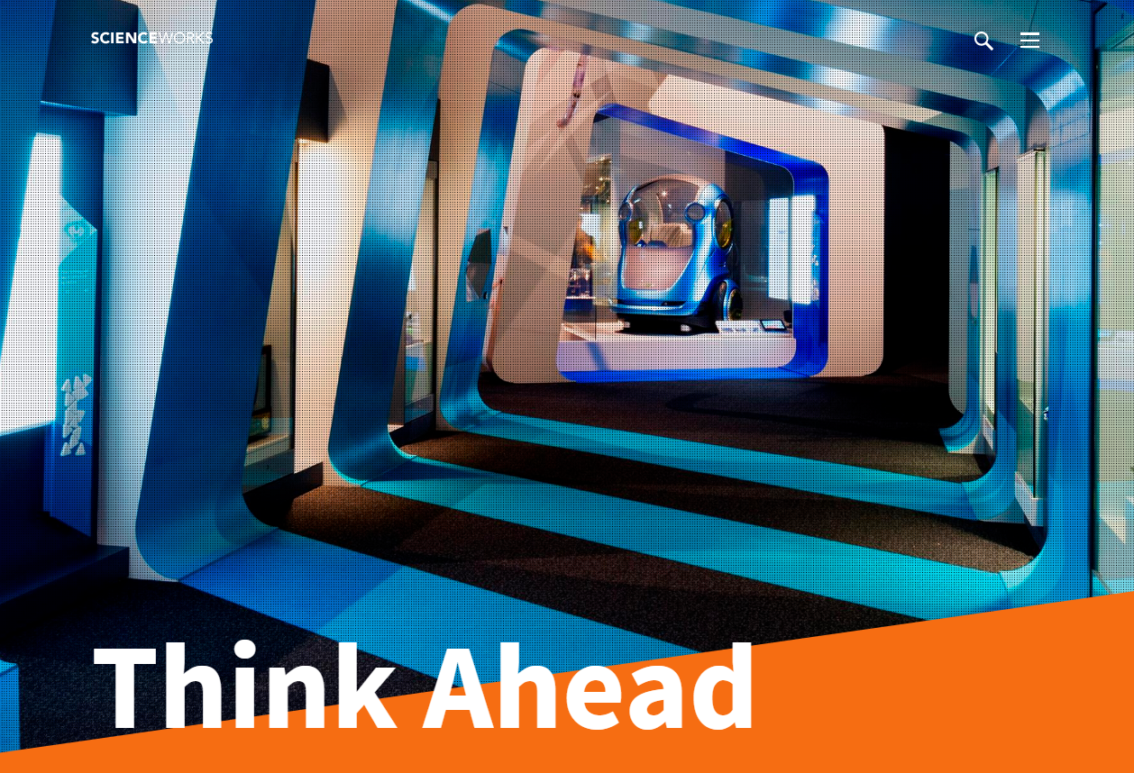
Think Ahead
The Think Ahead gallery at Scienceworks explores innovations past and present that will help shape our future.

Slide 3
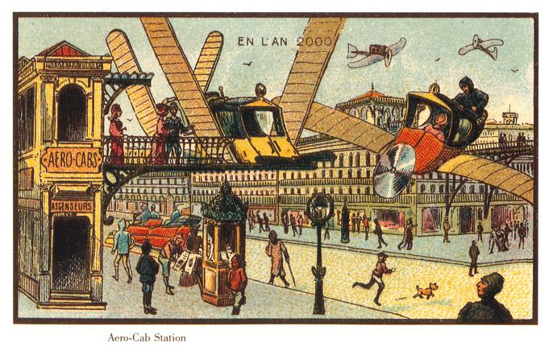
En l’an 2000
In the Year 2000
Can we predict the future limited by the knowledge that we have in the present?
In the early 1900s a group of French artists including Jean-Marc Côté produced a series of futuristic pictures showing how they imagined the world to be in the distant year of 2000. The artists made their predictions of the future based on what already existed when they were alive. There were many drawings with propellers, canvas wings and blimps - cutting edge technology of the time - and people in distinctly 19th-century clothes.
You can see many of the drawings via this link but we’ve picked out four below to think more deeply about.

Slide 4
Task
Complete the Deep Thinking activity for each of the past predictions and pick one as a theme to sketch your imagined solution for the future.

Slide 5
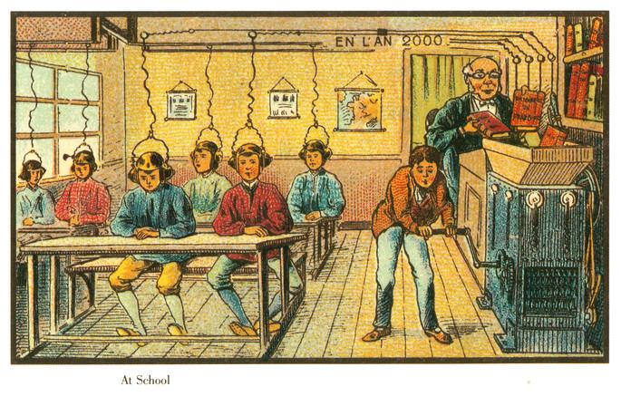
At Shool

Slide 6
Deep Thinking activity
What is happening in this picture?
What was the problem being solved and what was the solution?
What exists today to help this problem?

Slide 7
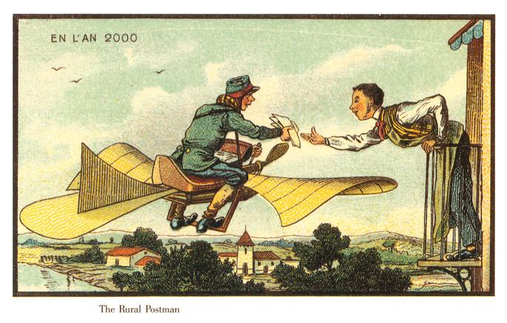
The Rural Postman

Slide 8
Deep Thinking activity
What is happening in this picture?
What was the problem being solved and what was the solution?
What exists today to help this problem?

Slide 9
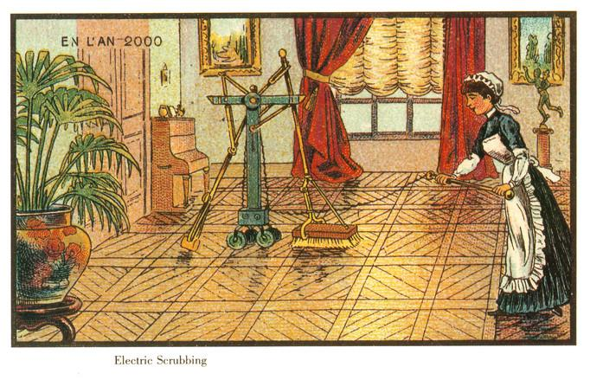
Electric Scrubbing

Slide 10
Deep Thinking activity
What is happening in this picture?
What was the problem being solved and what was the solution?
What exists today to help this problem?

Slide 11
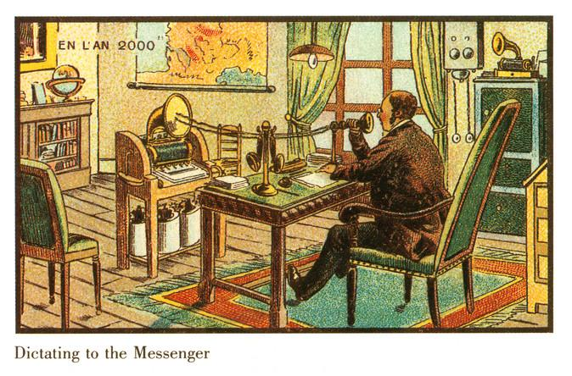
Dictating to the Messenger

Slide 12
Deep Thinking activity
What is happening in this picture?
What was the problem being solved and what was the solution?
What exists today to help this problem?

Slide 13
My prediction
Copy and paste small thumbnail of chosen image here
Pick one of the images and sketch your imagined solution to this problem 100 years from now. You can paste your prediction here, use a new slide if you need to.
Are there any technologies still being developed that might change your prediction? If so, describe the new technology briefly and add a link to an article that explains it in a bit more detail.

