Slide 1

Activity 5 - What do computers look like?
Student workbook

Slide 2
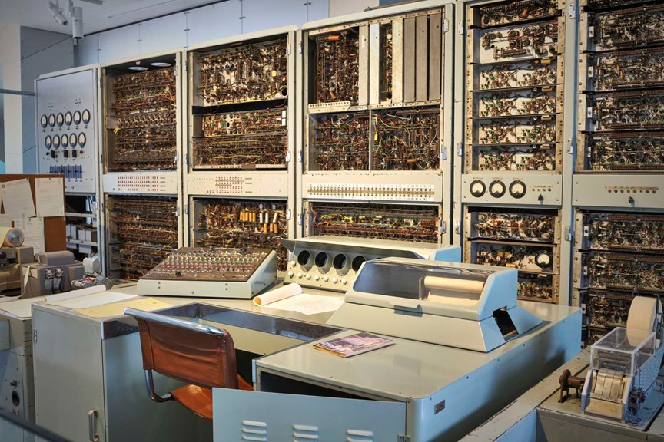
CSIRAC - Australia’s First Computer
The Think Ahead exhibition at Scienceworks is home to an important piece of Australian innovation.
CSIRAC stands for the Commonwealth Scientific Industrial Research Automatic Computer. When it was switched on in 1949, it was the first computer in Australia, the fourth computer in the world and would become the first computer in the world to play music. If you were asked to draw a computer today however, it probably wouldn’t look like CSIRAC. You might have drawn a desktop computer or a laptop, or maybe a smartphone. Computers have changed a lot in the past 100 years.
What do you think computers of the future will look like?

Slide 3
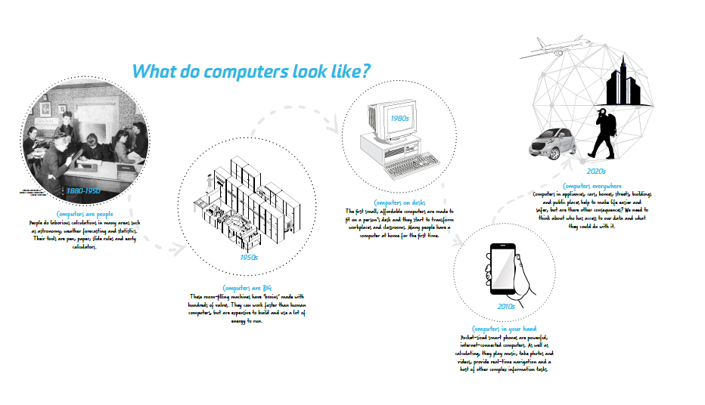
Read more about CSIRAC from the exhibition
Click on the image to see the writing more clearly in a PDF

Slide 4
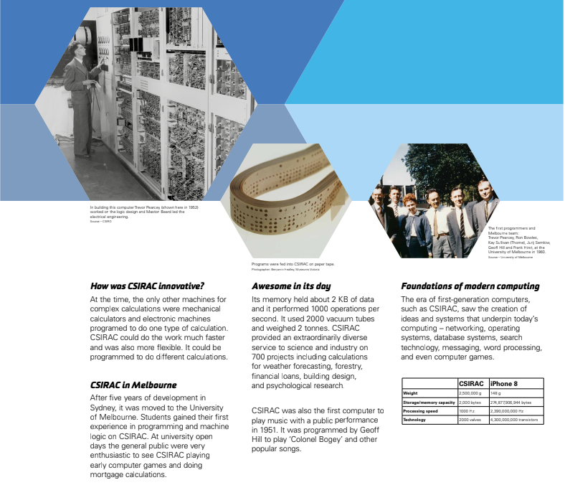
Read more about CSIRAC from the exhibition
Click on the image to see the writing more clearly in a PDF

Slide 5
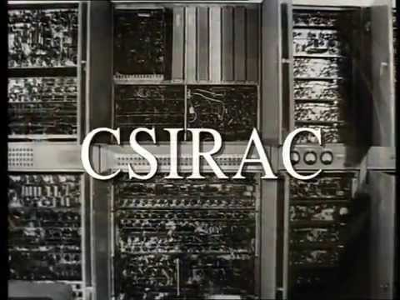
Video resource
CSIRAC
Watch this video about CSIRAC made for its 50th anniversary in 1999 when it first went on public display at Melbourne Museum. The video was made by ABC Science on the TV show Quantum. Part of it was filmed in the Scienceworks Collections.
In 2018, CSIRAC was moved to Think Ahead at Scienceworks.
.

Slide 6
Comparing CSIRAC to modern devices
While CSIRAC was a noisy, power hungry machine that filled a room, you can now fit a computer more than a million times more powerful inside your pocket.
FUN FACTS | CSIRAC, 1949 - 1964 | Smartphone, 2020
Processing speed | 1000 hertz | 2,960,000,000 hertz
Storage/memory capacity | 2000 bytes | 274,877,906,944 Bytes
Size | 40 square metres | 0.01 square metres
Weight | 2,500,000 grams | 200 grams
Power usage | 30,000 watts | 6 watts when charging
Hardware technology | 2000 valves | 4,300,000,000 silicon transistors
It hertz a bit to think about clock cycles
The speed of a computer depends on how many pulses of electricity can happen each second. That’s called a clock cycle and is measured in hertz.
CSIRAC’s processing speed is measured in kilohertz (KHz) while smartphones are now measured in gigahertz (GHz). Modern supercomputer speeds are measured in exaFLOPS.

Slide 7
Flex your maths skills (Part 1)
Using the table of information from the previous slide, flex your maths and descriptive skills to explain to someone the difference between CSIRAC and a familiar point of reference such as a smartphone.
You can make approximations and might like to use percentages, fractions, ratios, decimals or scientific notation to communicate your ideas.
See the next slide for examples

Slide 8
Flex your maths skills (Part 2)
Examples:
“My phone uses only ___% of the power that CSIRAC needed to run.” (Don’t forget to multiply by 100 to get the percentage!)
“CSIRAC was huge! It was ___ times the size of my bedroom.” (Measure the area of your room in square metres first).
“CSIRAC weighs as much as ___ elephants, whereas my phone is like carrying around (insert small animal that weighs the same as your phone).”
“The amount of memory CSIRAC could store was like (find out what could be saved with 2KB).”
Fill in the blanks or make a new slide with your statement.

Slide 9
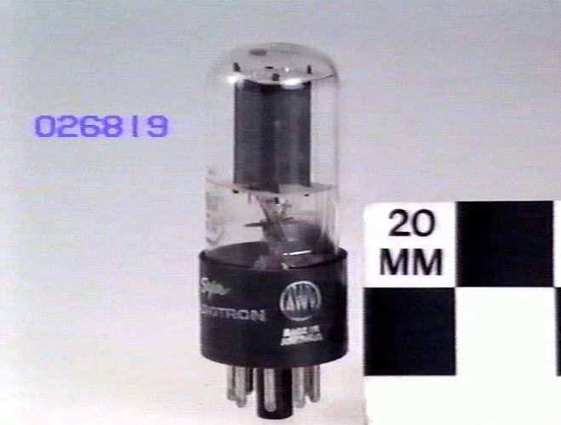
What’s still the same about computing since CSIRAC?
Even though modern computers are vastly faster, smaller and more powerful than CSIRAC, at the most basic level there are still some similarities.
CSIRAC used electric valves to represent information in a binary bit: 1 for when the circuit was on and 0 for when the circuit was off.
Silicon transistors in today’s computers still represent information in binary as 1 for on and 0 for off - there are just billions more of these switches! The more transistors there are, the more information can be manipulated. The more transistors we can fit on a computer chip, the more powerful and portable a computer can be.
Electronic Valve or vacuum tube similar to the ones used in CSIRAC. These act to record a 1 for on and 0 for off.
Source: Museums Victoria

Slide 10
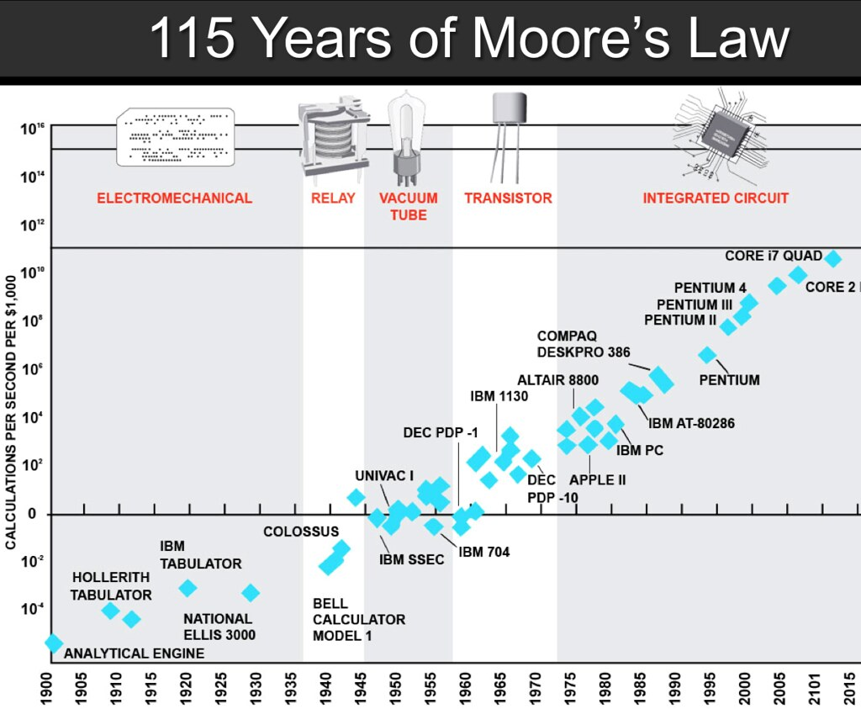
Did you know?
Moore’s Law is a prediction about the development of computing made by Gordon Moore who was the CEO and co-founder of Intel. Moore’s Law observes that every two years, computing power (the number of transistors on a chip) doubles while the cost of the computer halves. This has largely been true until recently and has provided a goal for chip and software developers to work towards. Rate of advancement in computer development is slowing however as we are reaching the limits of how many transistors can fit on a chip.
What do you think the future of computing looks like?
Steve Jurvetson, Flickr

Slide 11
Understanding binary (part 1)
While we need ten different digits (0,1,2,3,4,5,6,7,8,9) to be able to count the way we do, it’s much easier for computers to be able to count with just two digits (0,1) as you can use an electric switch turning on or off to physically represent that. The way we count, we can use the first place value to represent any number from 0 to 9, however if we want to say the next number bigger than that we have two use two place values to say 10 (1 ten and 0 ones). While decimal place values go up in multiples of 10 (100, 1000, 10,000 etc), binary place values go up in multiples of 2.
Binary place values:
128 | 64 | 32 | 16 | 8 | 4 | 2 | 1
An example:
0 | 0 | 1 | 0 | 1 | 0 | 1 | 0
 |  | 32 |  | 8 |  | 2
32+8+2 = 42

Slide 12
Understanding binary (part 2)
Try these questions and see if you understand:
What’s the biggest number you can represent with one place value in binary?
How do you represent two in binary?
What number does 11101 represent?
A byte is eight binary bits, what’s the largest number you can represent with a byte and how do you write it in binary?
(Bonus tricky question) CSIRAC had around 2000 bytes of storage. How would you work out the largest number that can be represented with 2000 bytes?
Use the table below to help you with your working
128 | 64 | 32 | 16 | 8 | 4 | 2 | 1
=

Slide 13
Understanding binary (part 3)
Of course, this is just a start to how numbers are represented in binary.
Computers also represent words, colours, sounds which are all encoded at machine level in binary too!
What’s the simplest way you can think up to represent letters and words in binary? Once you’ve done that, send someone a secret message and see if they can crack your code!
Clue: if a = 1, b = 2 … y = 25, z = 26, how would you write your message in binary?
Can you use GarageBand or Scratch to make that code into music?

