Slide 1

Track and Field
A slideshow of images from Museums Victoria's collection relating to sports and recreation from the 1930s – 1970s.

Slide 2
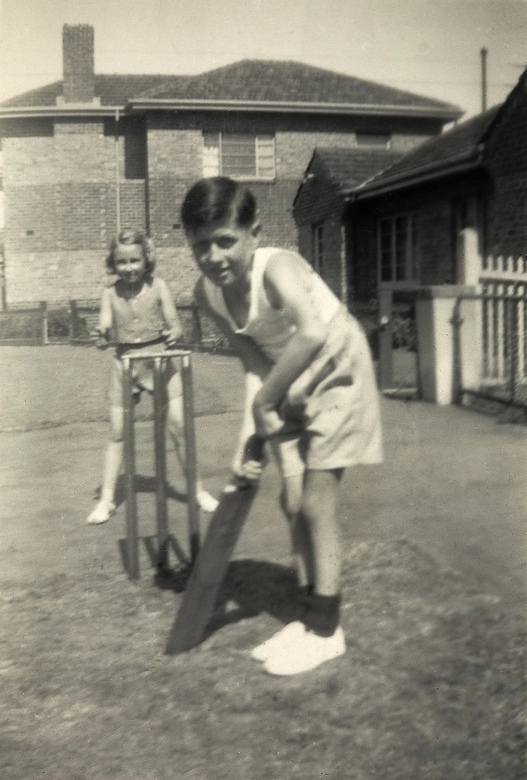
Children playing cricket in the yard. Prahran, Victoria 1948
Photographer: Unknown

Slide 3
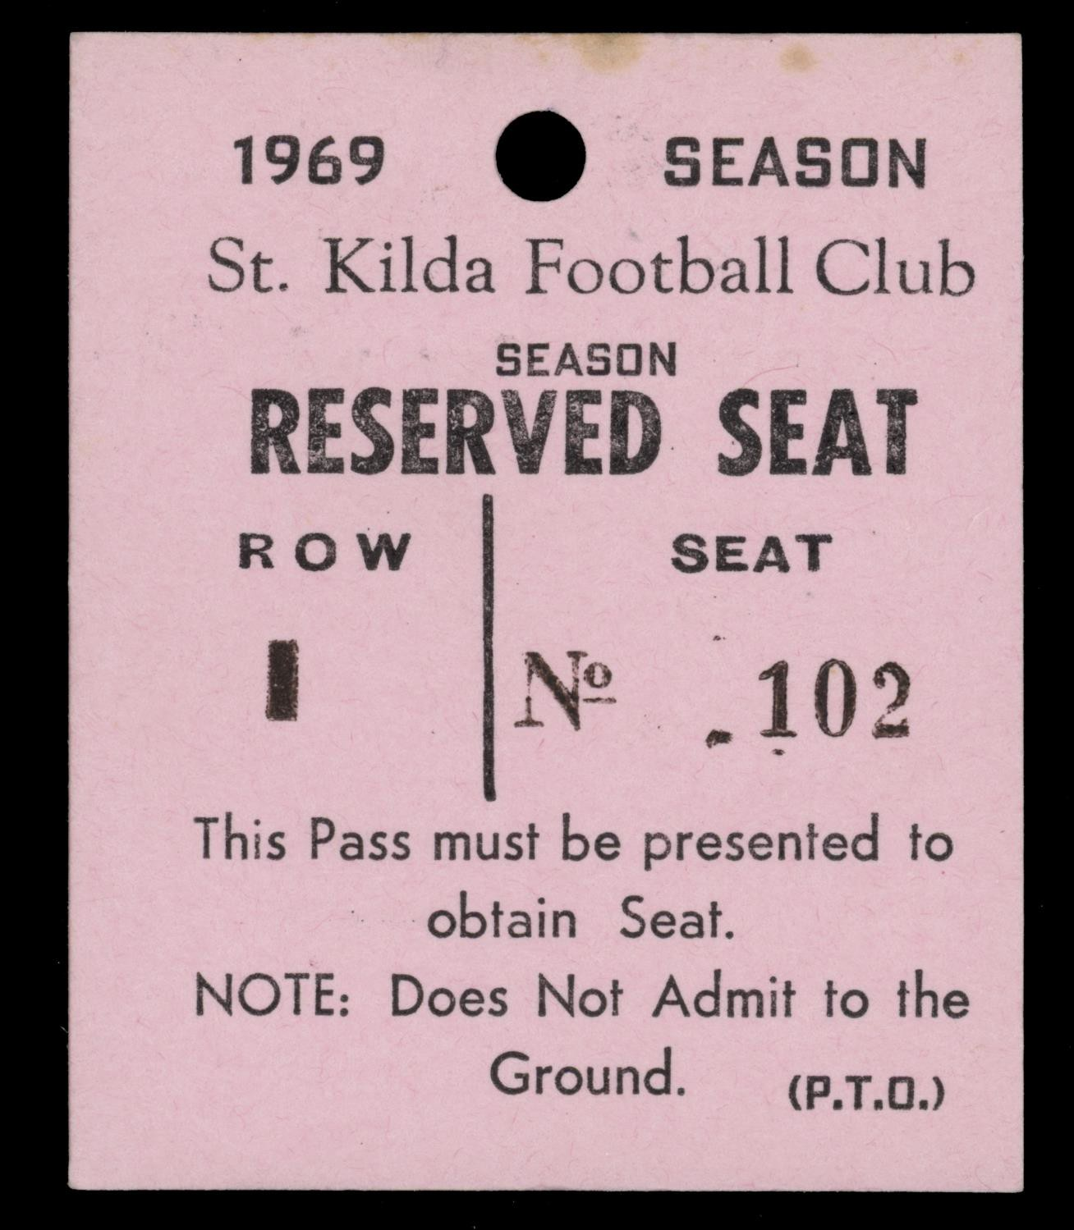
Reserved seat pass for the for St Kilda Football Club 1969 football season.
Melbourne, Victoria, 1969
Unknown creator

Slide 4
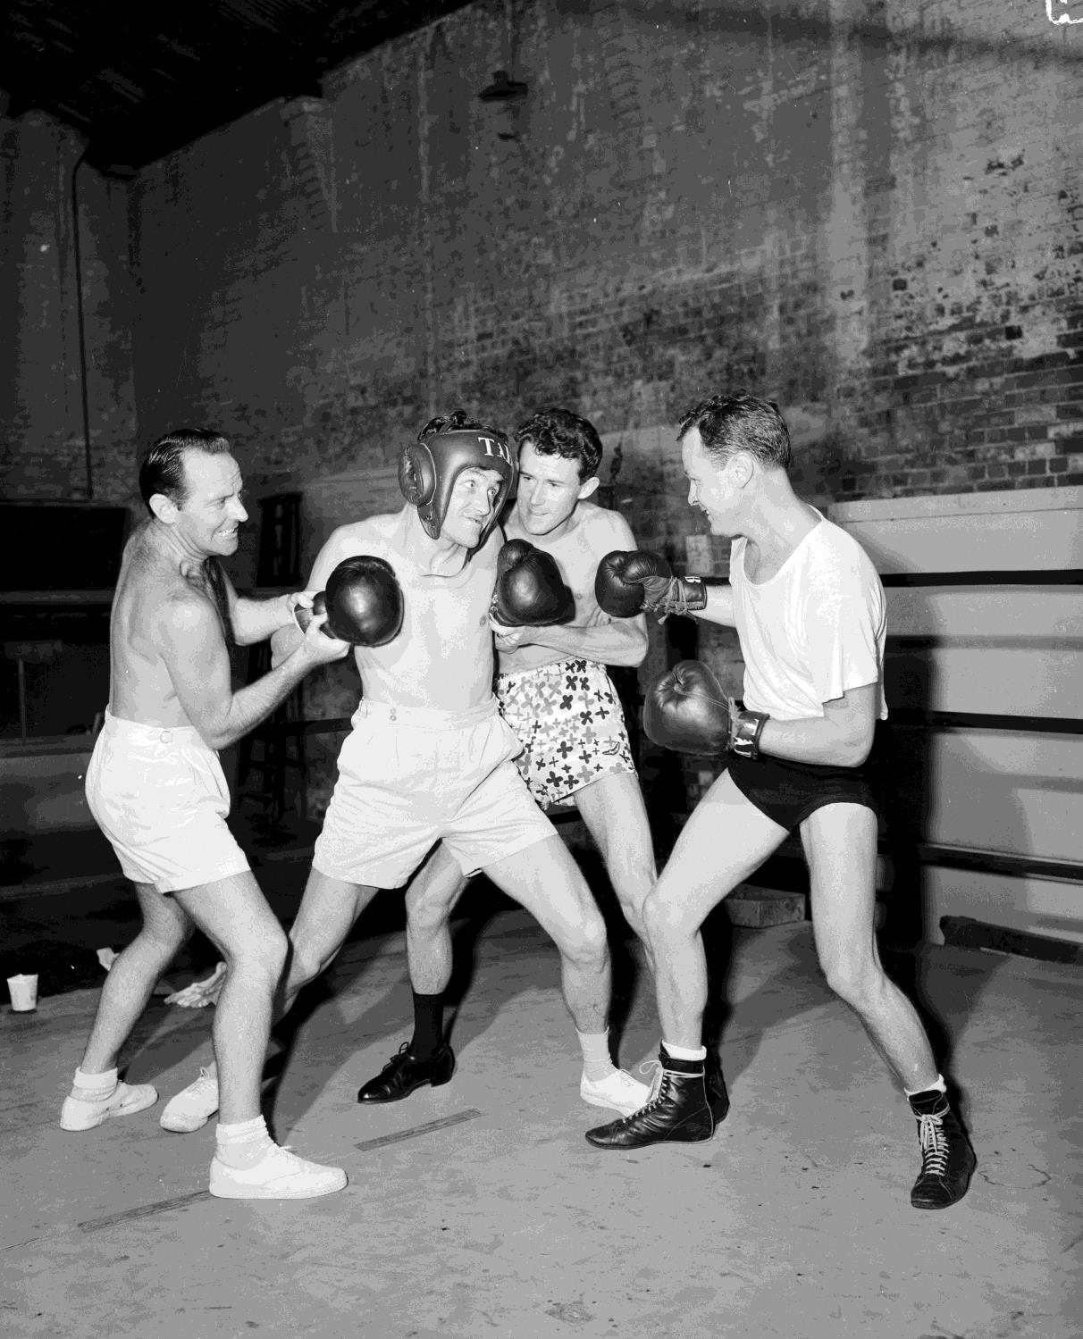
Four men standing together in a boxing ring.
Victoria, 1957
Photographer: Laurie Richards

Slide 5
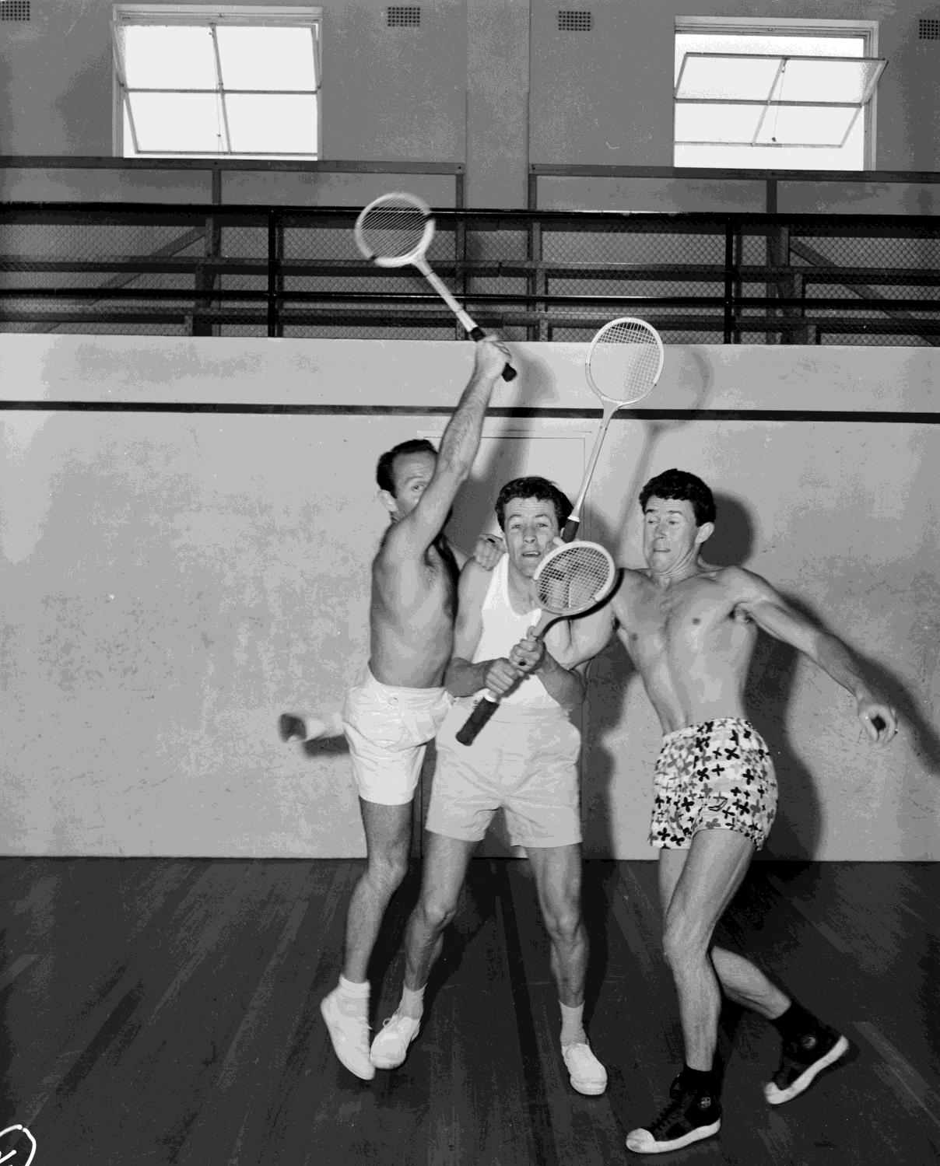
Three men with tennis racquets. 1957
Photographer: Laurie Richards

Slide 6
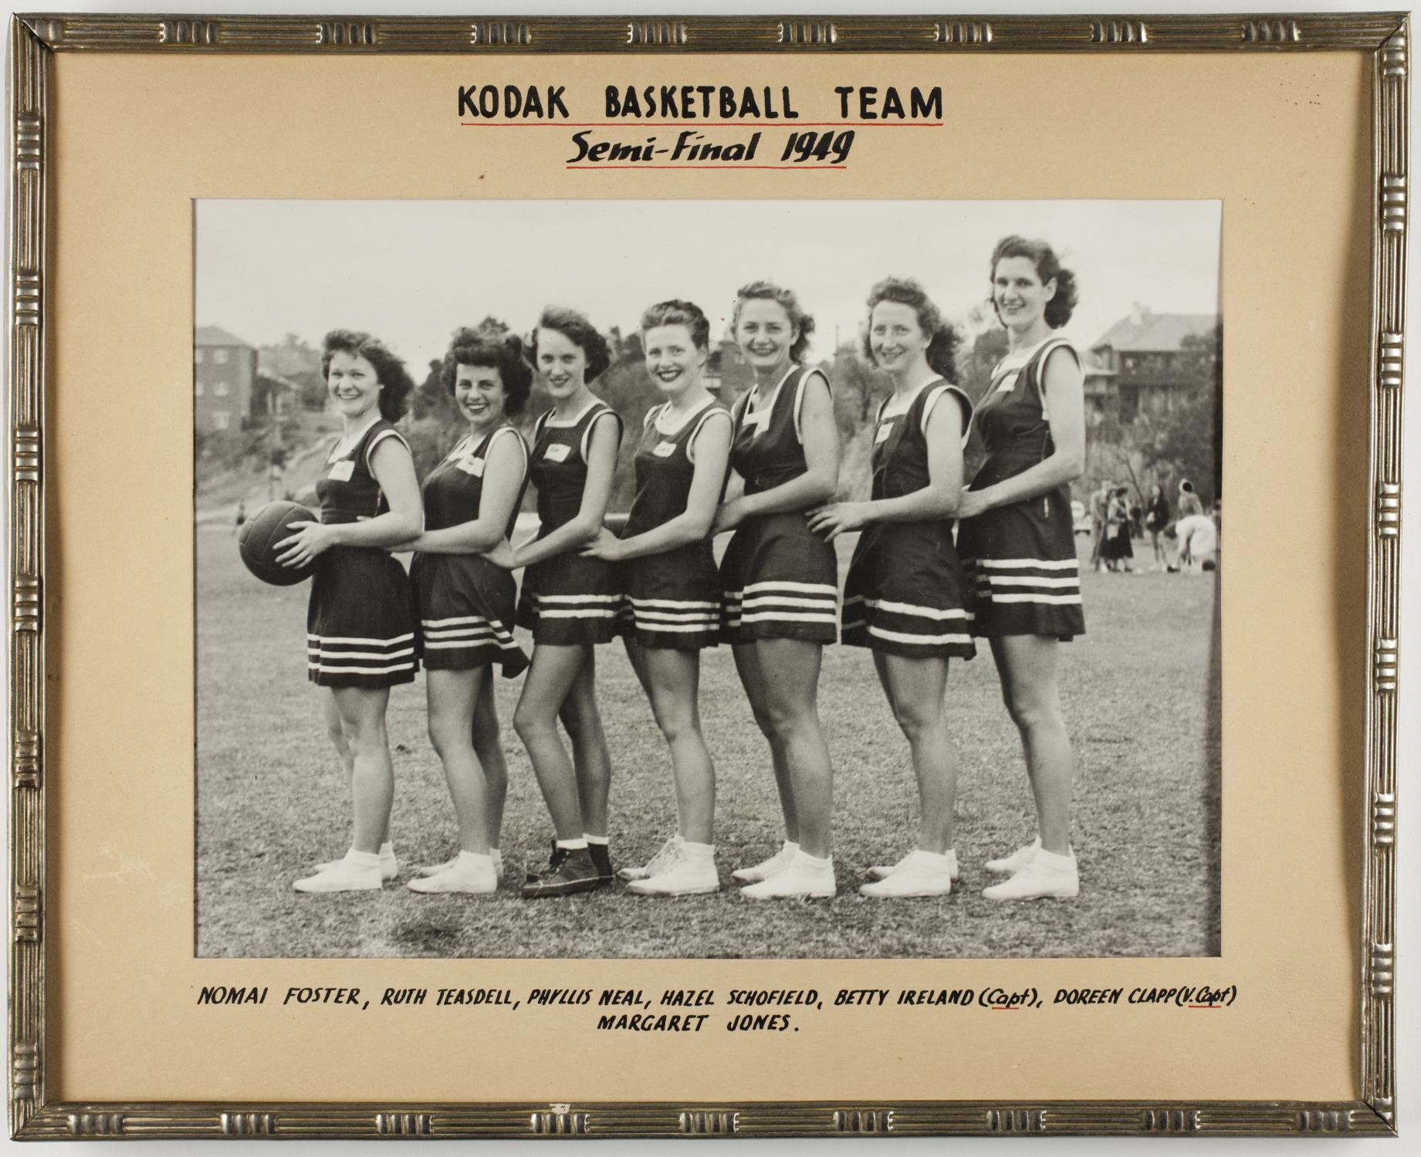
Kodak Women's Basketball Team Semi-Final, Melbourne, 1949

Slide 7
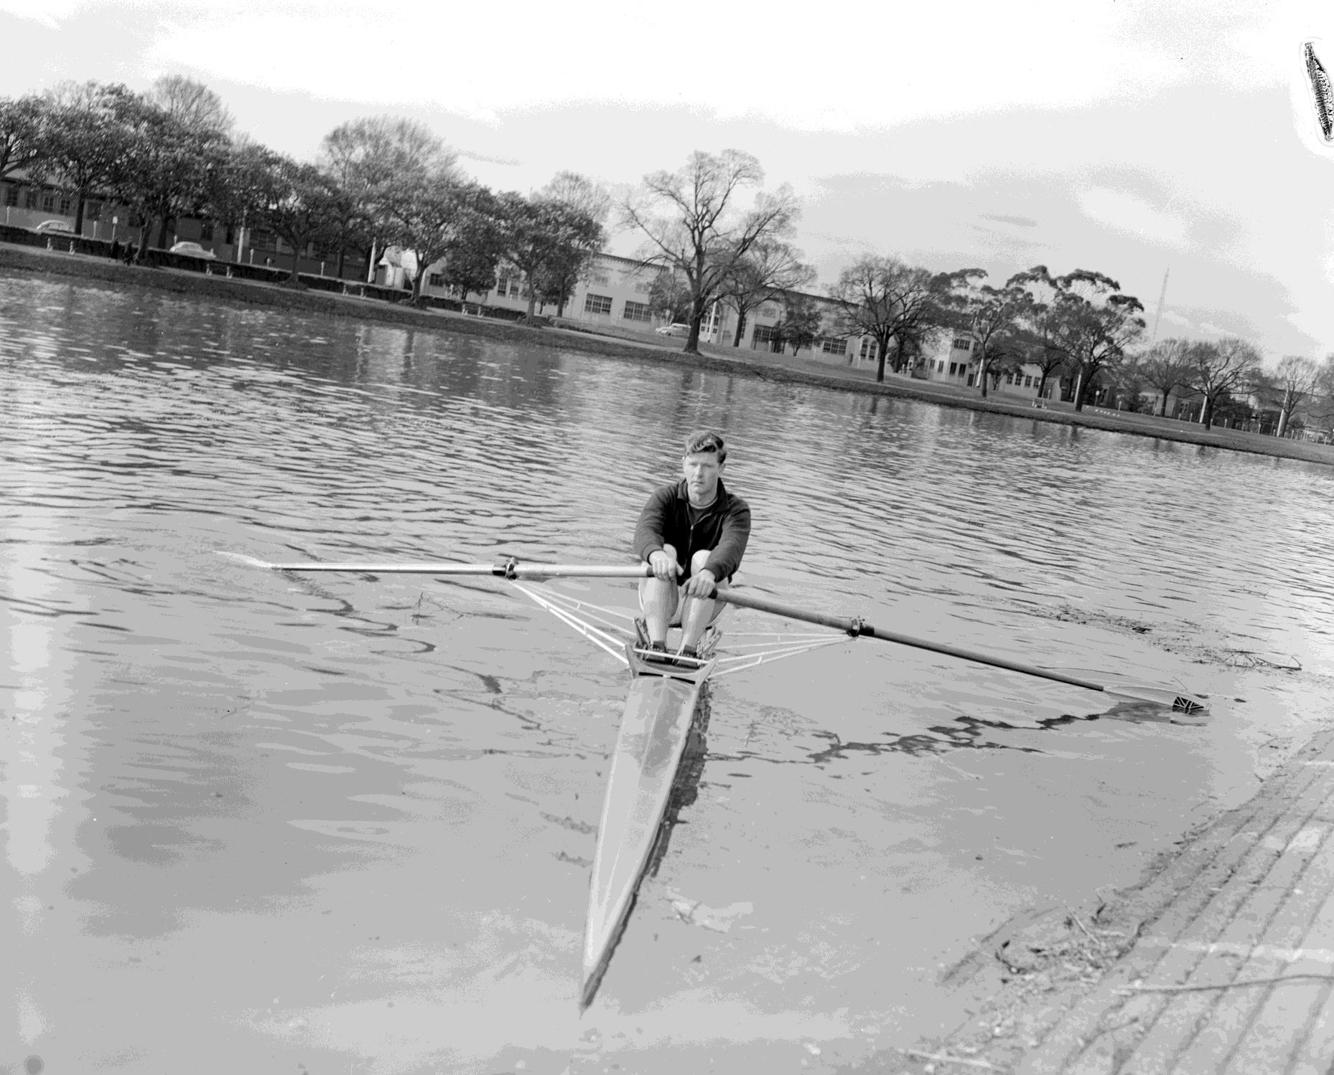
Rower in a rowboat.
Melbourne, Victoria, 1958
Photographer:
Laurie Richards

Slide 8
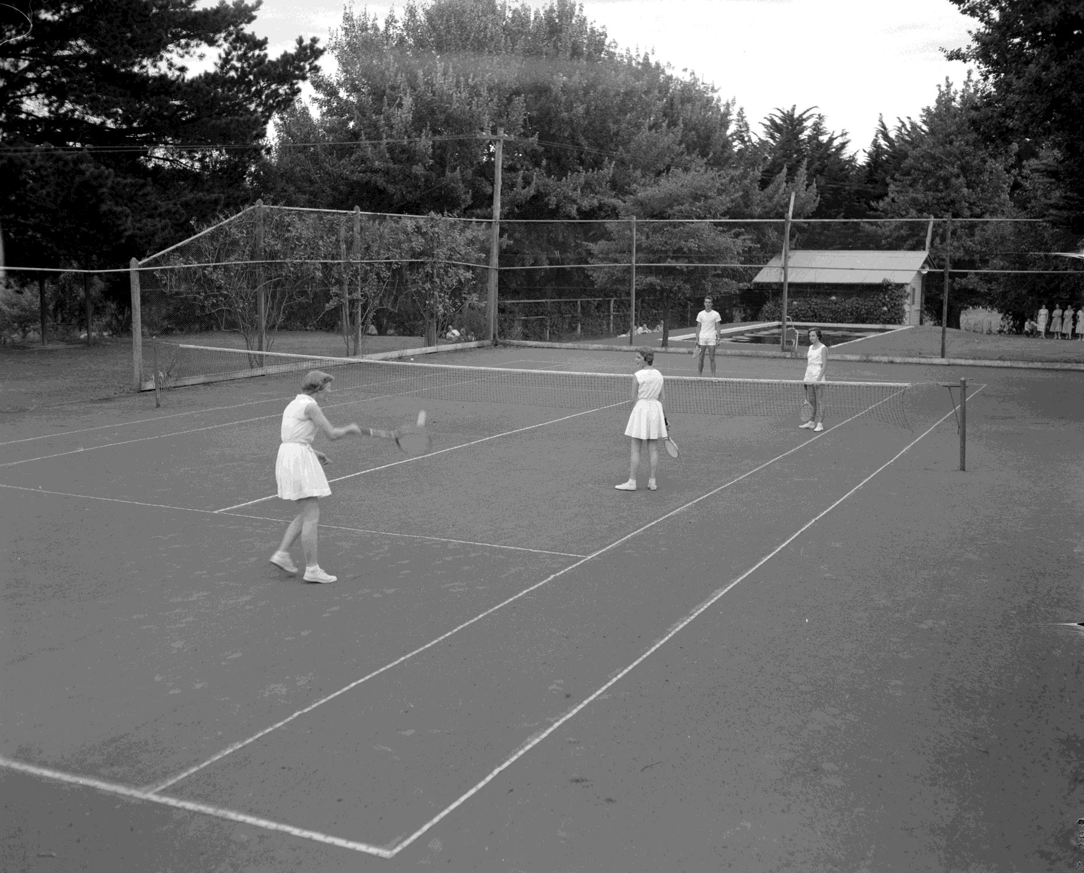
Recreational tennis match at the RACV Country Club.
Healesville, Victoria, 1956
Photographer:
Laurie Richards

Slide 9
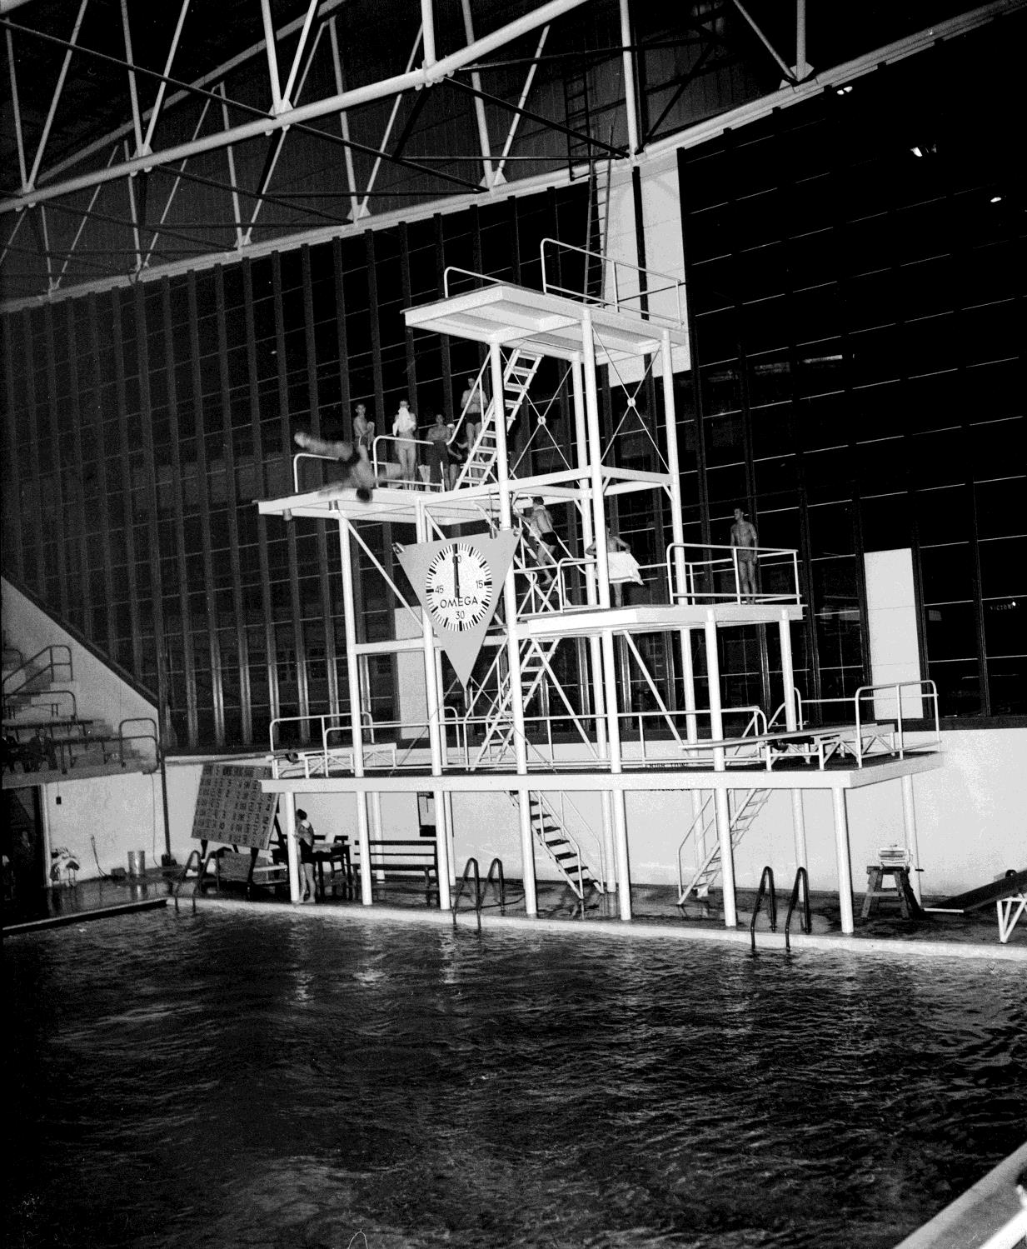
Diving event at the 1956 Melbourne Olympic Games.
Photographer: Laurie Richards

Slide 10
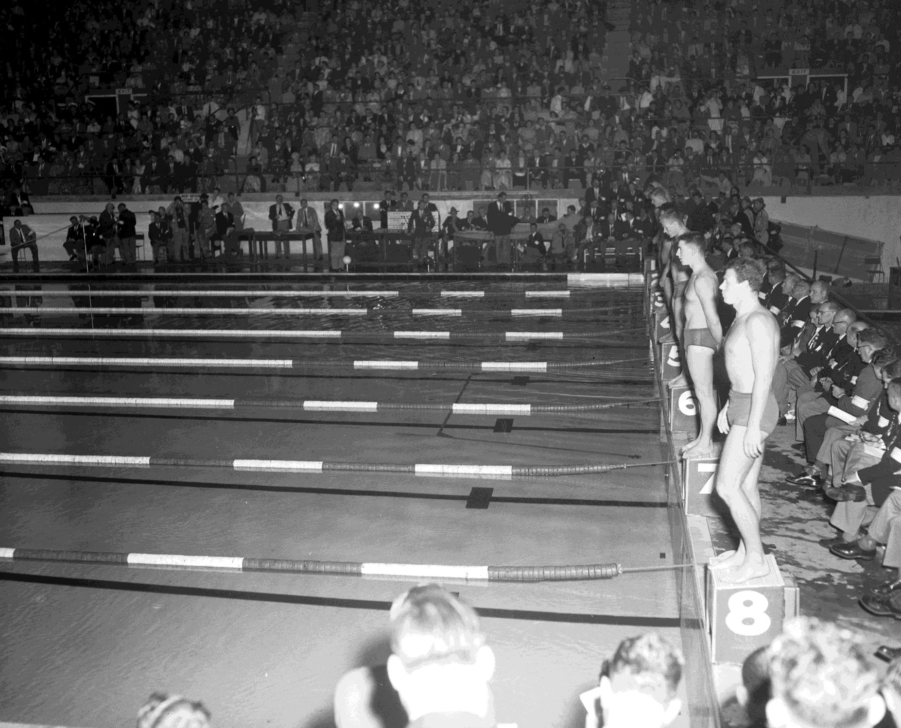
Swimming event at the 1956
Melbourne Olympic Games showing male athletes standing in a line on the starting blocks
Photographer: Laurie Richards

Slide 11
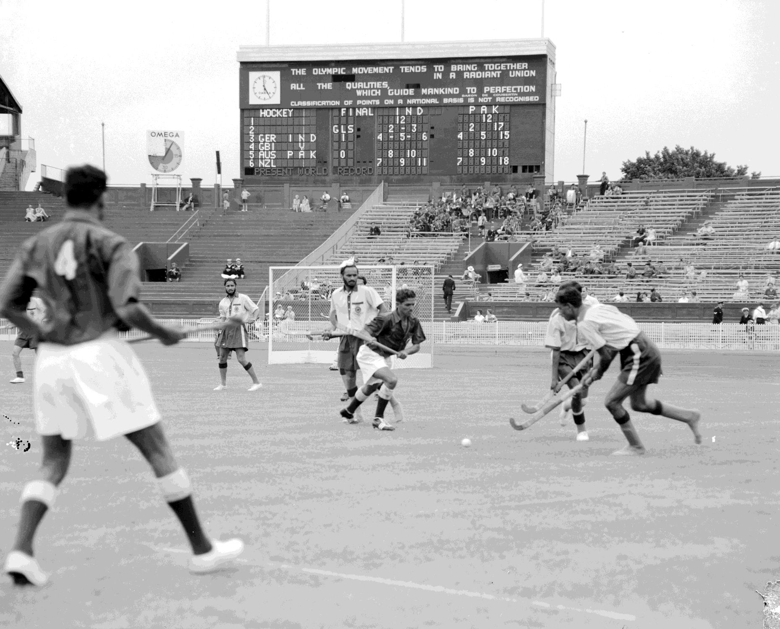
Men's field hockey final showing India versus Pakistan at the 1956 Melbourne Olympic Games.
Photographer: Laurie Richards

Slide 12
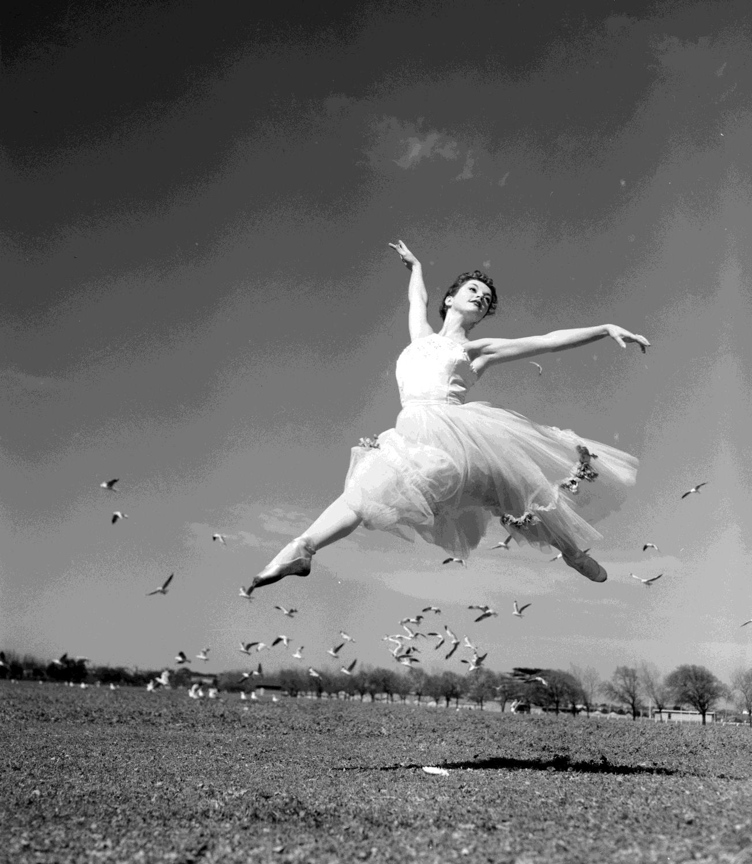
Female ballerina performing a jeté.
Albert Park, Victoria, 1957
Photographer: Laurie Richards

Slide 13
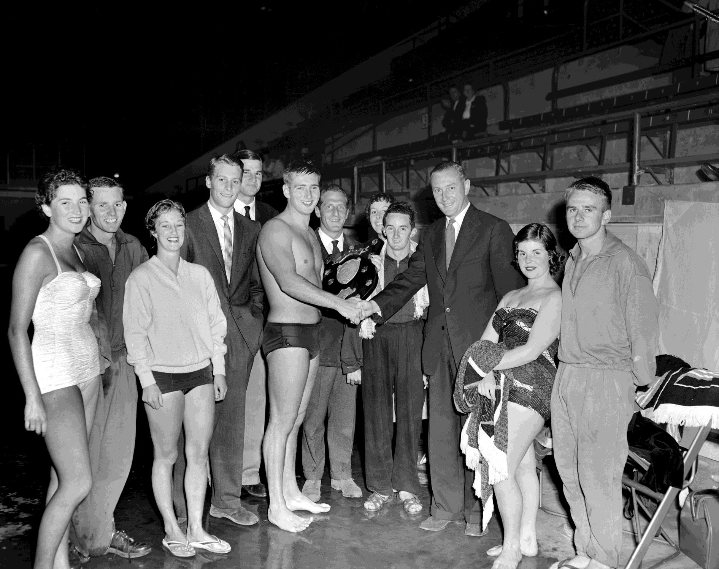
Swimming award ceremony. Port Melbourne 1959
Photographer: Laurie Richards

Slide 14
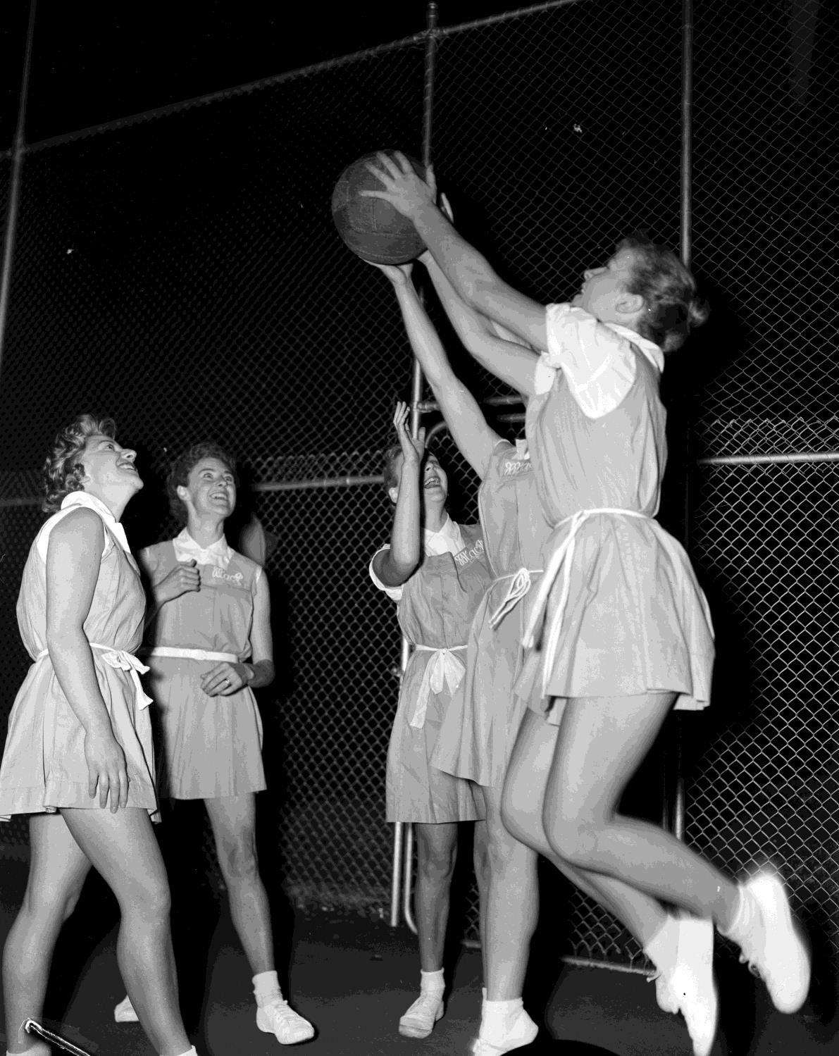
MacRobertson Girl's High School students playing Netball. Flagstaff Gardens, Melbourne, 1959
Photographer: Laurie Richards

Slide 15
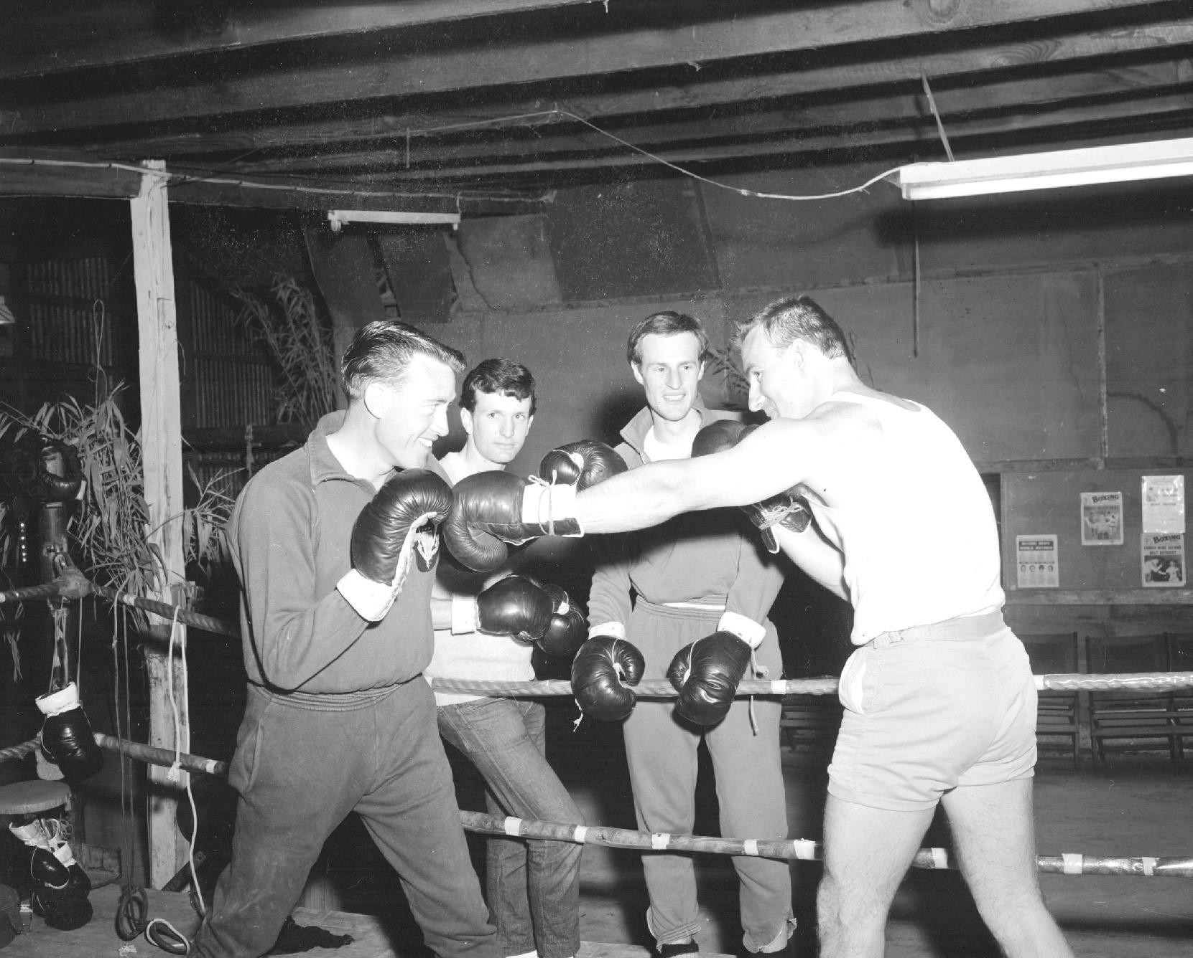
Group of men boxing in
a suburban hall Doncaster
East, Melbourne,
1953
Photographer: Laurie Richards

Slide 16
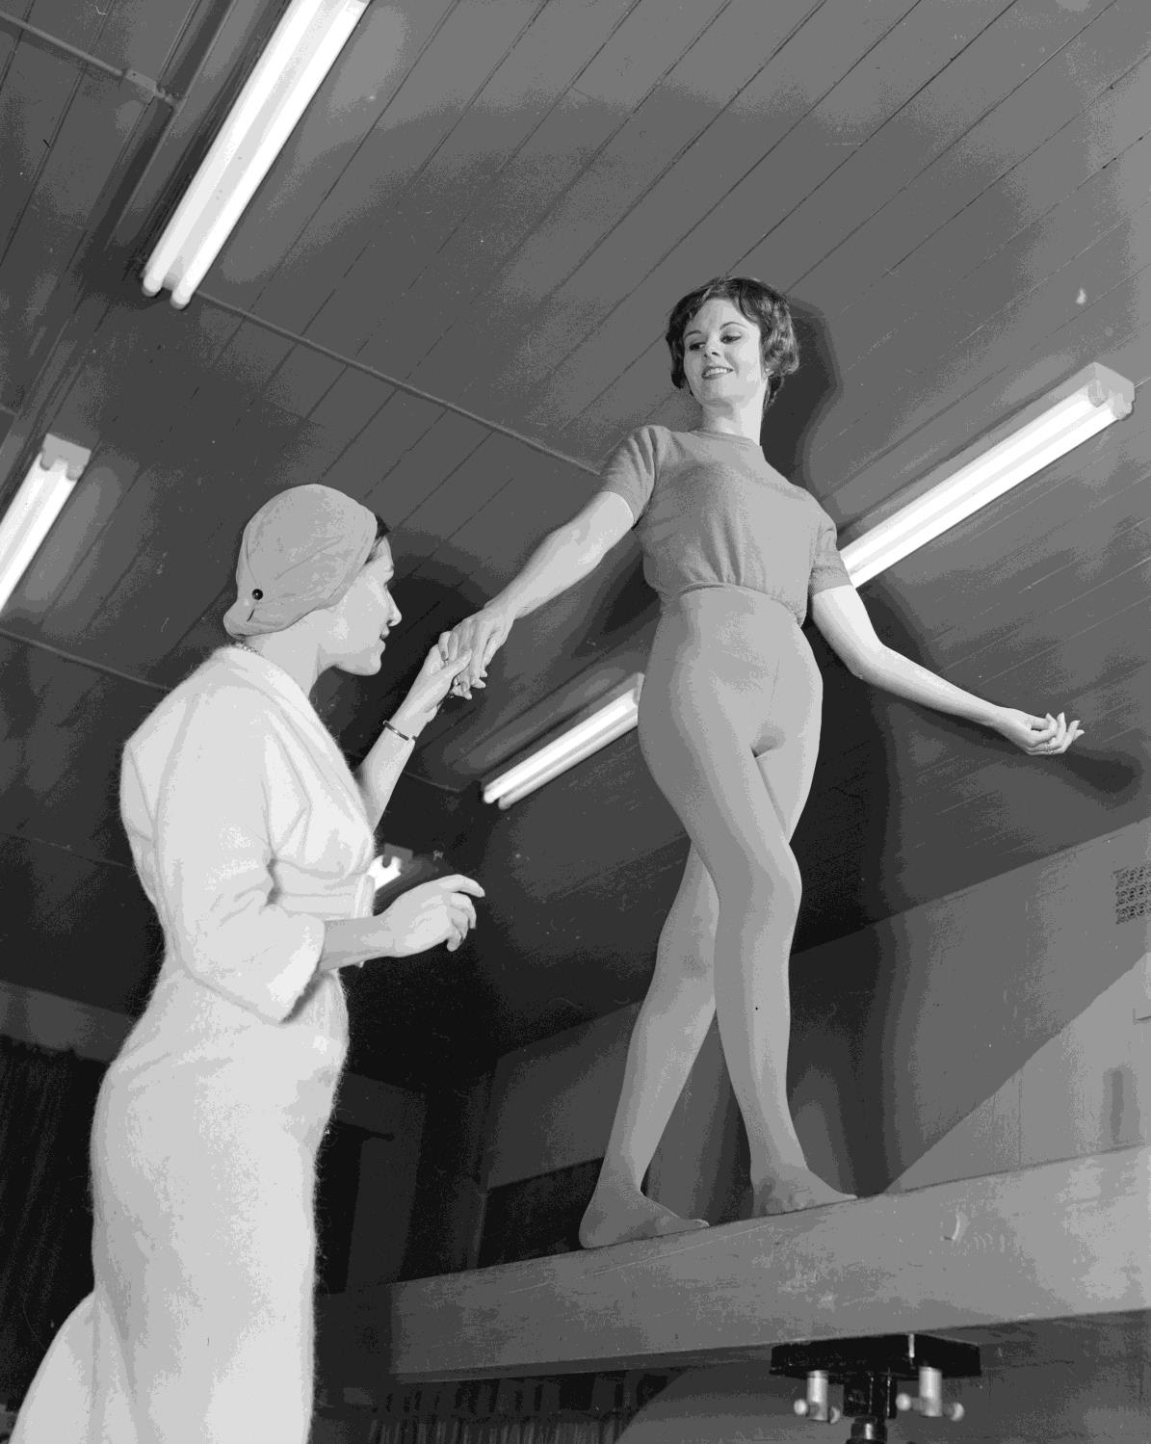
Gymnast balancing on a beam with a spotter. 1959
Photographer: Laurie Richards

Slide 17
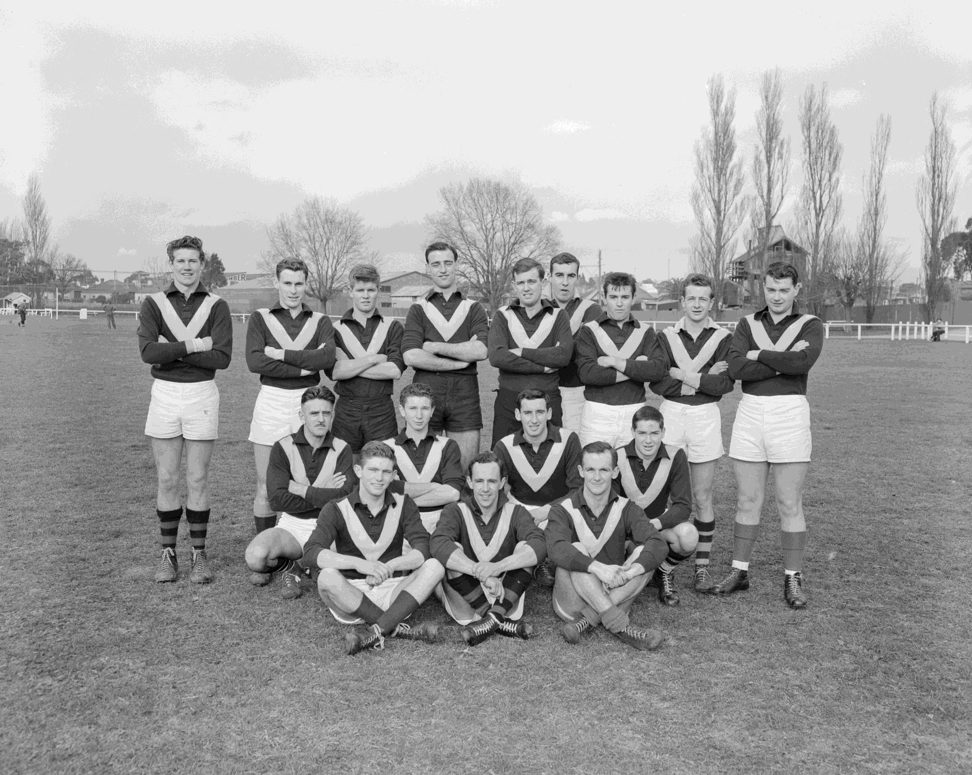
Team portrait of the Shell Company Australian Rules Football team.
Tooronga, Victoria, 1959
Photographer: Laurie Richards

Slide 18
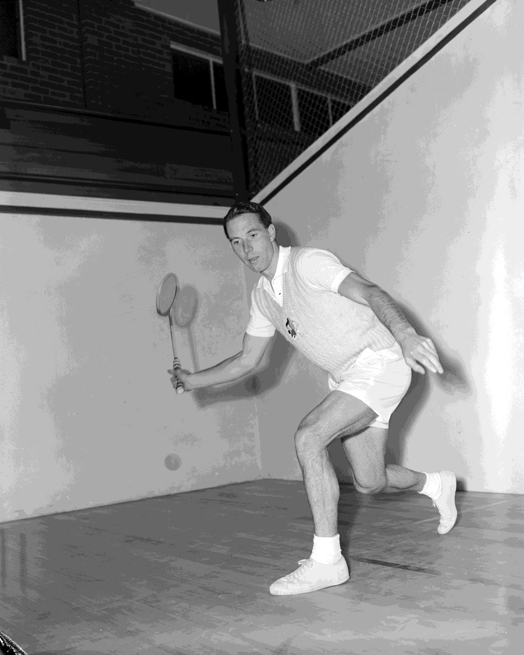
Man playing squash. Tooronga, Victoria, 1959
Photographer: Laurie Richards

Slide 19
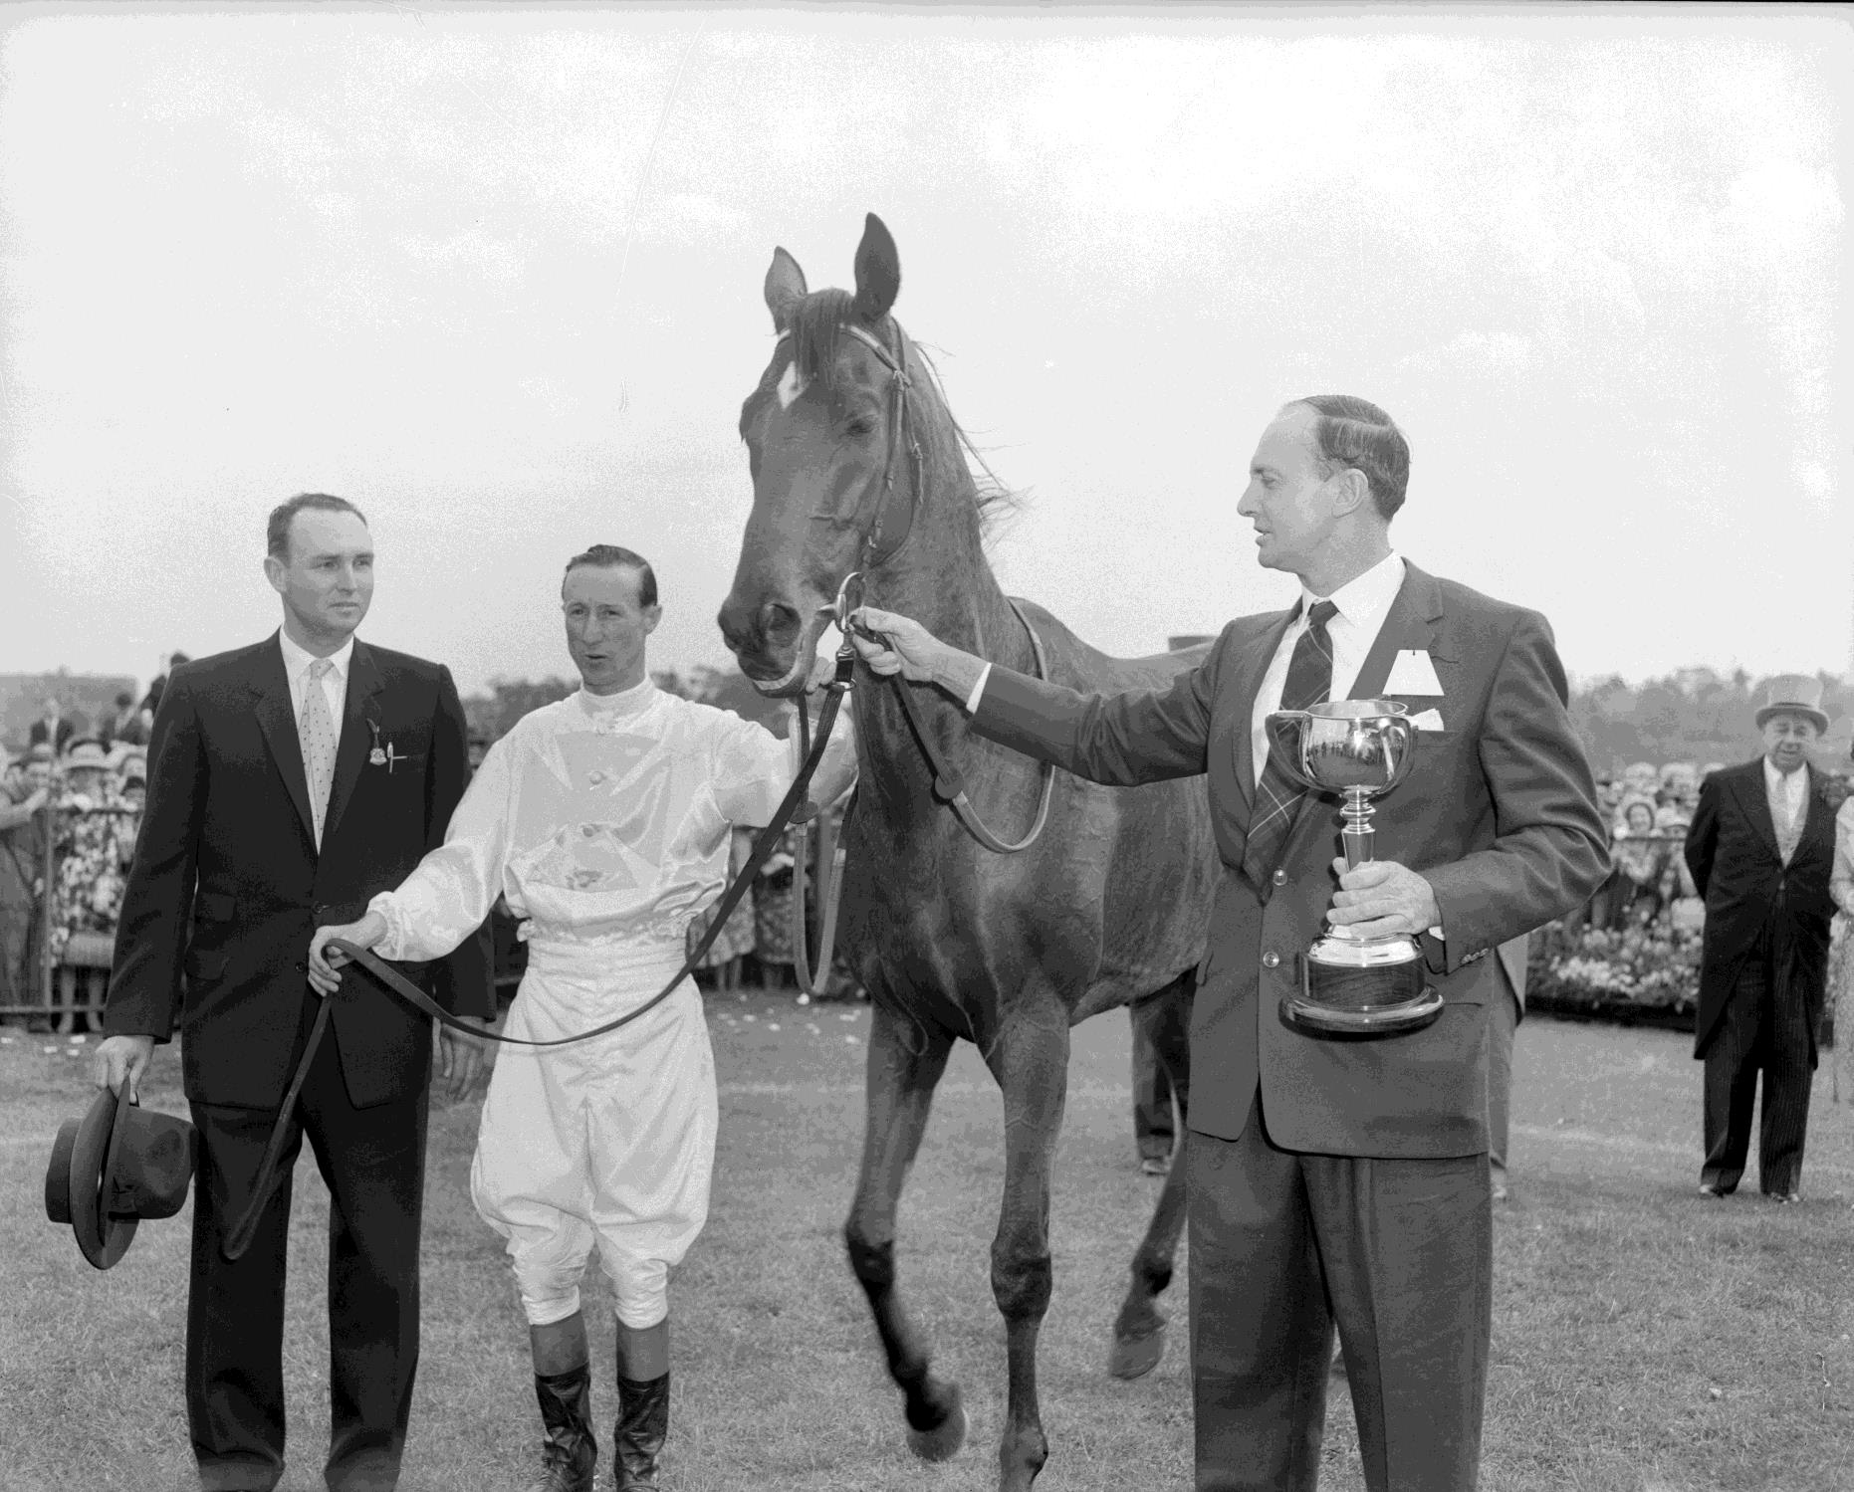
Race horse and jockey at the Flemington race track.
Flemington, Victoria, 1959
Photographer:
Laurie Richards

Slide 20
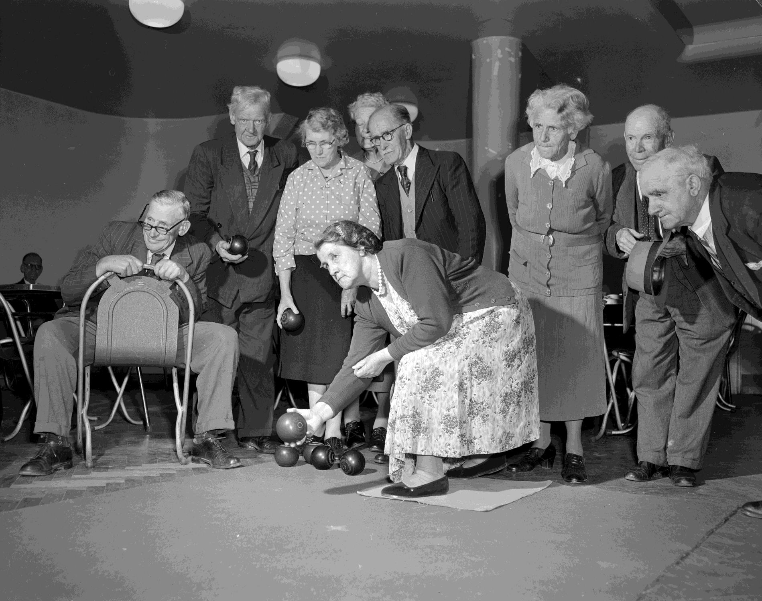
Group of people playing bowls.
Melbourne, Victoria, 1959
Photographer:
Laurie Richards

Slide 21
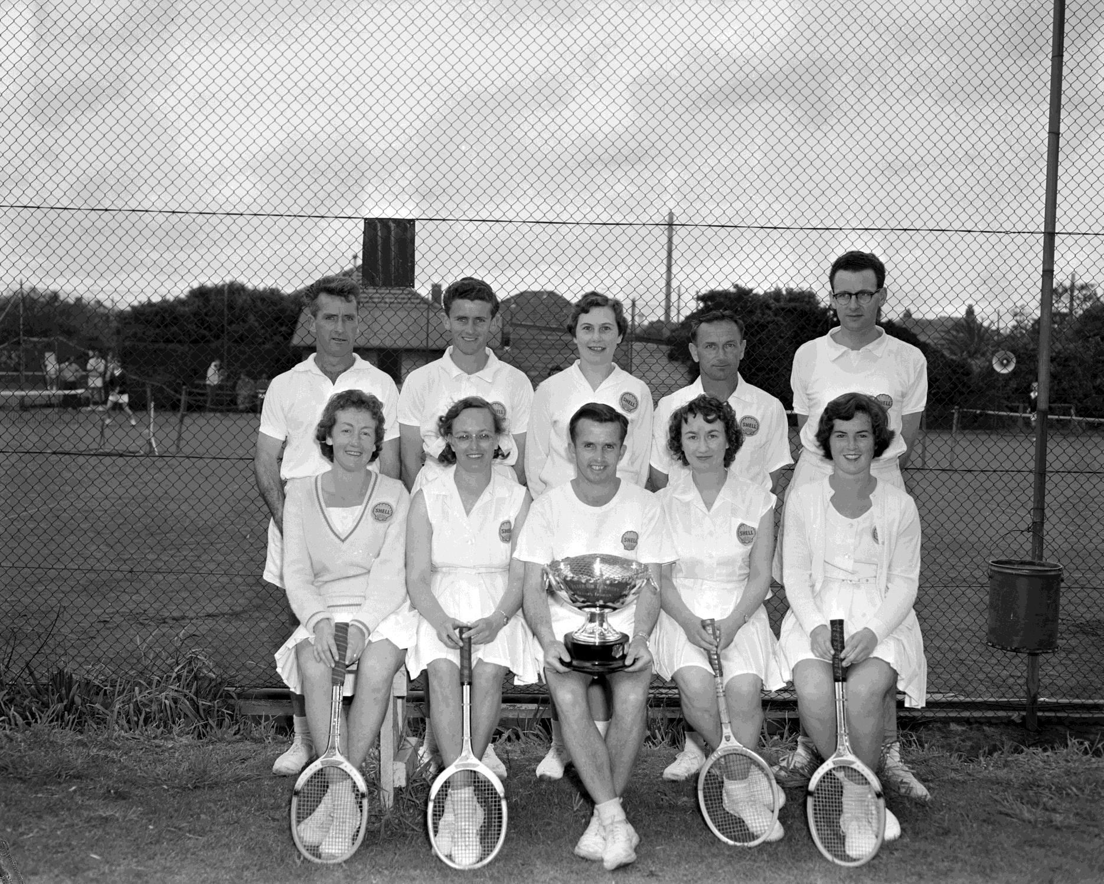
Shell Company tennis team and trophy.
Mentone, Victoria, 1959

Slide 22
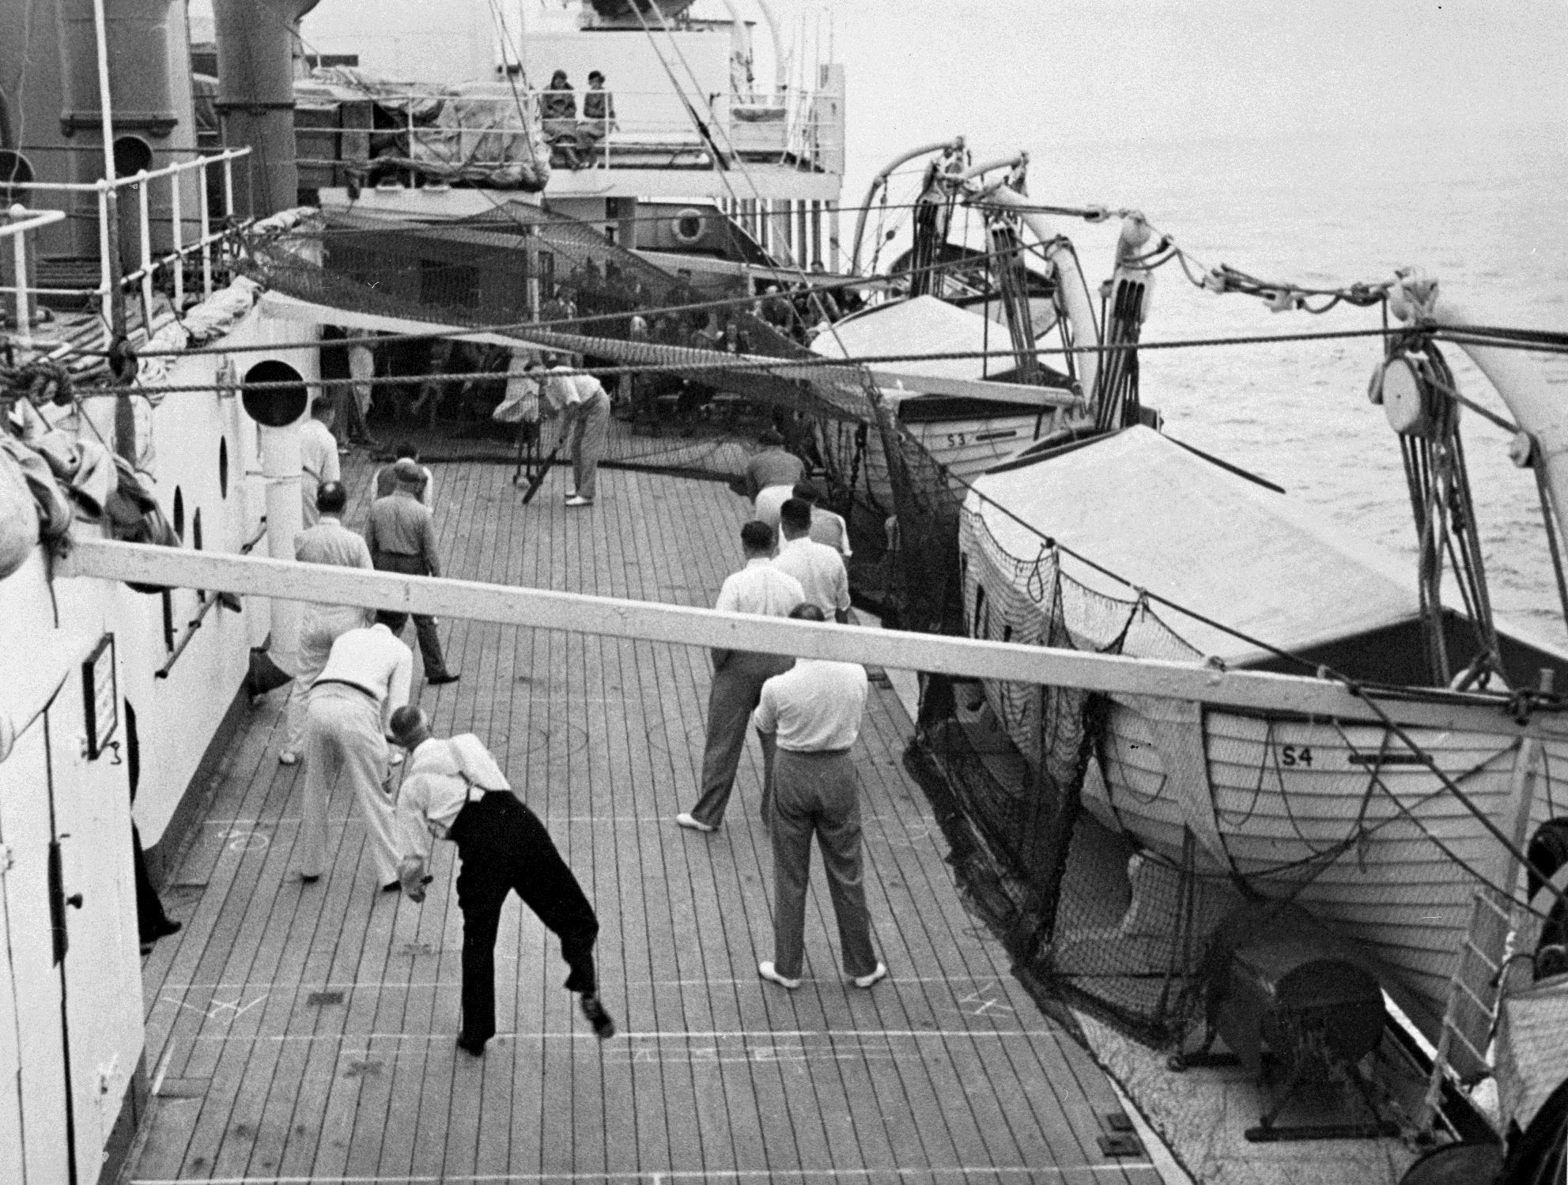
Passengers playing deck cricket on a ship.
Australia, 1930
Photographer: Dorothy Davidson

Slide 23
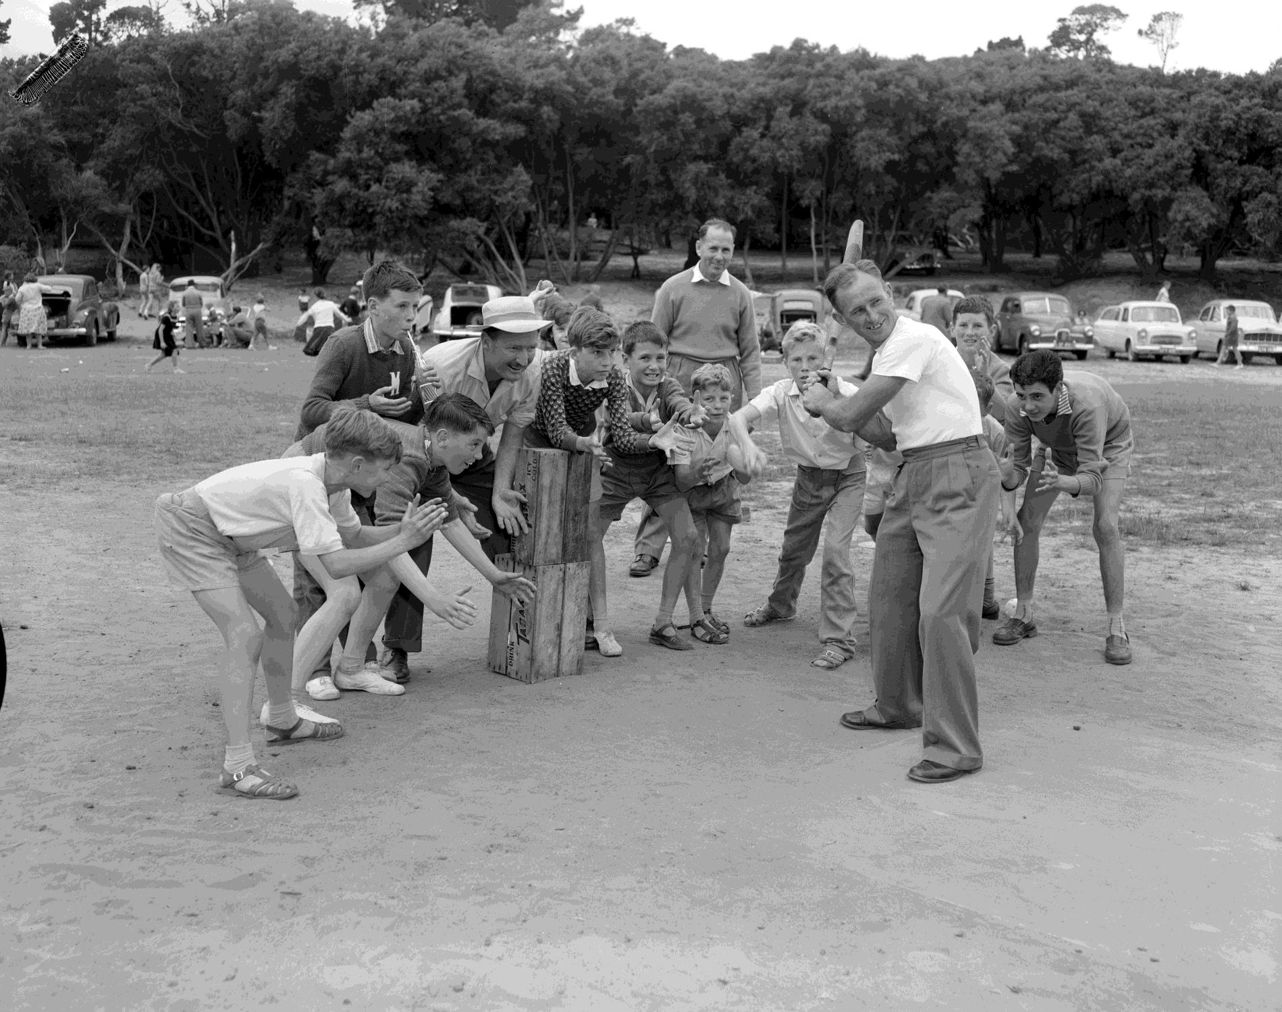
Group Playing Cricket, Cheltenham Park, 1959
Photographer: Laurie Richards

Slide 24
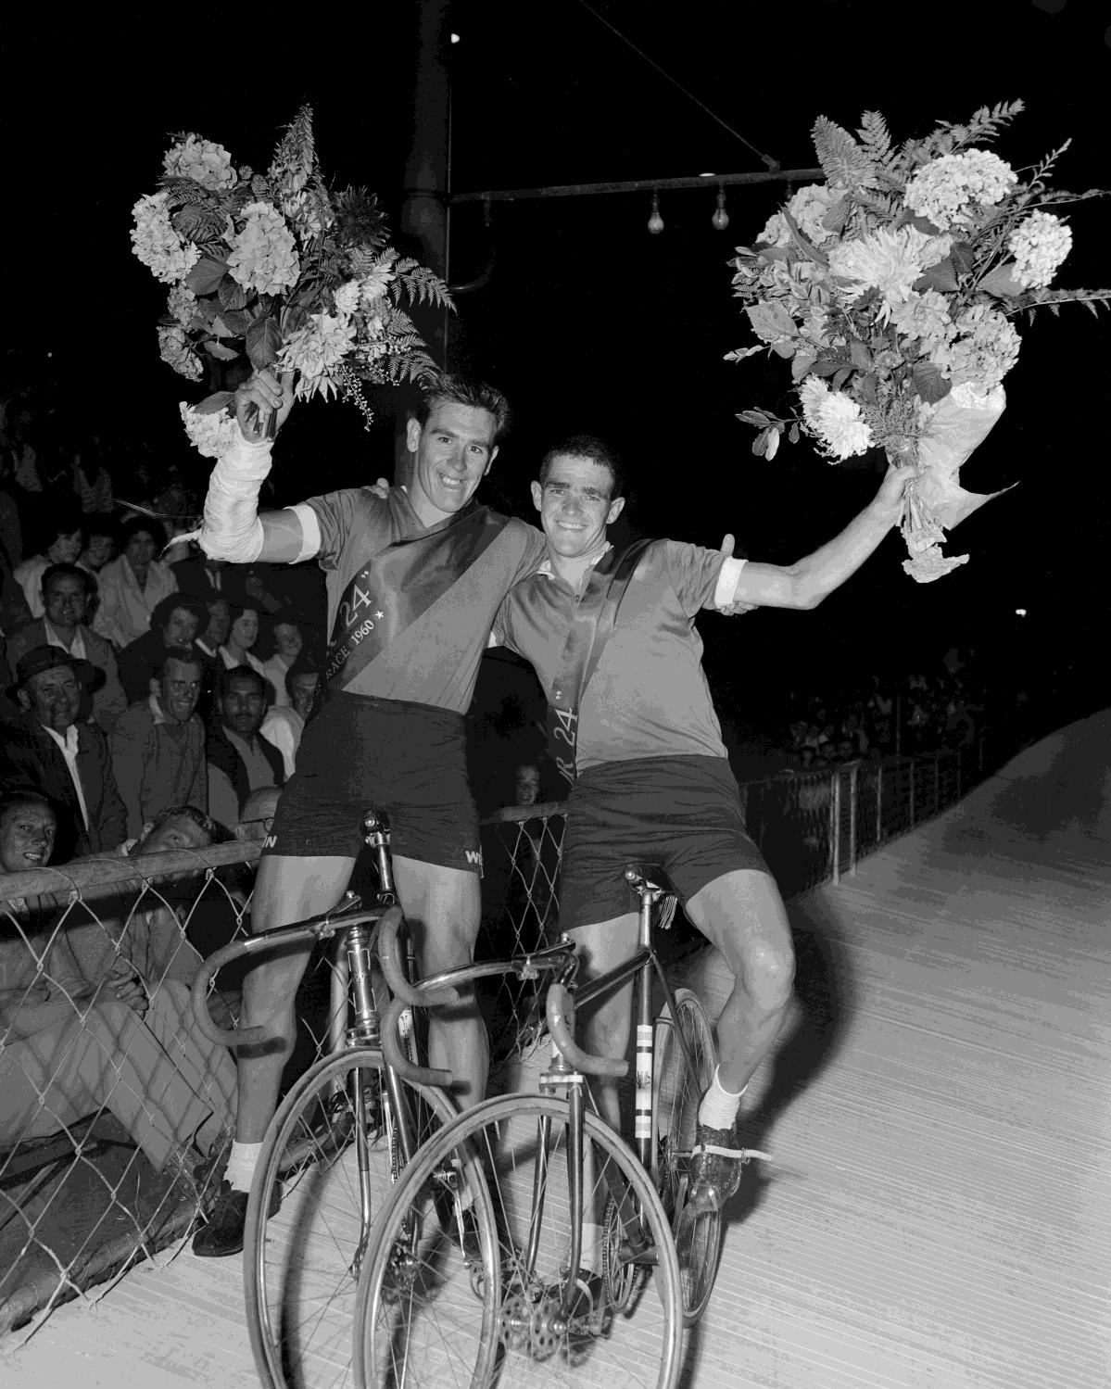
Two cyclists with sashes and bouquets at the Astor 24 cycling race.
Melbourne, Victoria, 1960
Photographer: Laurie Richards

Slide 25
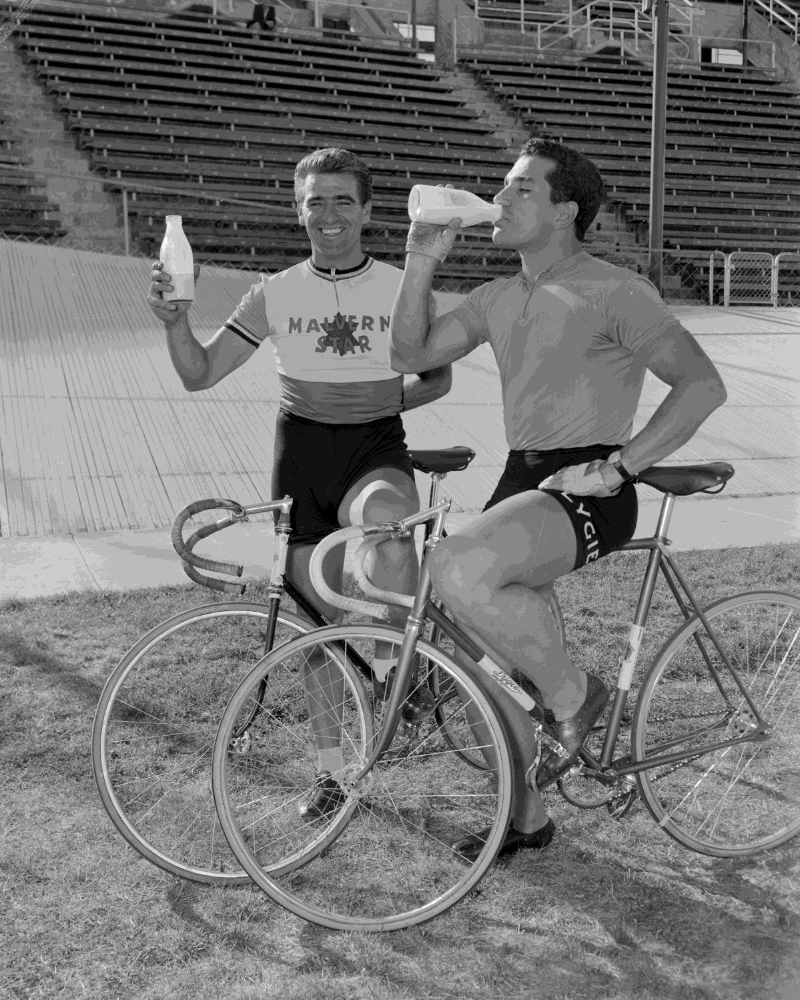
Two cyclists at a Velodrome.
Melbourne, Victoria, 1960
Photographer: Laurie Richards

Slide 26
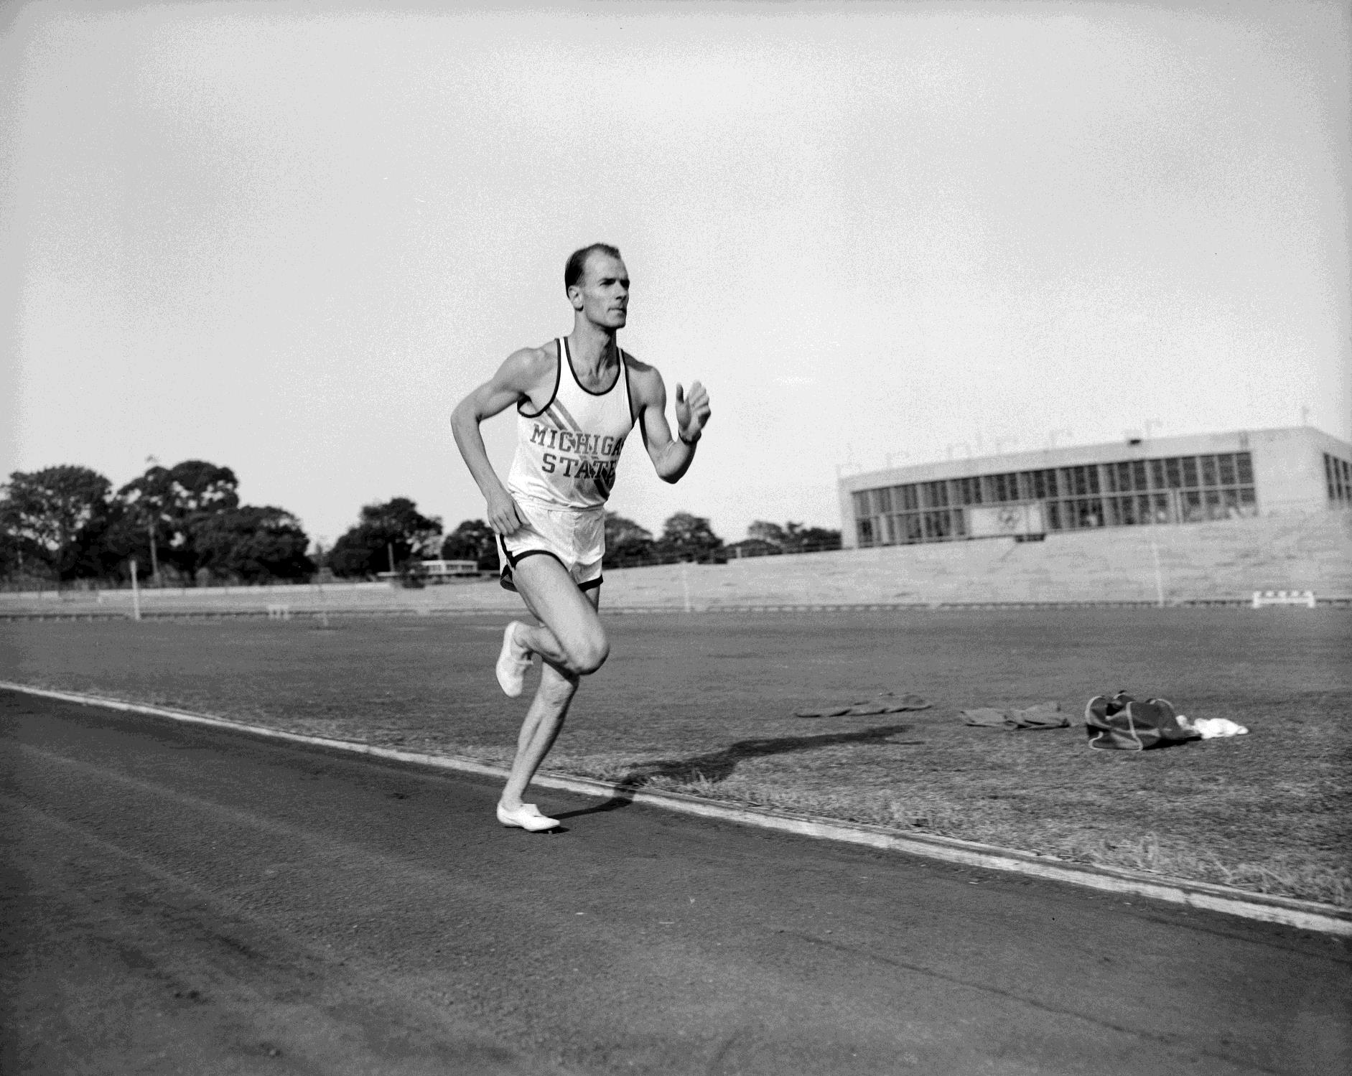
A man running on a track at Olympic Park, Melbourne.
Melbourne,
Victoria, 1960
Photographer:
Laurie Richards

Slide 27
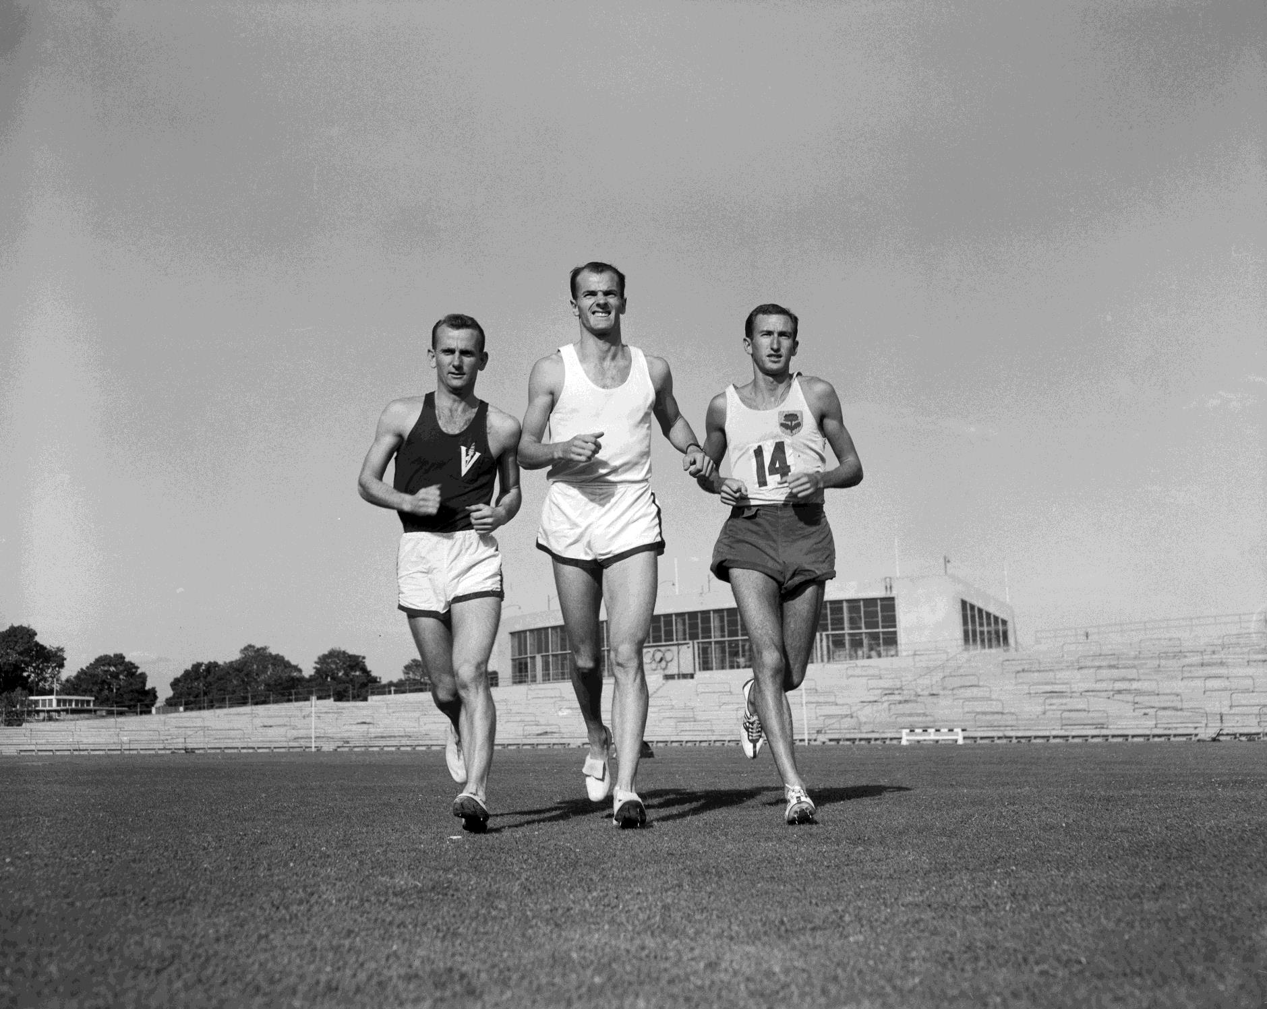
Three men running across an oval at Olympic Park, Melbourne.
Melbourne,
Victoria, 1960
Photographer:
Laurie Richards

Slide 28
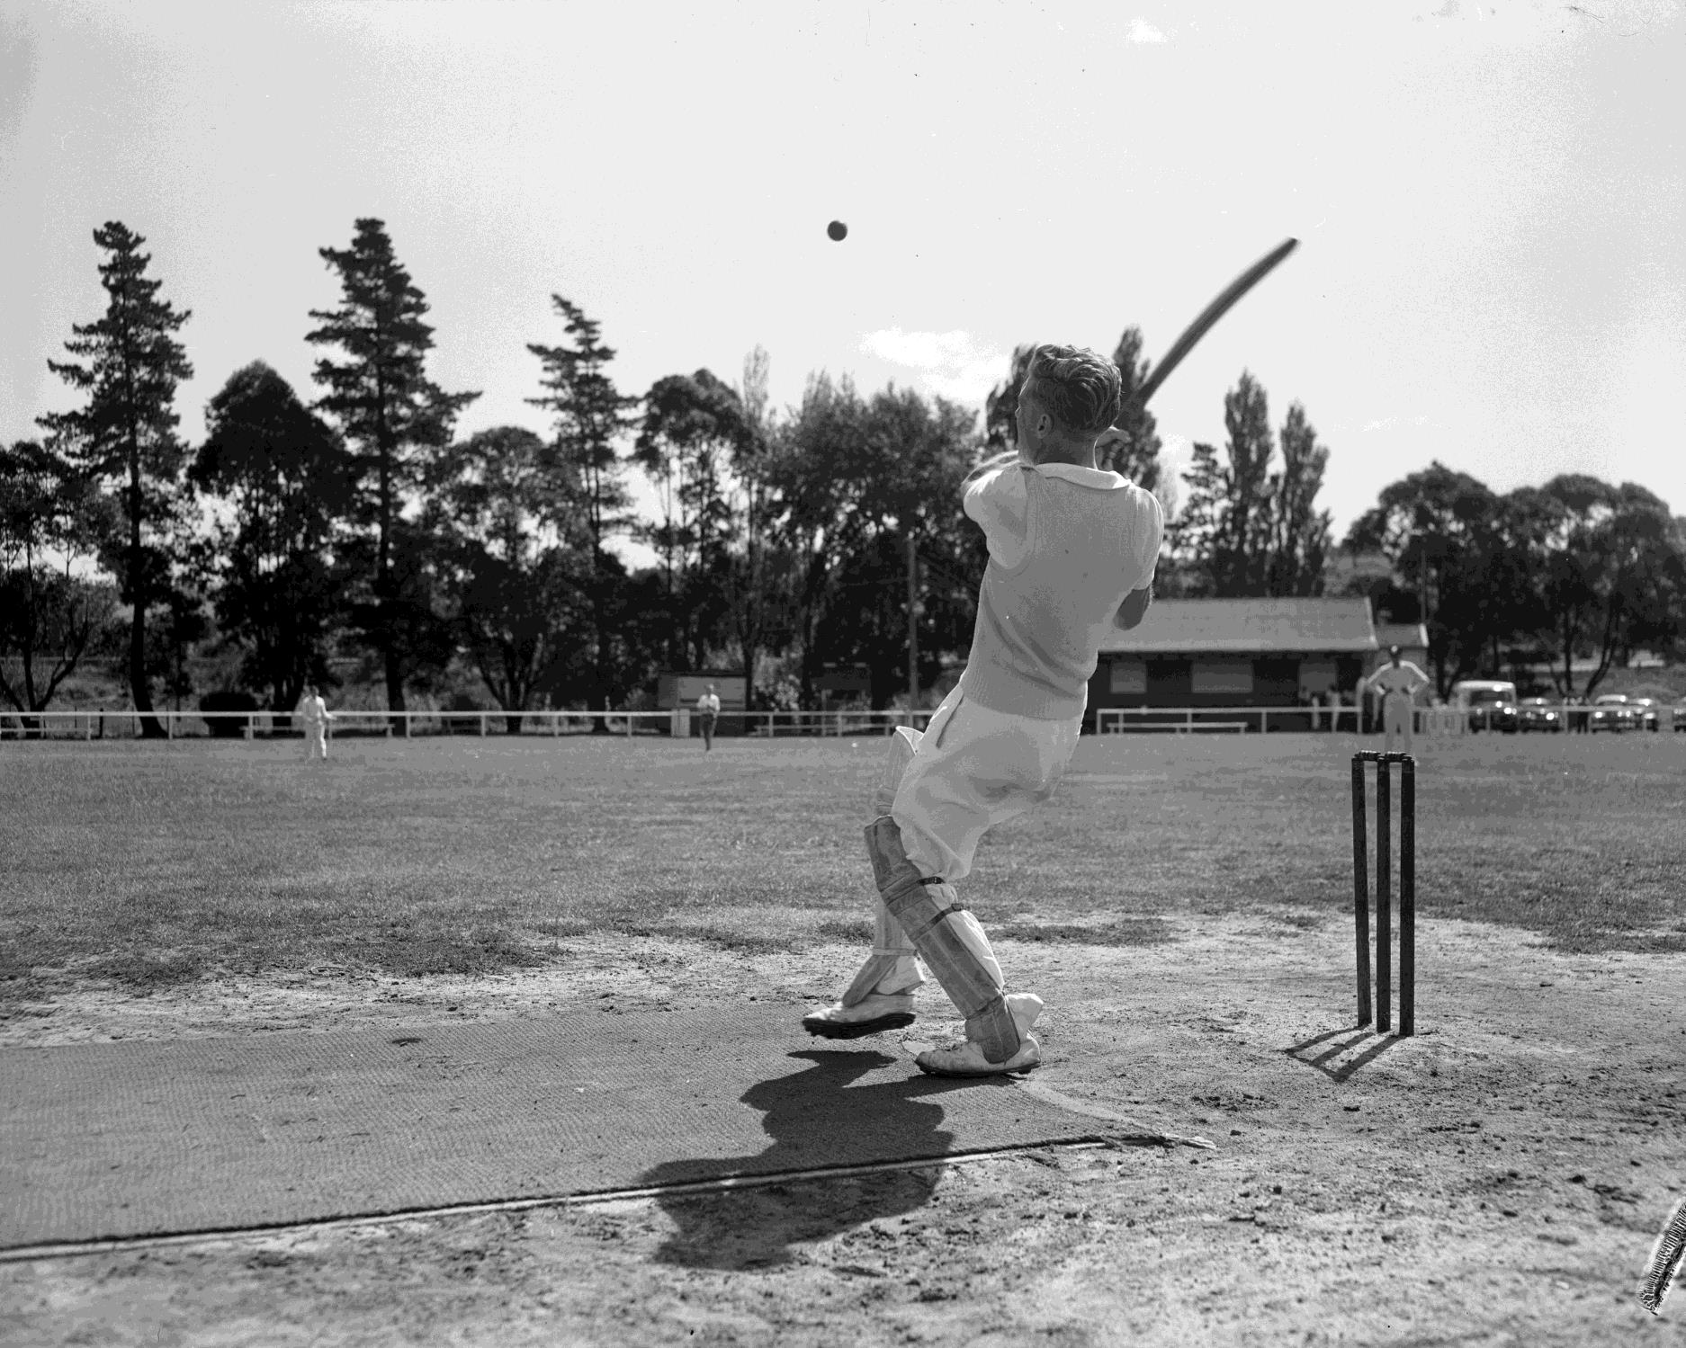
Cricket batsman hitting a ball at
the Tooronga Oval. East Malvern, Victoria, 1960
Photographer:
Laurie Richards

Slide 29
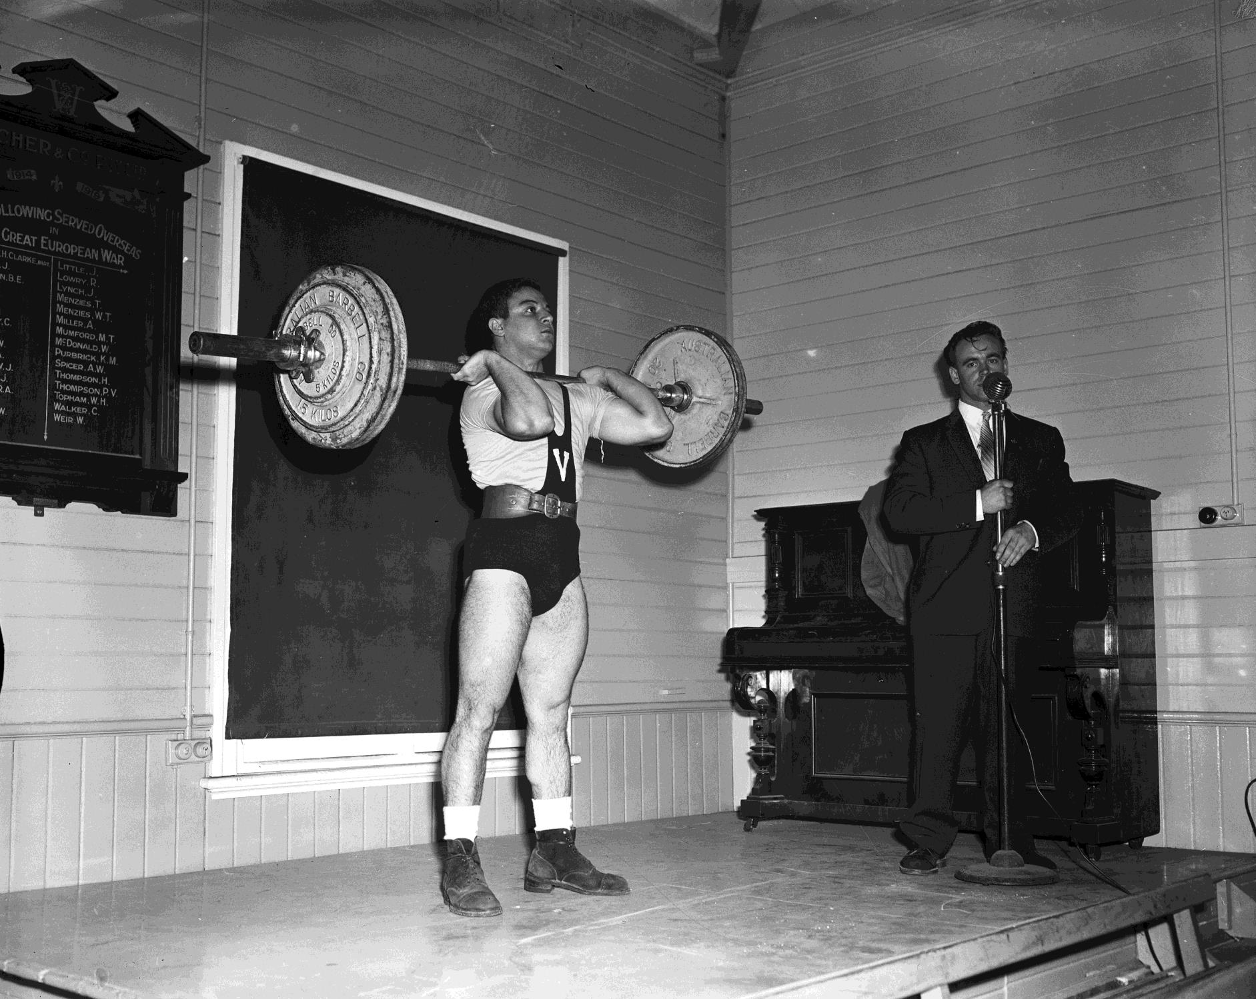
Weightlifting demonstration Yarraville, Victoria, 1960
Photographer:
Laurie Richards

Slide 30
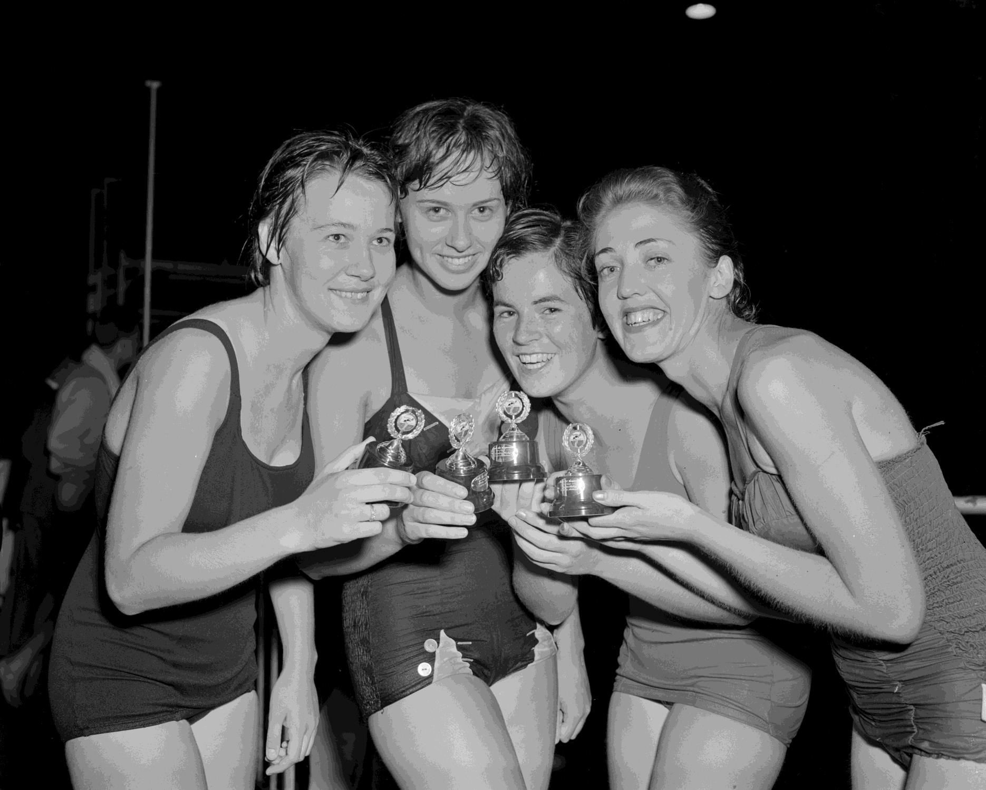
Shell Company swimming competition winners.
Richmond 1960
Photographer:
Laurie Richards

Slide 31
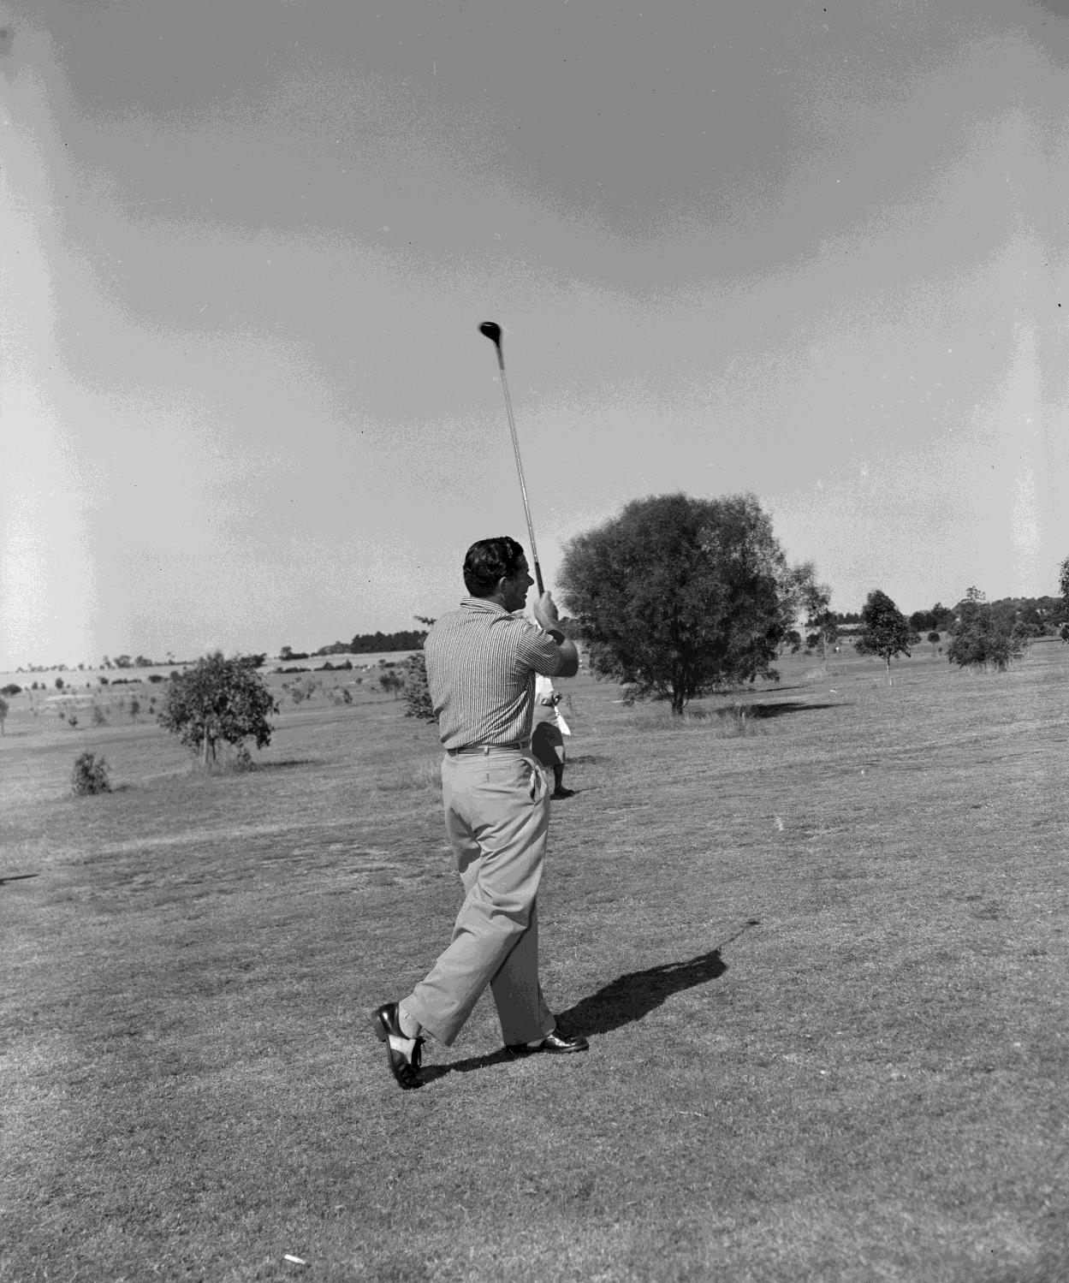
Golfer swinging a golf club at the Cranbourne Golf Club.
Cranbourne, Victoria, 1960
Photographer: Laurie Richards

Slide 32
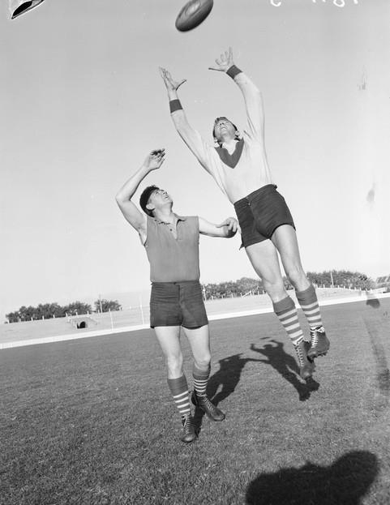
Fred Goldsmith, South Melbourne Football Player, Melbourne, Victoria, 1958
Photographer: Laurie Richards

Slide 33
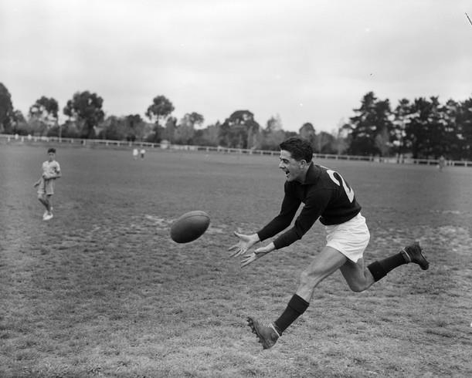
Footballer, Melbourne 1958
Photographer: Laurie Richards

Slide 34
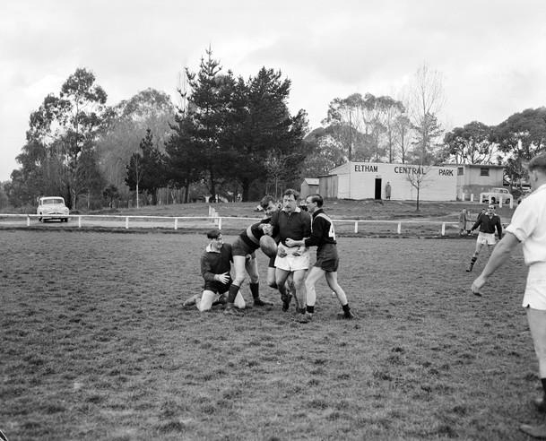
Football Players Celebrating on Ground, Eltham, Victoria, Jul 1958
Photographer: Laurie Richards

Slide 35
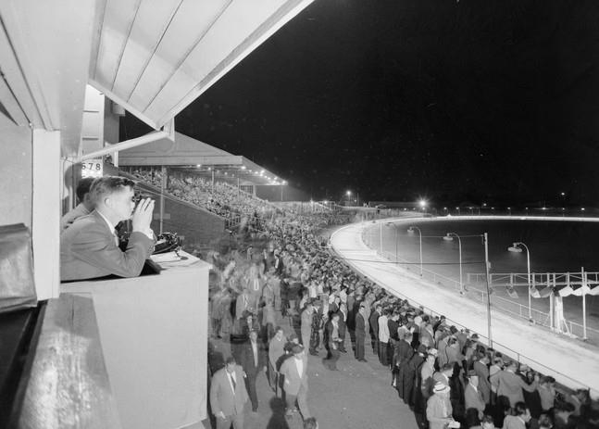
Arden Street Oval, North Melbourne, Victoria, 23 December
1957
Photographer: Laurie Richards

Slide 36
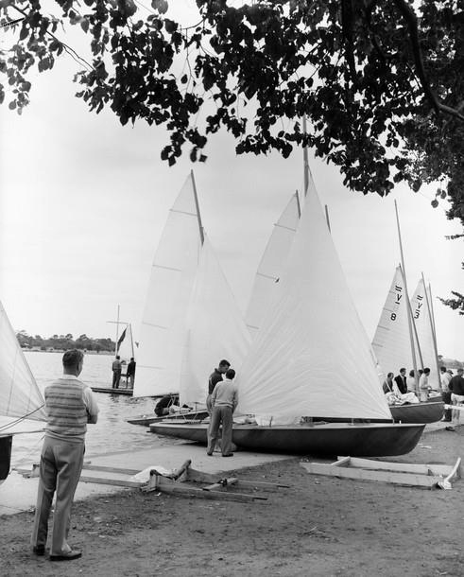
Yachting, Albert Park Lake, Victoria, 1958
Photographer: Laurie Richards

Slide 37
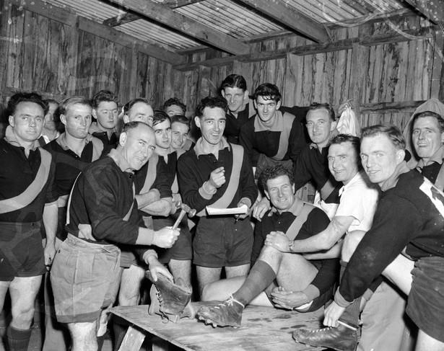
Male Sports Team, Group Portrait May 1957
Photographer: Laurie Richards

Slide 38
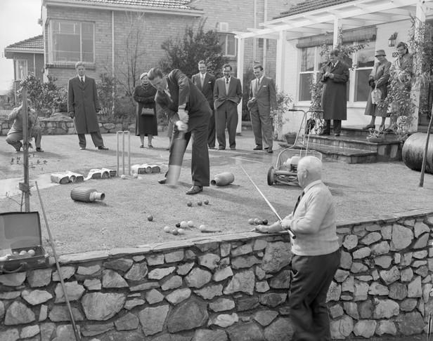
Games on the lawn for lawn mower promotion. North Balwyn, Victoria, 1957
Photographer: Laurie Richards

Slide 39
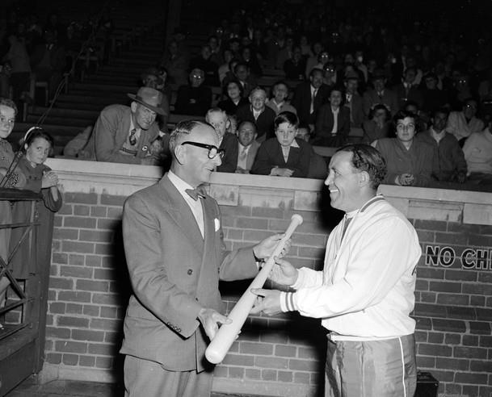
Man Presenting Bat to Baseball Player with a Pee Wee Reese Louisville Slugger baseball bat., Melbourne, Victoria, 1956
Photographer: Laurie Richards

Slide 40
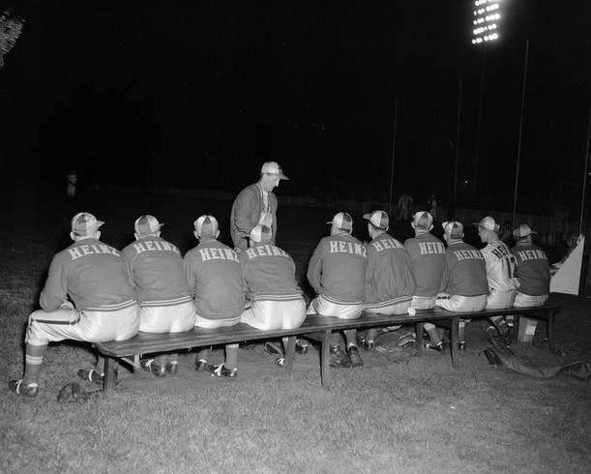
Baseball Players, Olympic Park, Melbourne, Victoria, 1956
Photographer: Laurie Richards

Slide 41
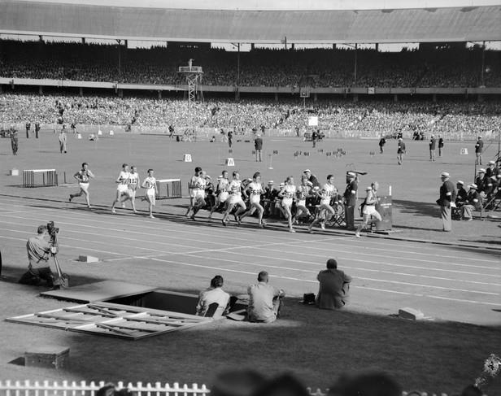
Men's 5000 Metres Final, Olympic Games, Melbourne Cricket Ground, Melbourne, Victoria, 1956
Photographer: Laurie Richards

Slide 42
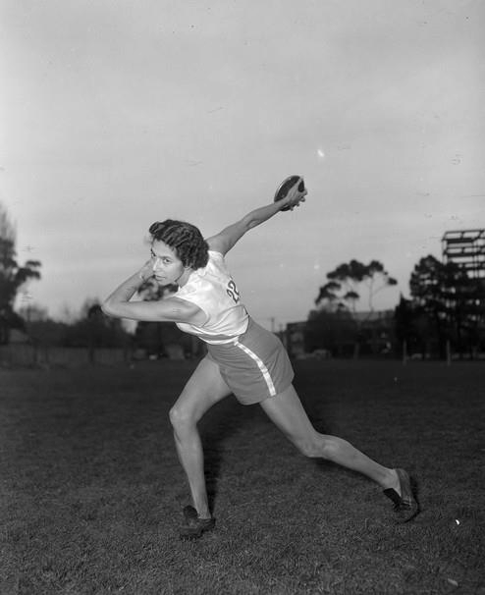
Female Discus Thrower, Olympic Park, Melbourne, Victoria, 1956
Photographer: Laurie Richards

Slide 43
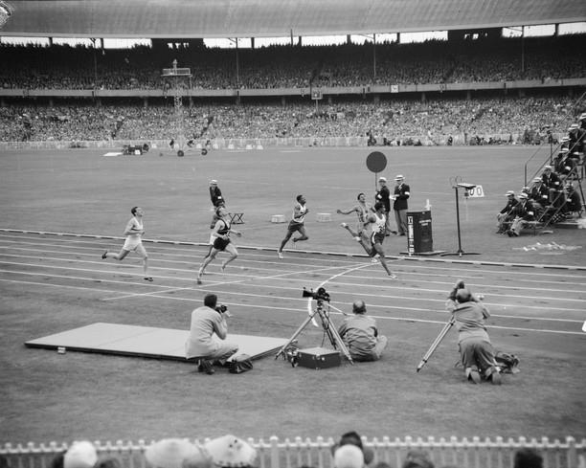
Men's 200 Metres, Olympic Games, Melbourne Cricket Ground, Melbourne, Victoria, 1956
Photographer: Laurie Richards

Slide 44
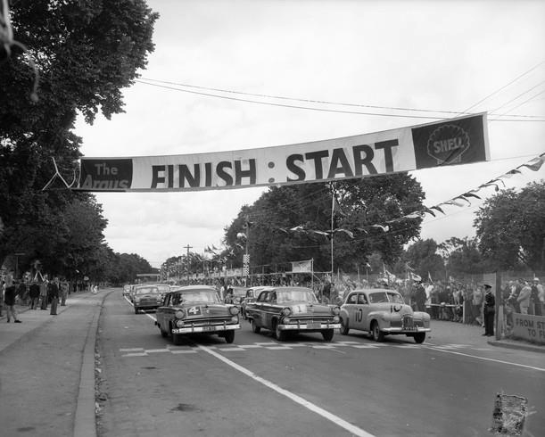
Australian Grand Prix, Albert Park, Victoria, 1956
Photographer: Laurie Richards

Slide 45
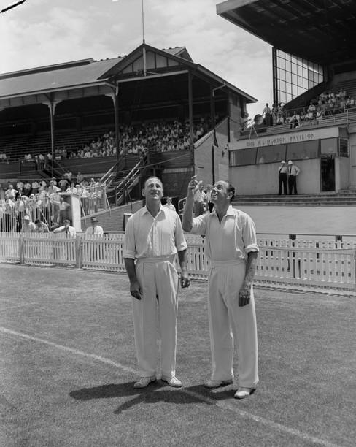
Two Cricket Players Tossing a Coin, St Kilda Cricket Ground, St Kilda, Victoria, Jan 1959
Photographer: Laurie Richards

Slide 46
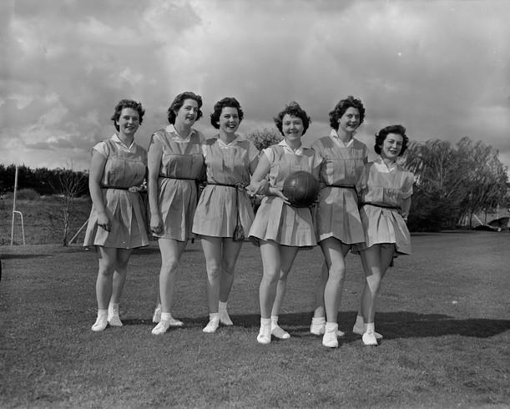
Brockhoff Biscuit Co, Women's Volleyball Team, Burwood, Victoria, Sep 1958
Photographer: Laurie Richards

Slide 47
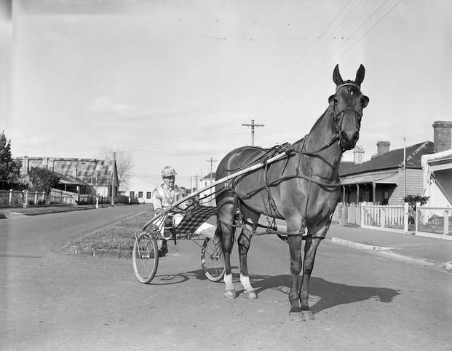
Jockey and Racehorse, Melbourne, Victoria, 1953
Photographer: Laurie Richards

Slide 48
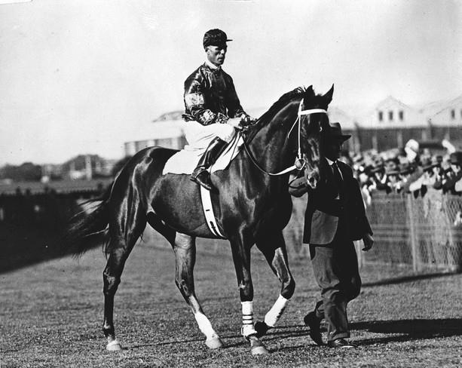
Phar Lap at race track with Pike and Woodcock, 1930
Photographer: Unknown

