Slide 1

Transport and Trave Slideshow
A collection of images from Museums Victoria depicting modes of transport from the twentieth century.

Slide 2
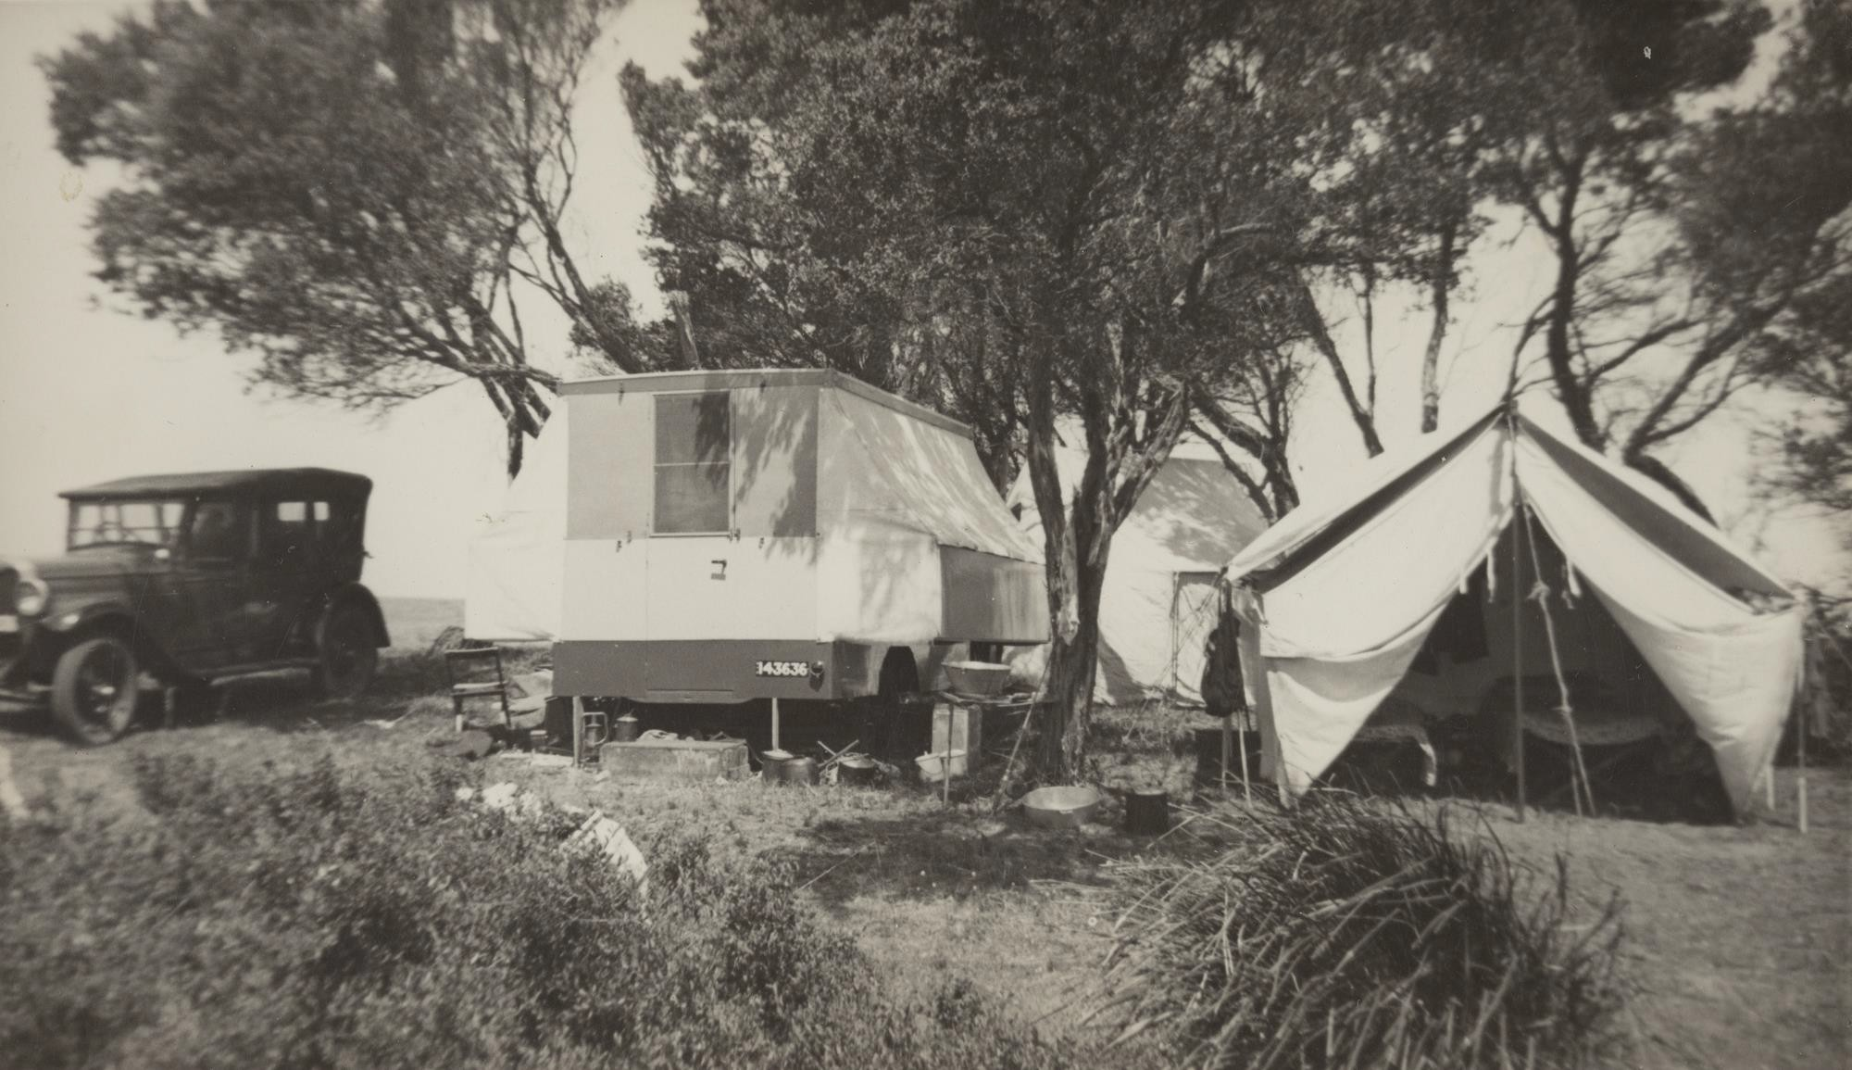
Family Camping, St Leonards VIC
Photographer: Unknown

Slide 3
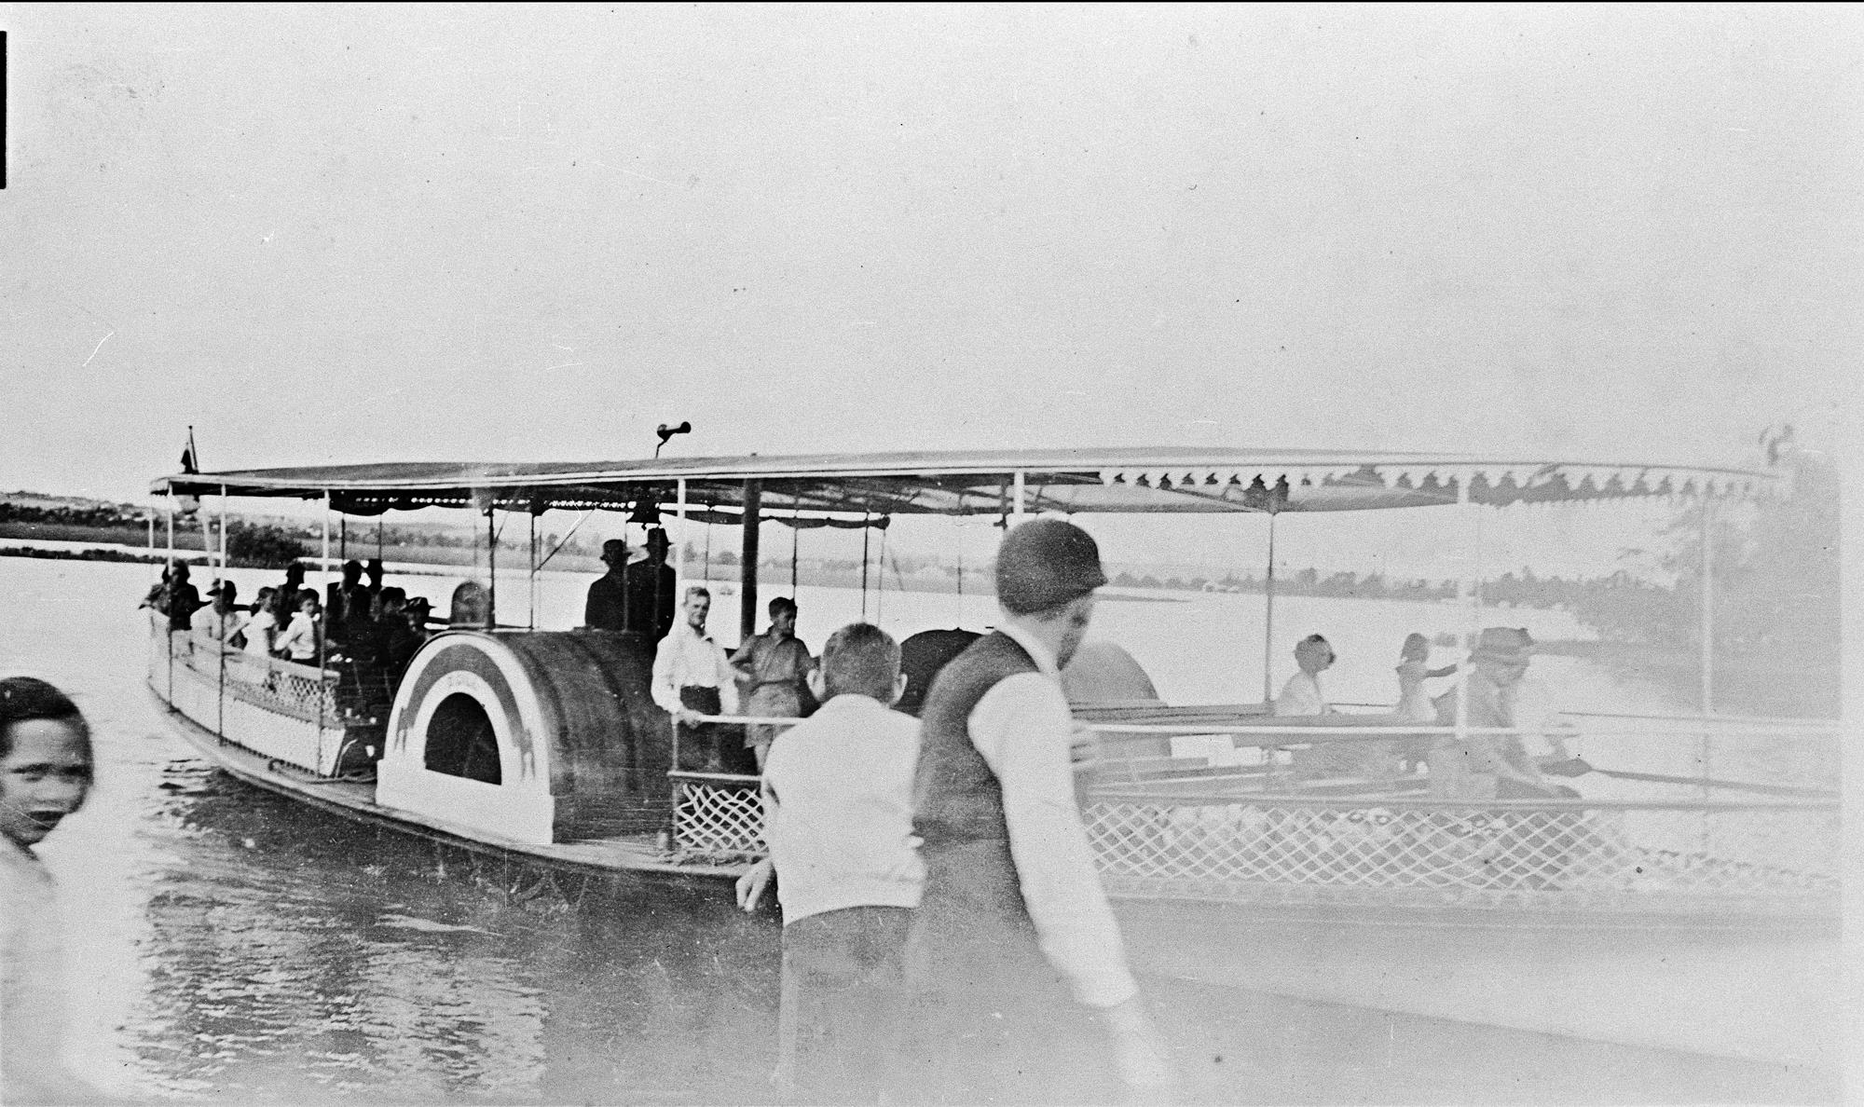
The paddle steamer 'Gem' on Lake Wendouree.
Photographer: Taylor Studio

Slide 4
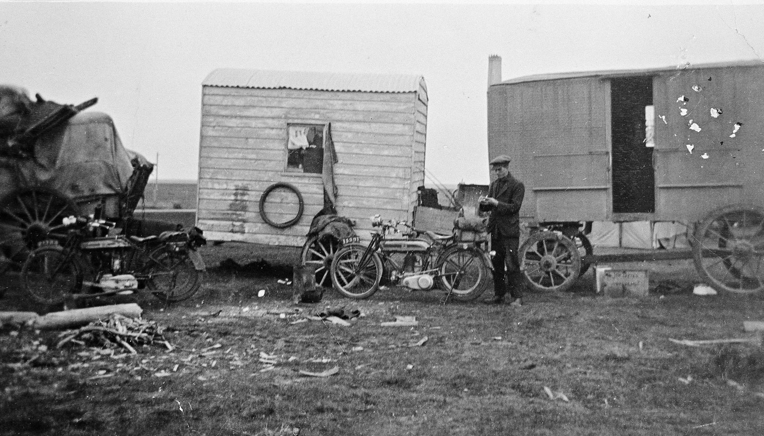
Motor cycles and vans at a local Shire Road camp
Photographer: Unknown

Slide 5
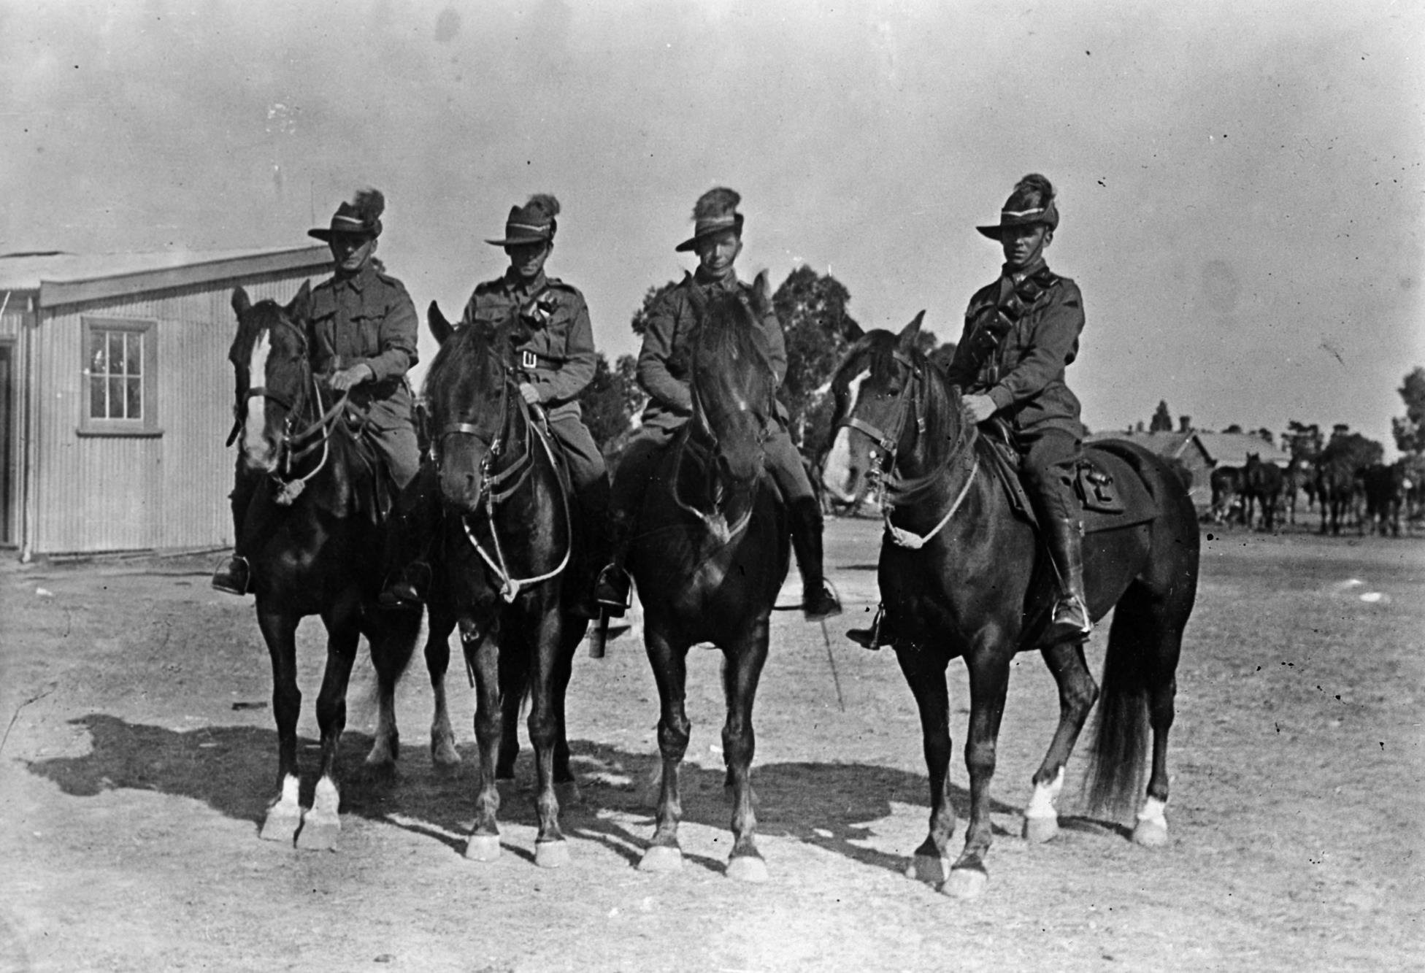
Members of light horse brigade in camp at Broadmeadows, 1929
Photographer:
B McGeehan Studio

Slide 6
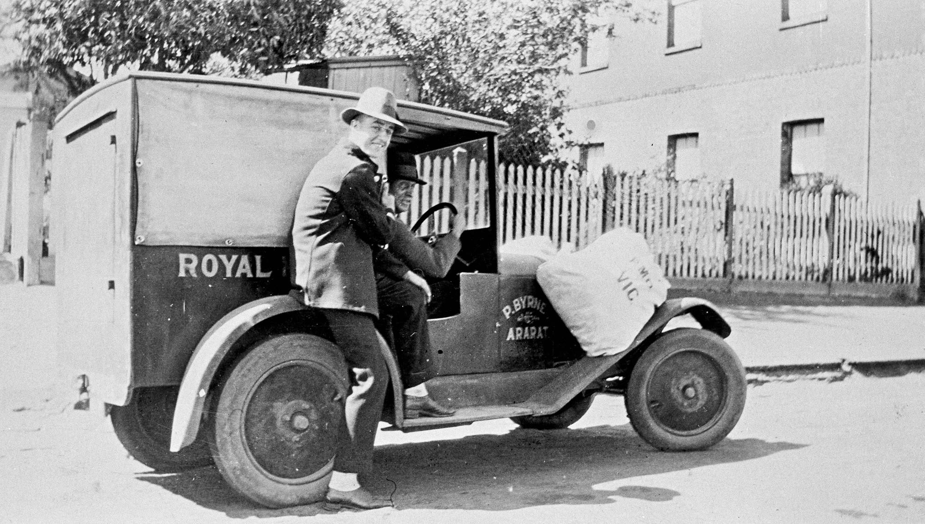
The first Royal Mail van in Ararat.
Photographer: Unknown

Slide 7
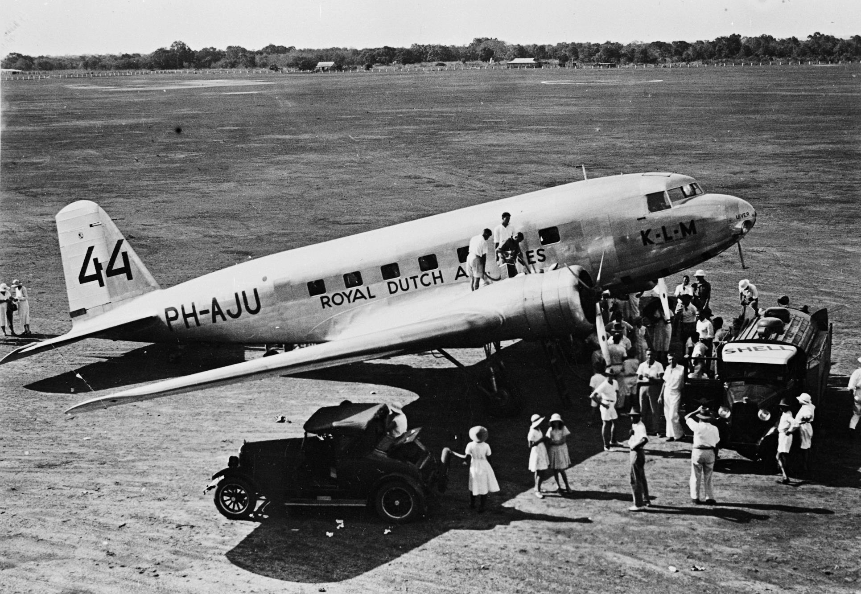
The DC2 flown by Parmentier and Moll for KLM in the MacRobertson Centennial Air Race (from England to Australia), refueling in Darwin. They came second in the race.
Photographer: Unknown

Slide 8
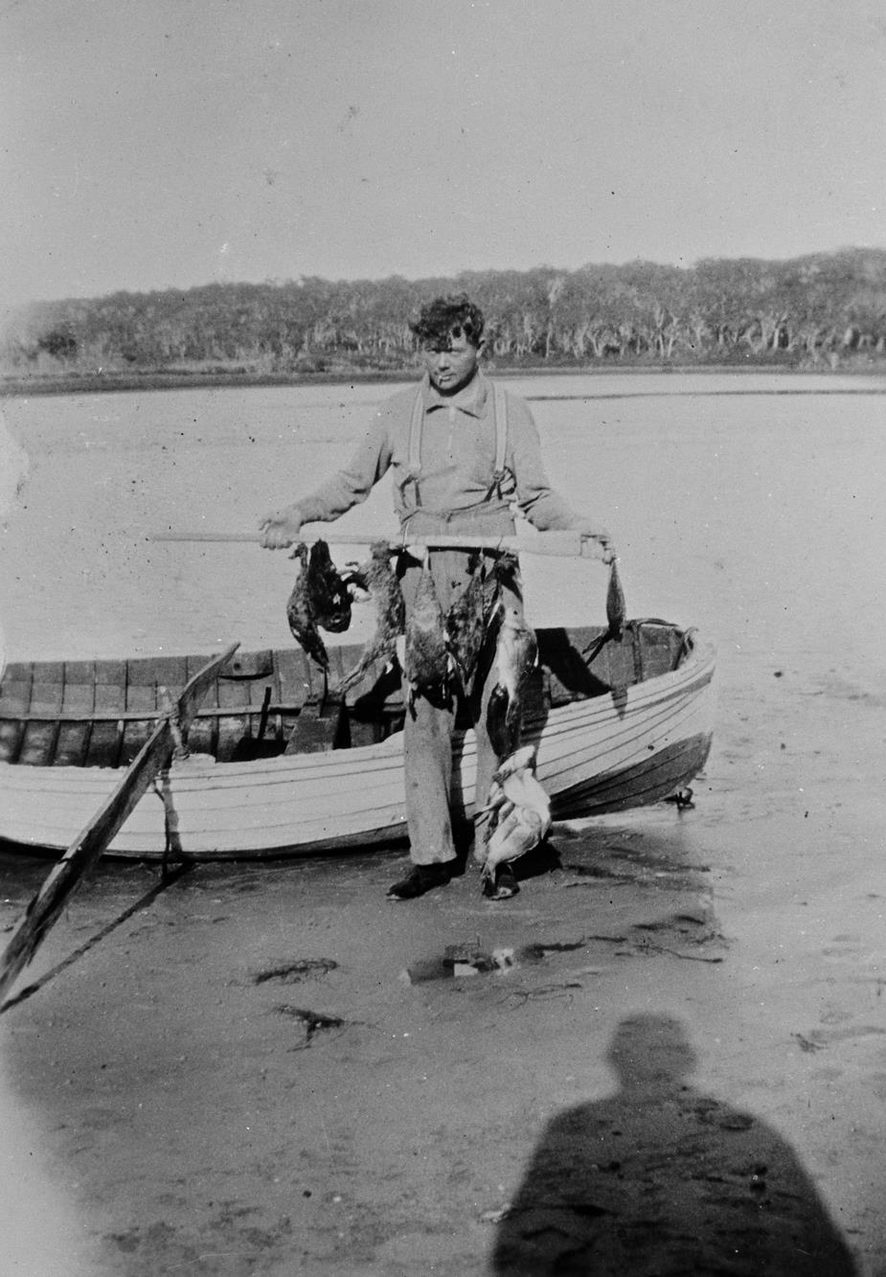
A man standing by a boat and carrying a number of ducks strung on a pole or oar
Photographer: Unknown

Slide 9
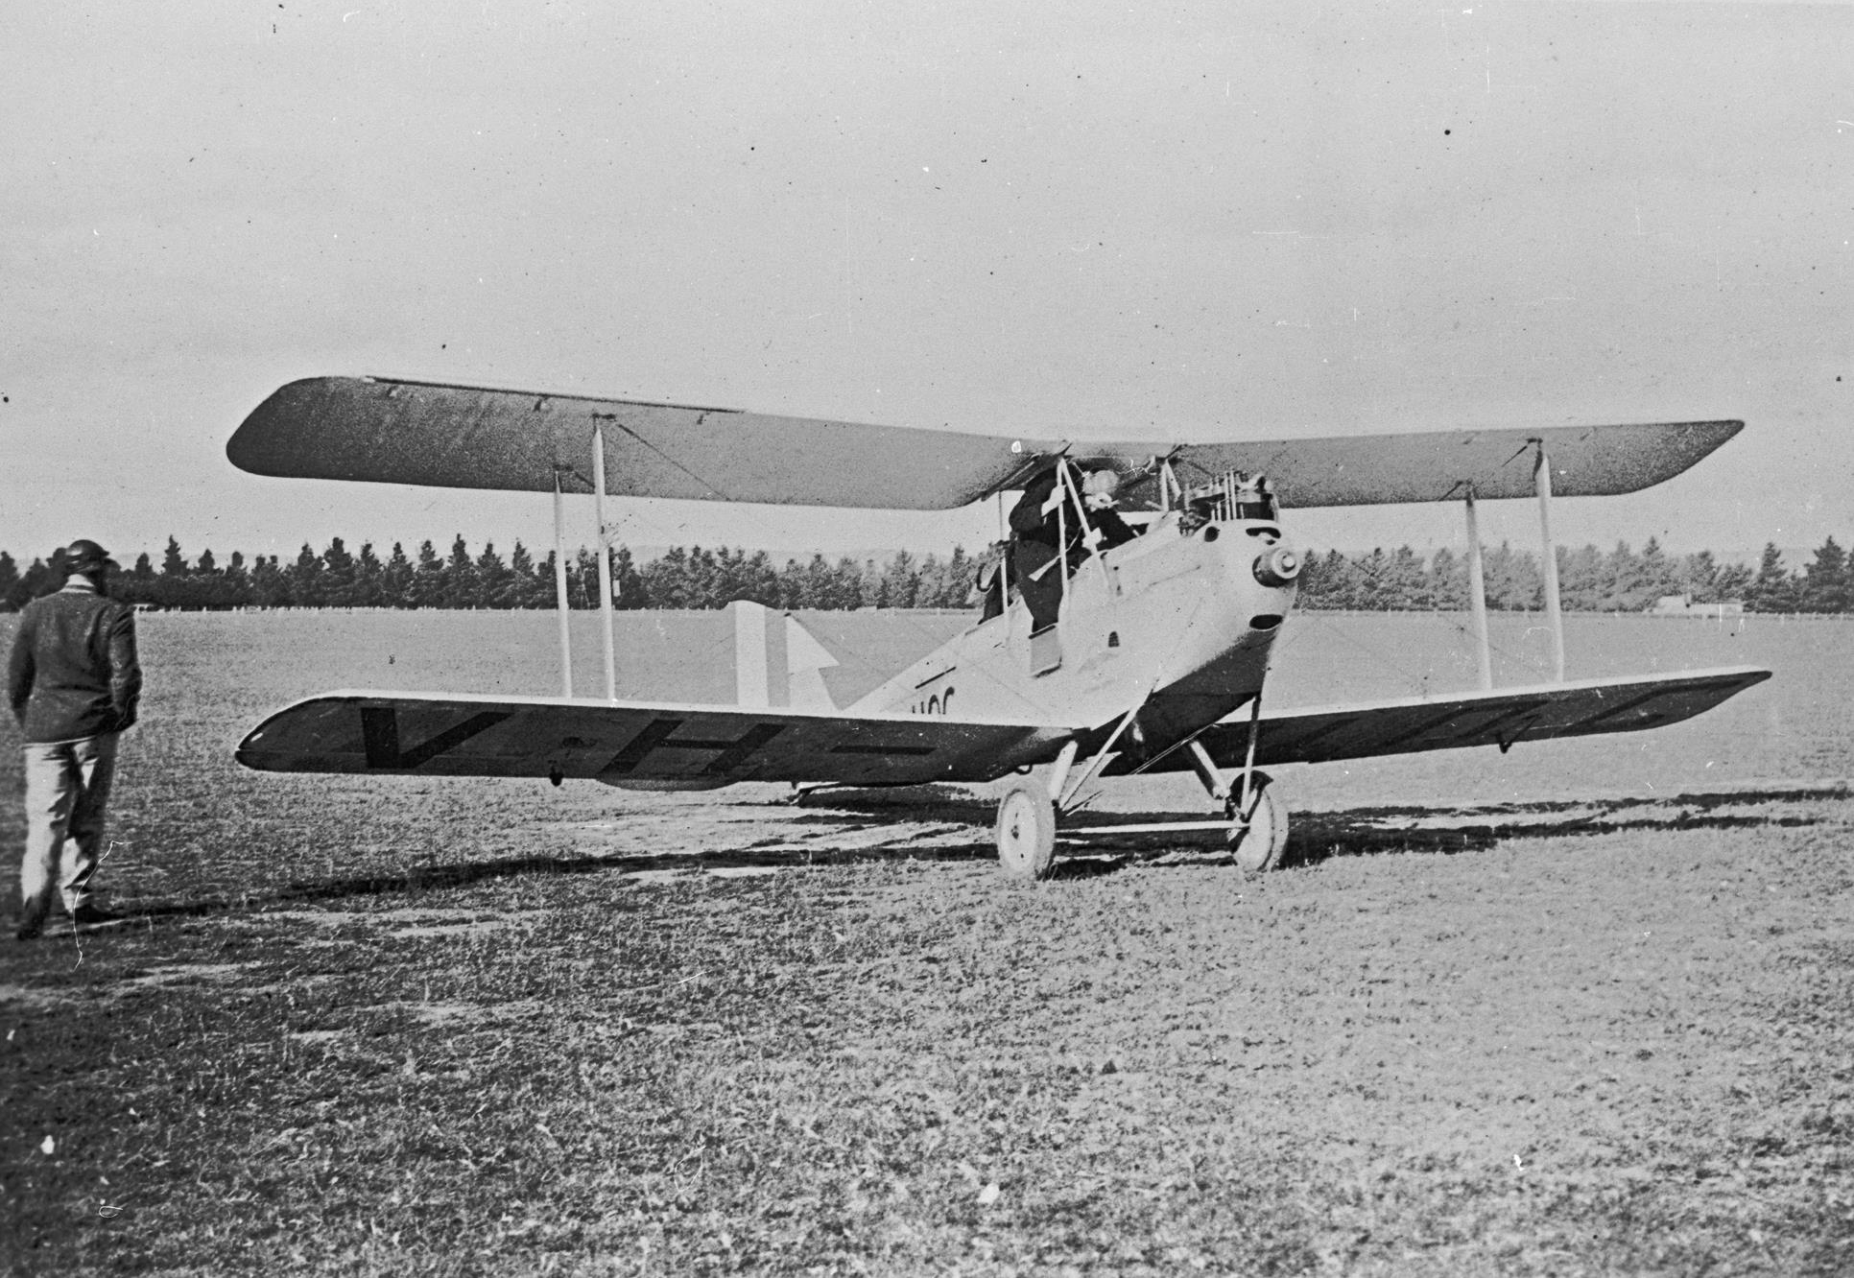
A gypsy moth of the Ballarat Aero Club.
Photographer:
K.H. Wilkie

Slide 10
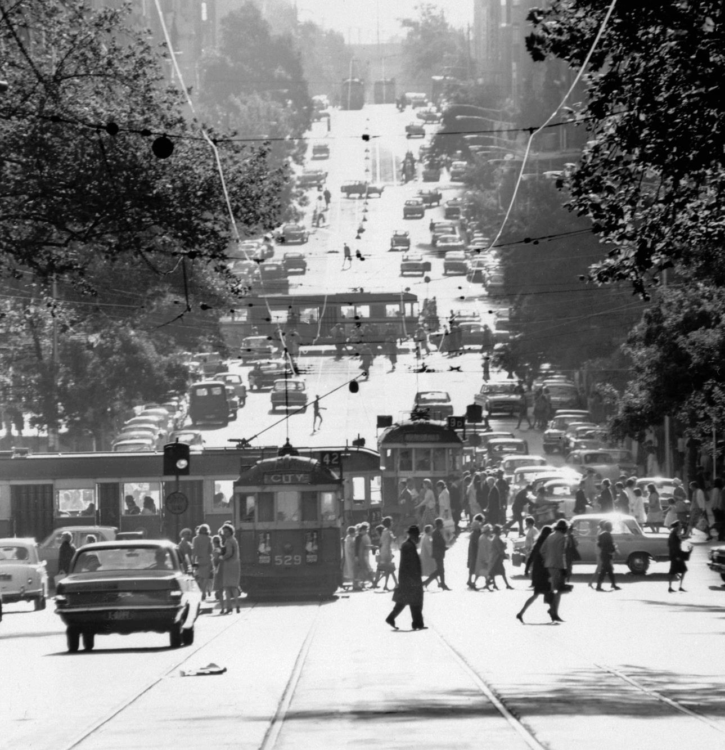
Black and white photograph of lower Collins Street from Russell Street, 2 Jan 1967
Photographer: Mark Strizic

Slide 11
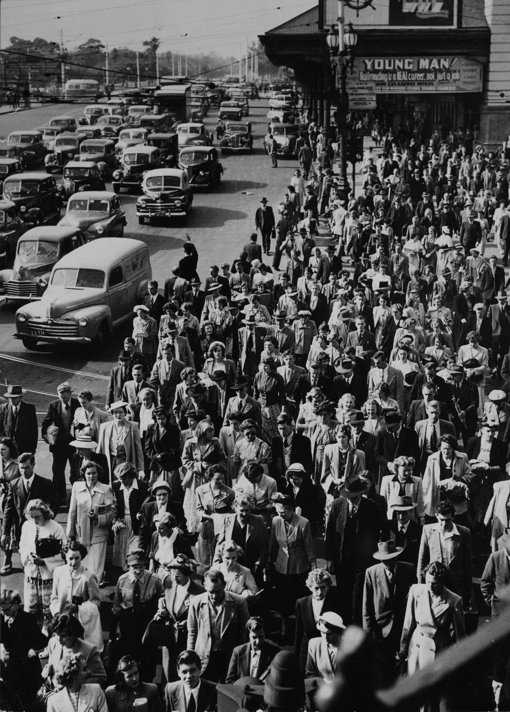
Melbourne transport strike on the corner of Flinders and Swanston Streets.
Photographer: Unknown

Slide 12
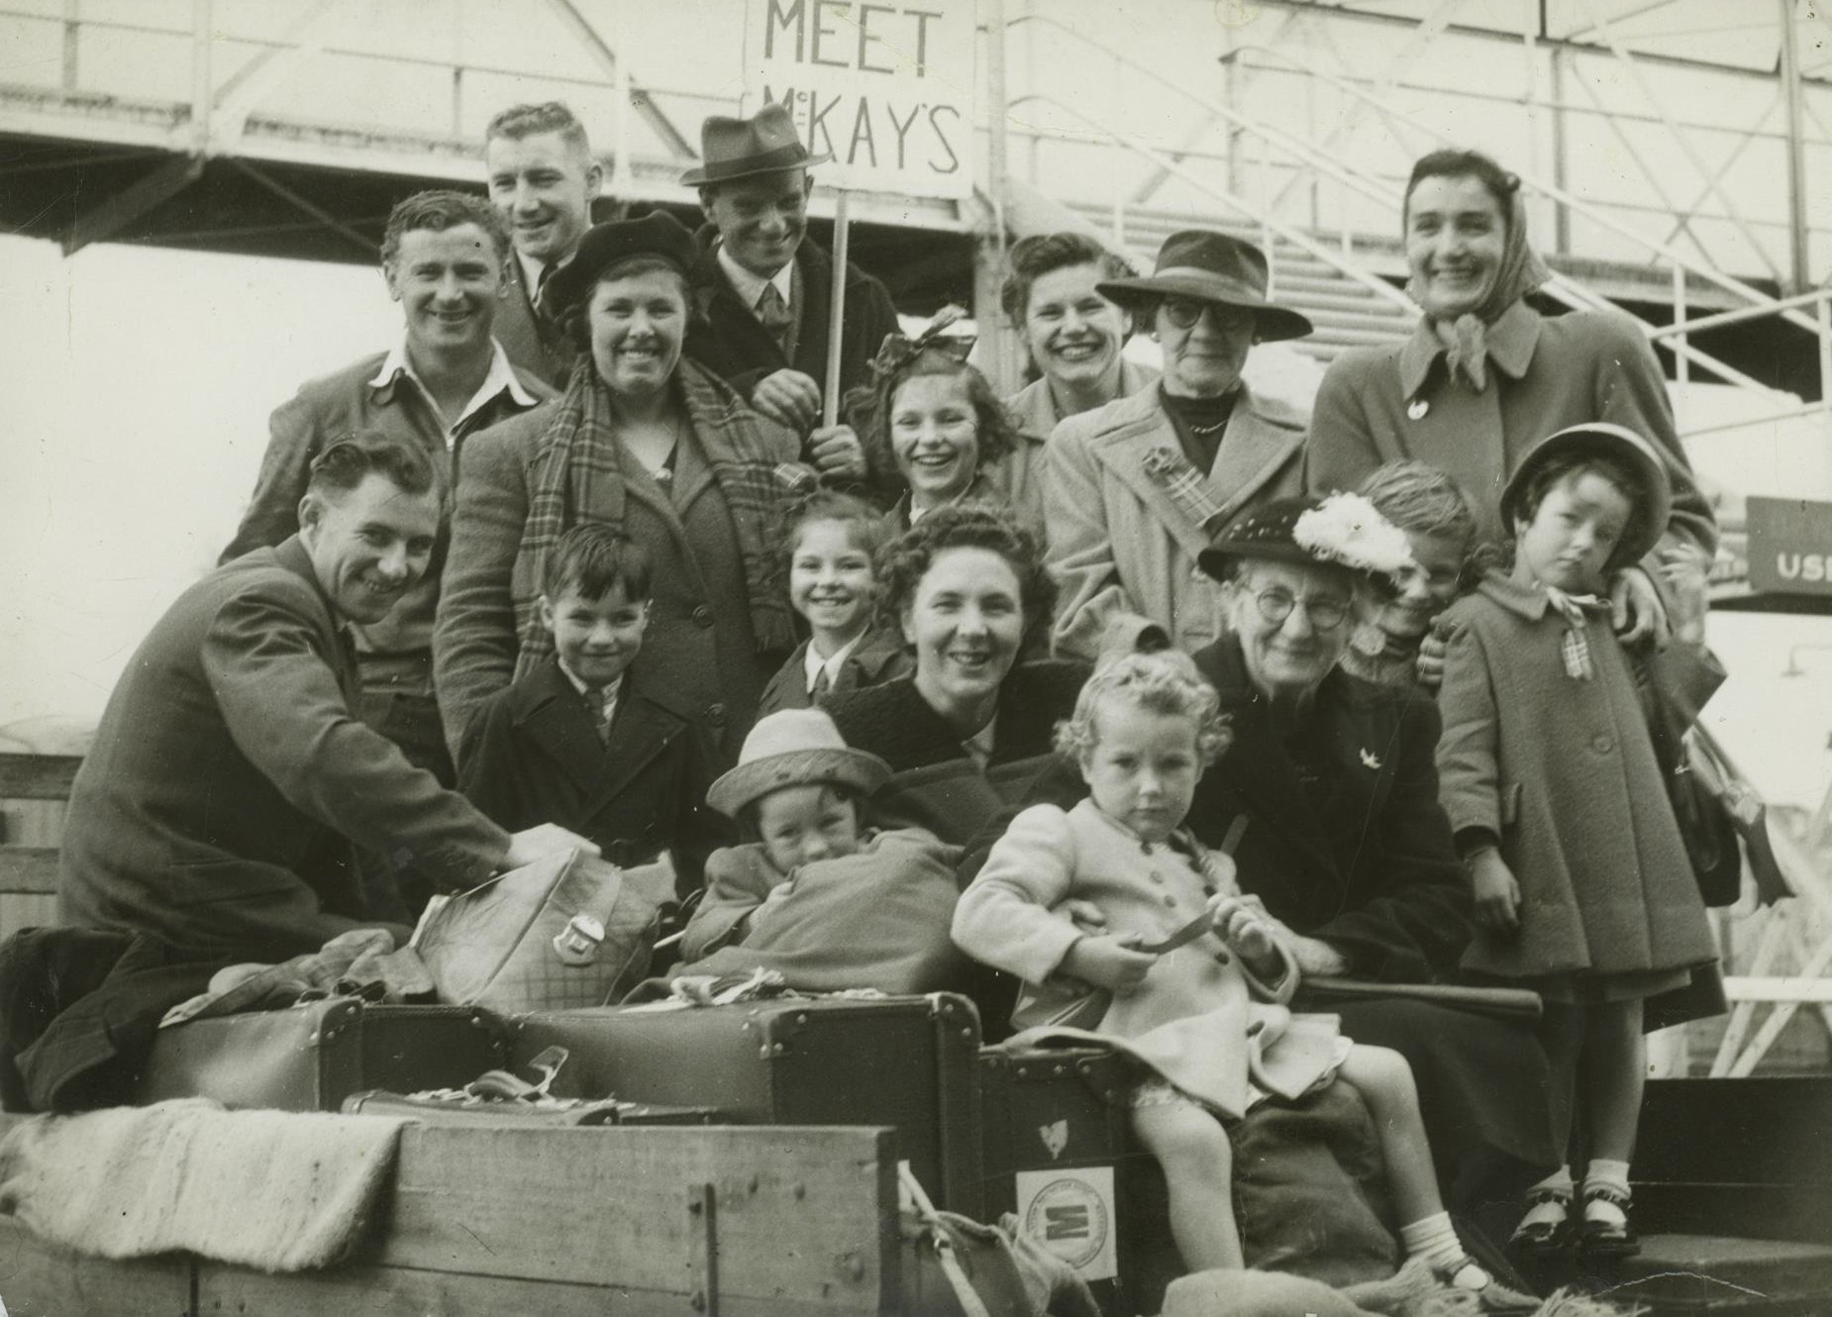
The Mackay family arrive at Station Pier on the S.S. Cameronia.
Photographer: Unknown

Slide 13
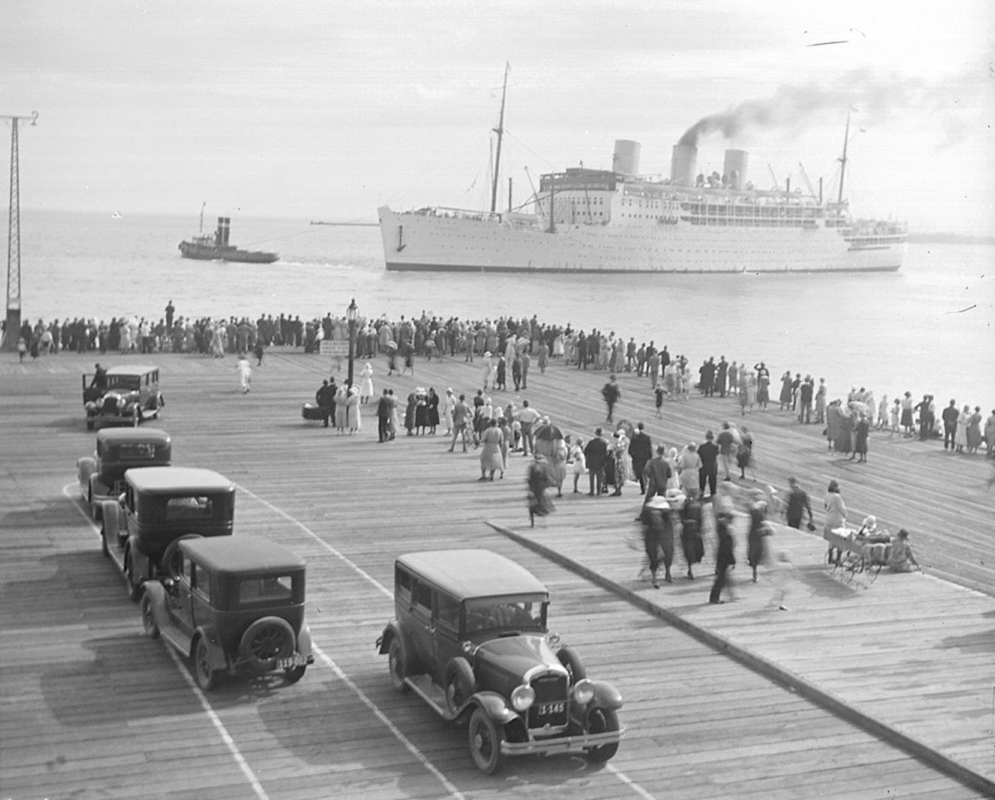
A ship pulled by tug into Port Melbourne.
Photographer: Unknown

Slide 14
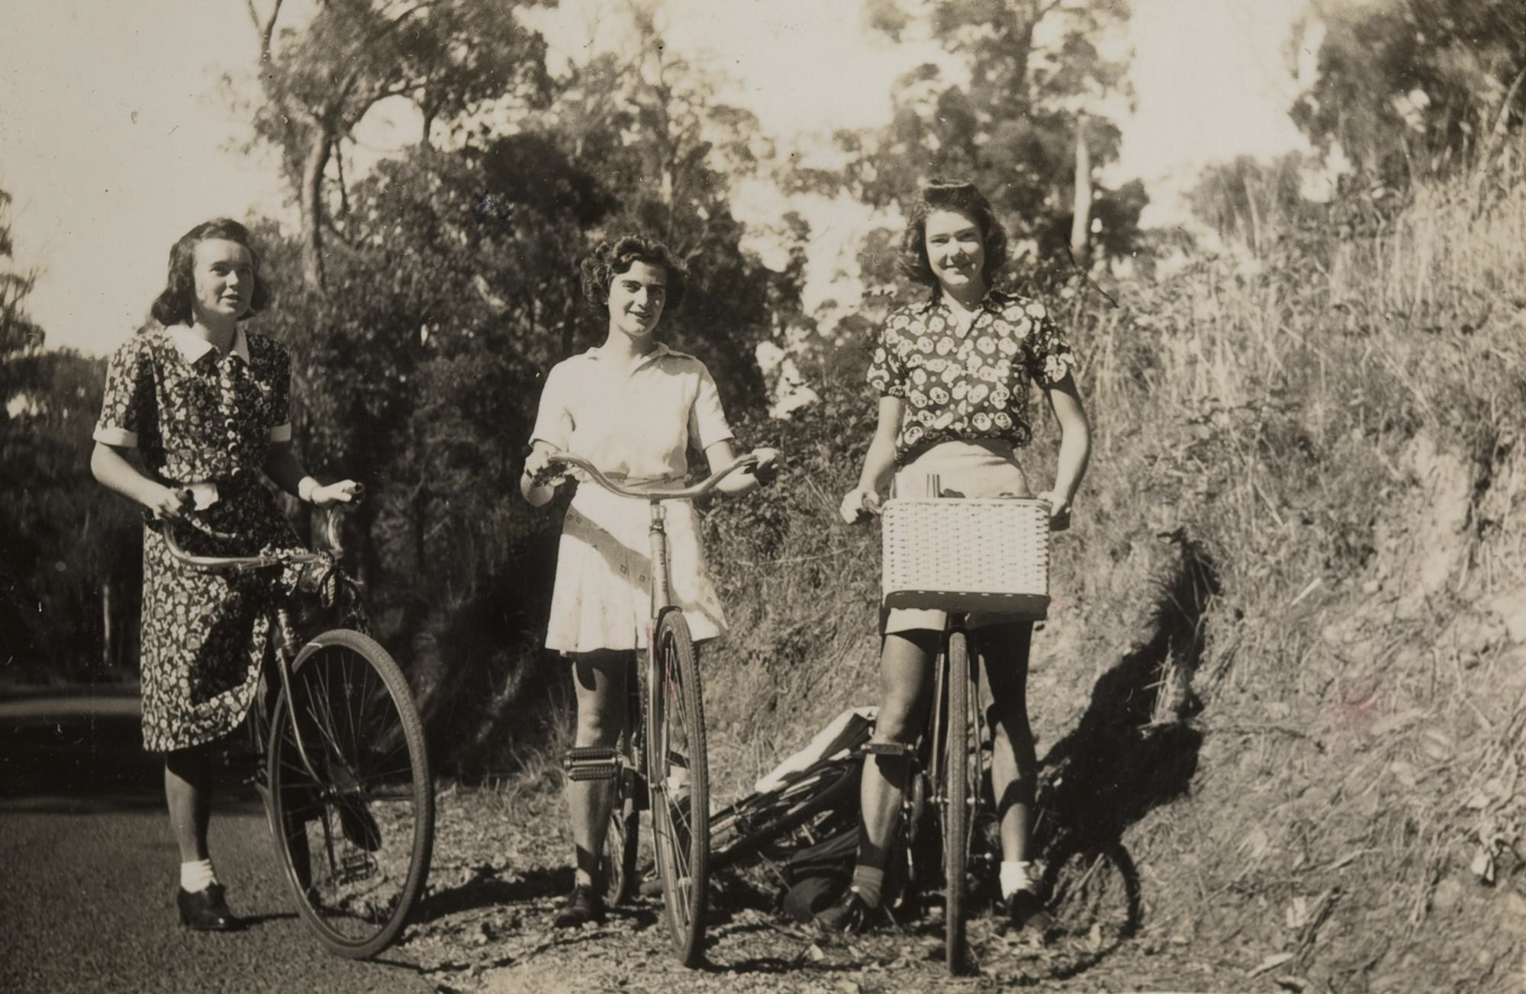
Three girls riding their bikes.
Photographer: Unknown

Slide 15
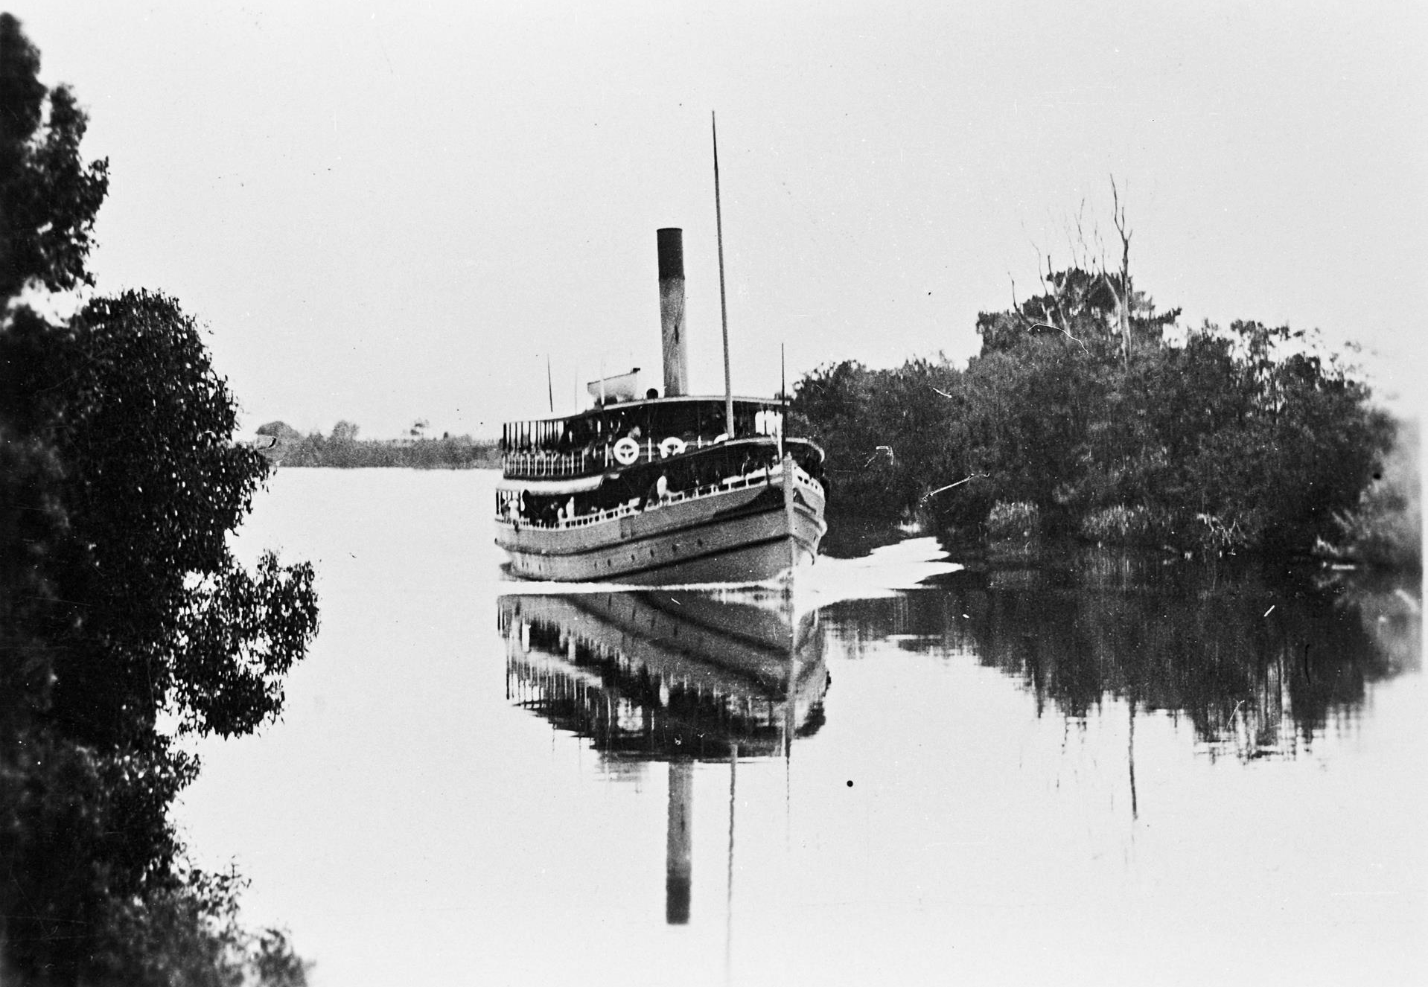
The 'Gippsland' steamer leaving Bairnsdale on the Gippsland Lakes
Photographer: Unknown

Slide 16
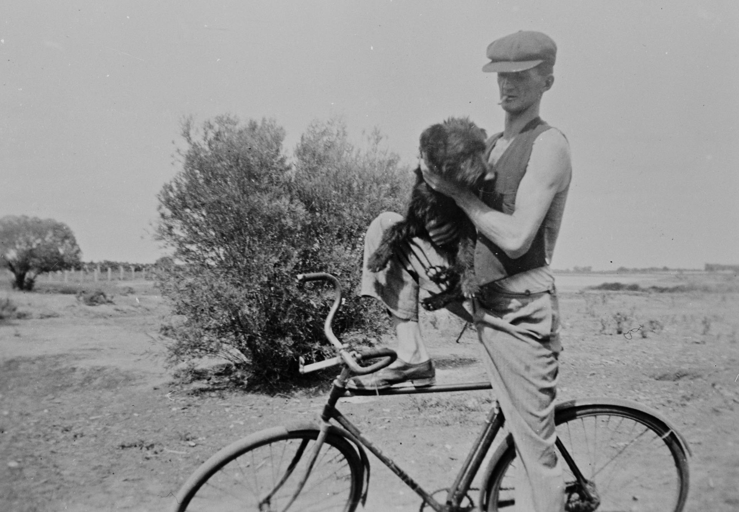
Man on a bicycle, holding a dog.
Photographer: Unknown

Slide 17
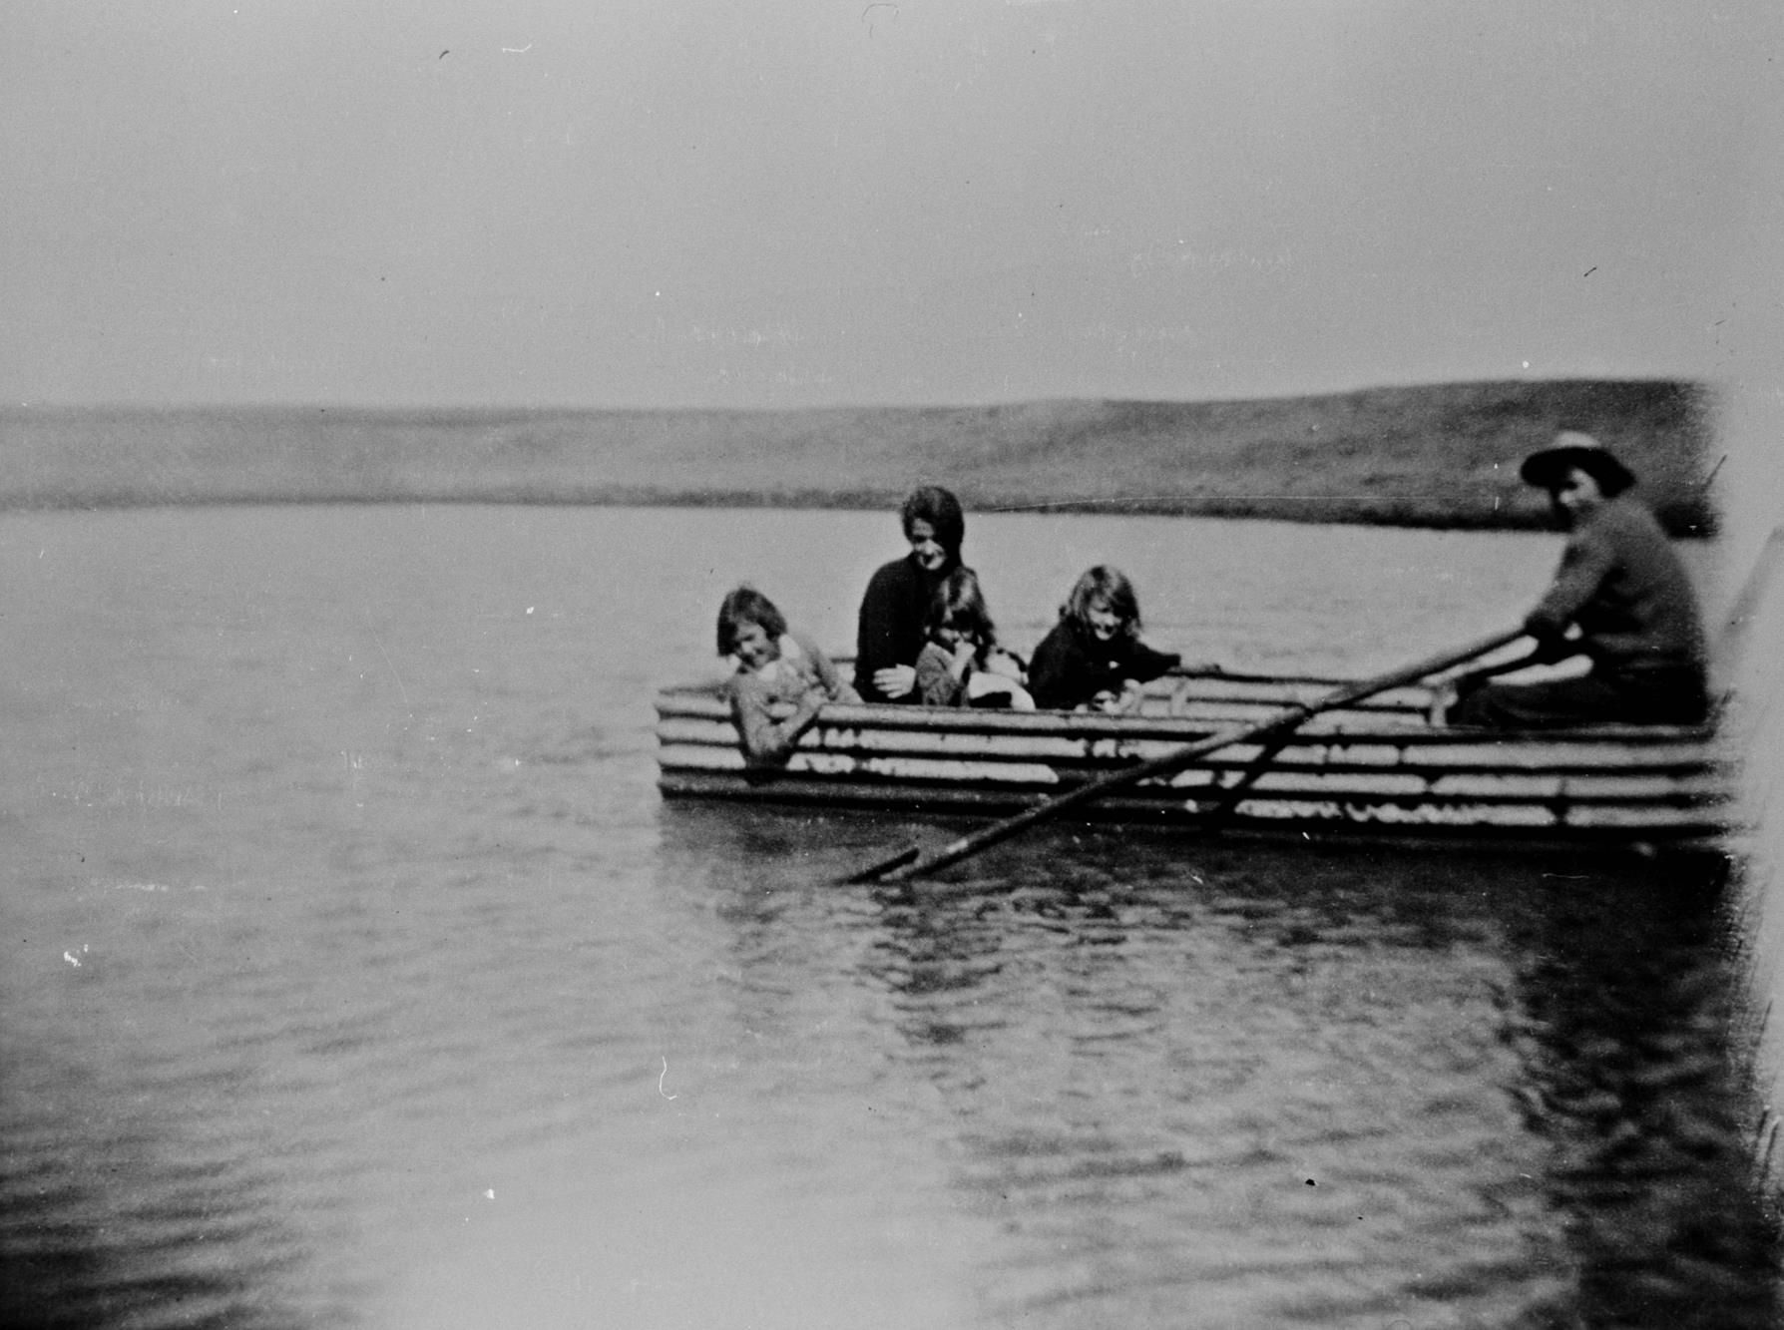
A man, woman and three children in a boat made from corrugated iron.
Photographer: Unknown

Slide 18
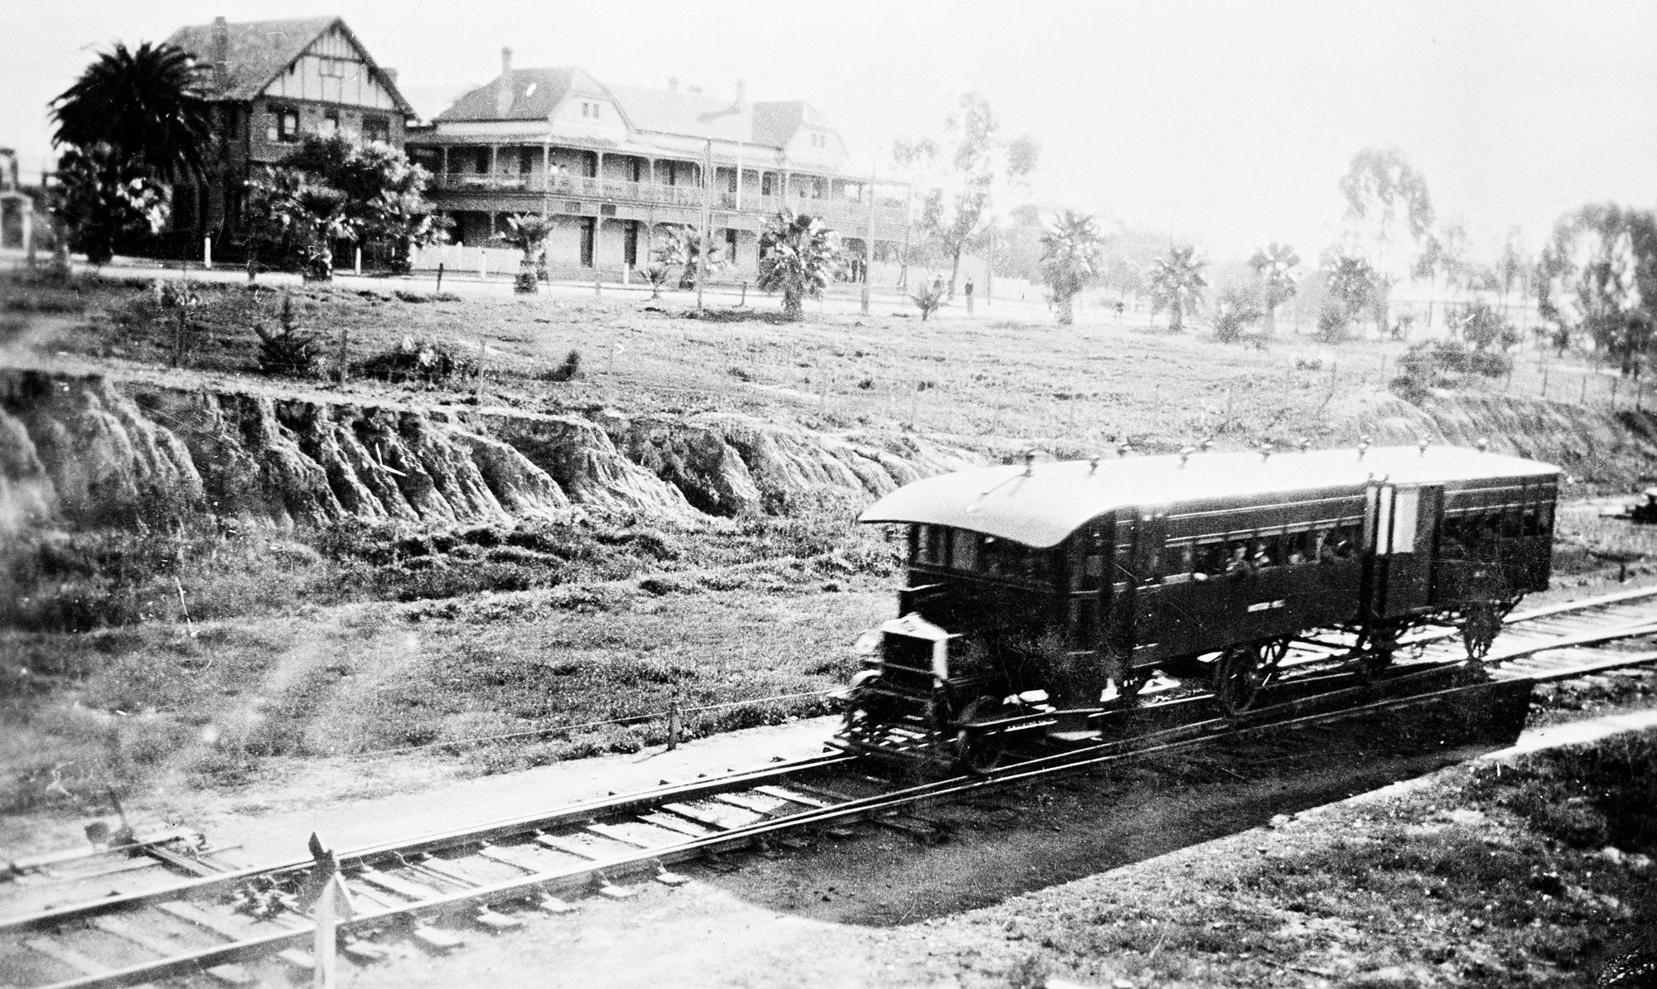
Rail motor travelling past the Grand Hotel, Mildura VIC
Photographer: Unknown

Slide 19
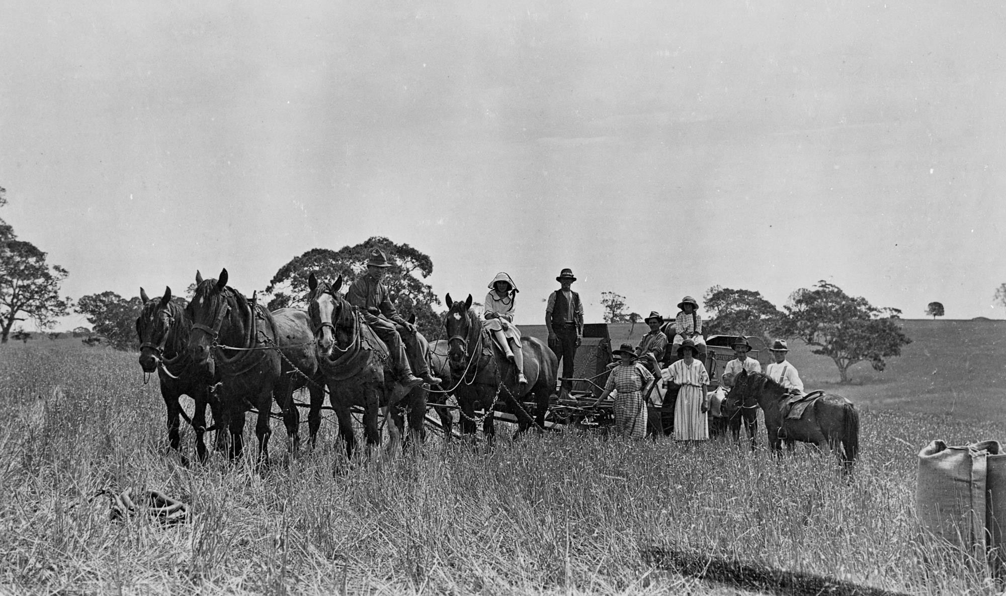
The McLaughlin family beside their horse-drawn harvester.
Photographer: Unknown

Slide 20
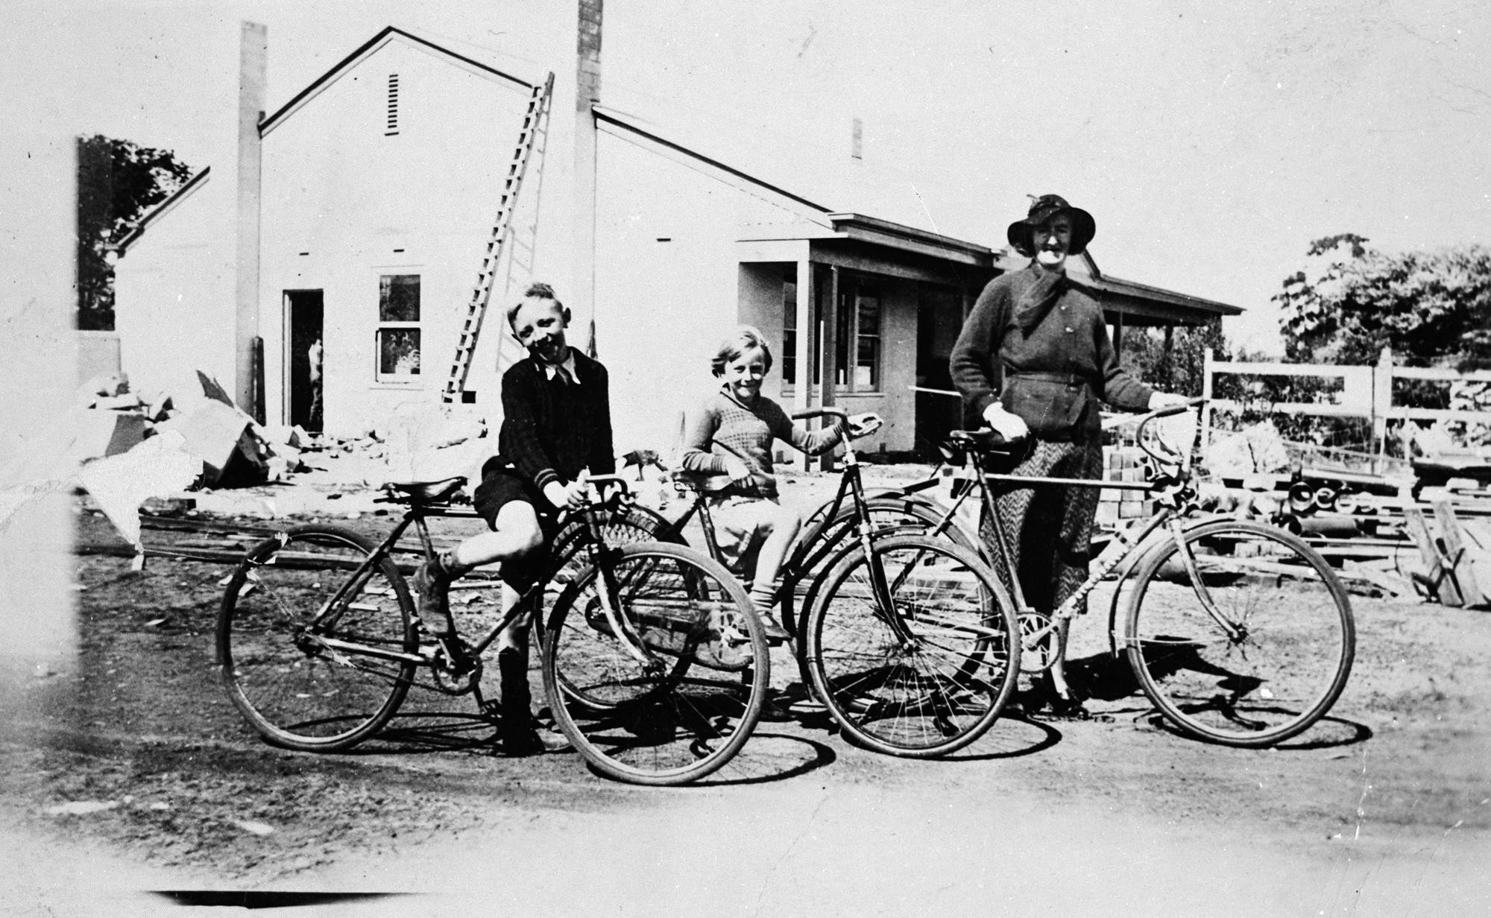
A woman, a small boy and a small girl with their bicycles.
Photographer: Unknown

Slide 21
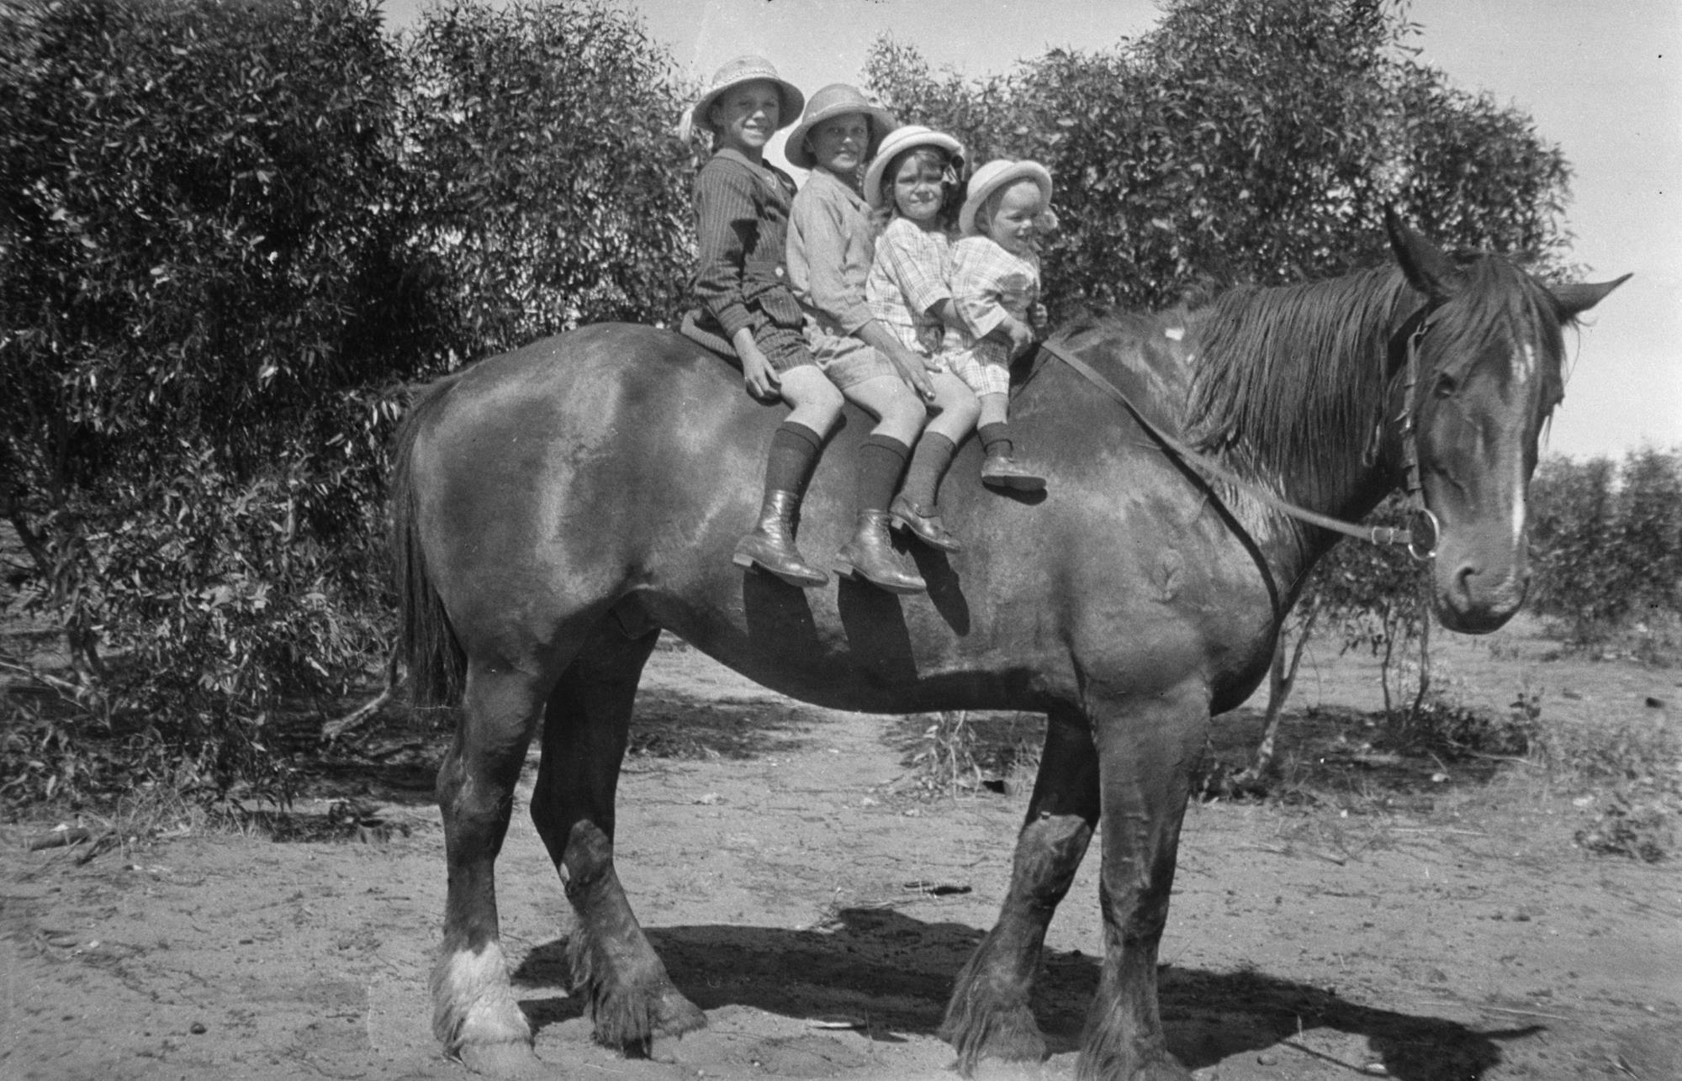
Four children on horseback.
Photographer: Bill Boyd

Slide 22
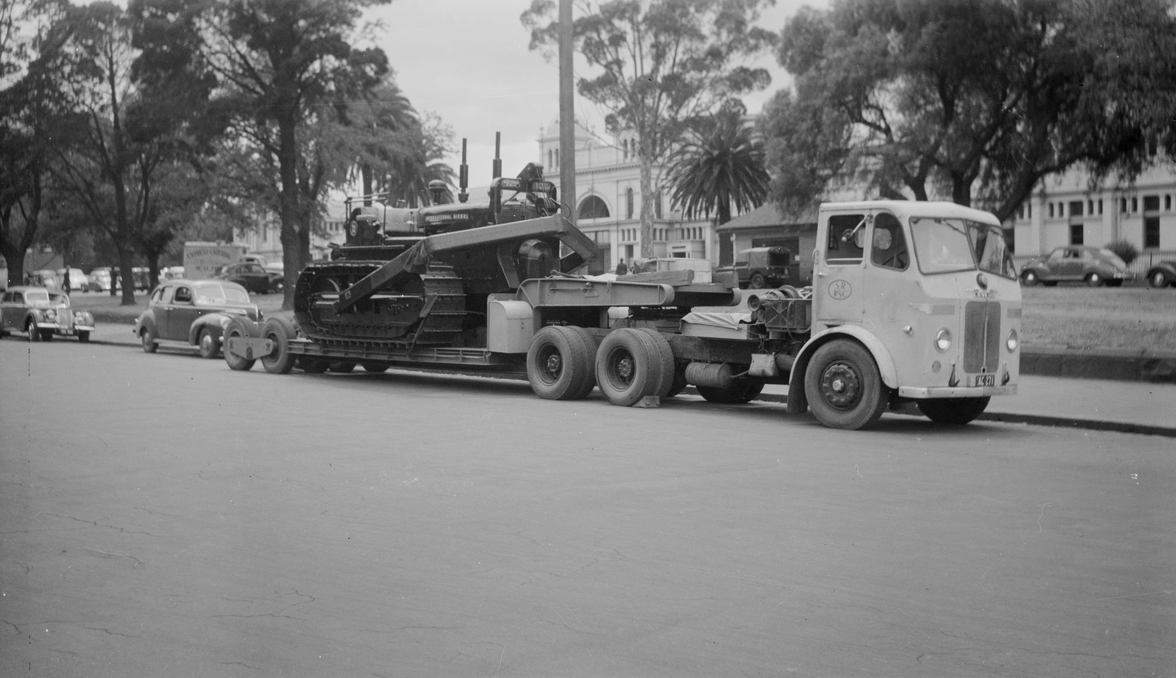
State Rivers and Water Supply Commission TD24 tractor atop a flat-bed transporter truck, parked near the Exhibition Buildings.
Photographer: Unknown

Slide 23
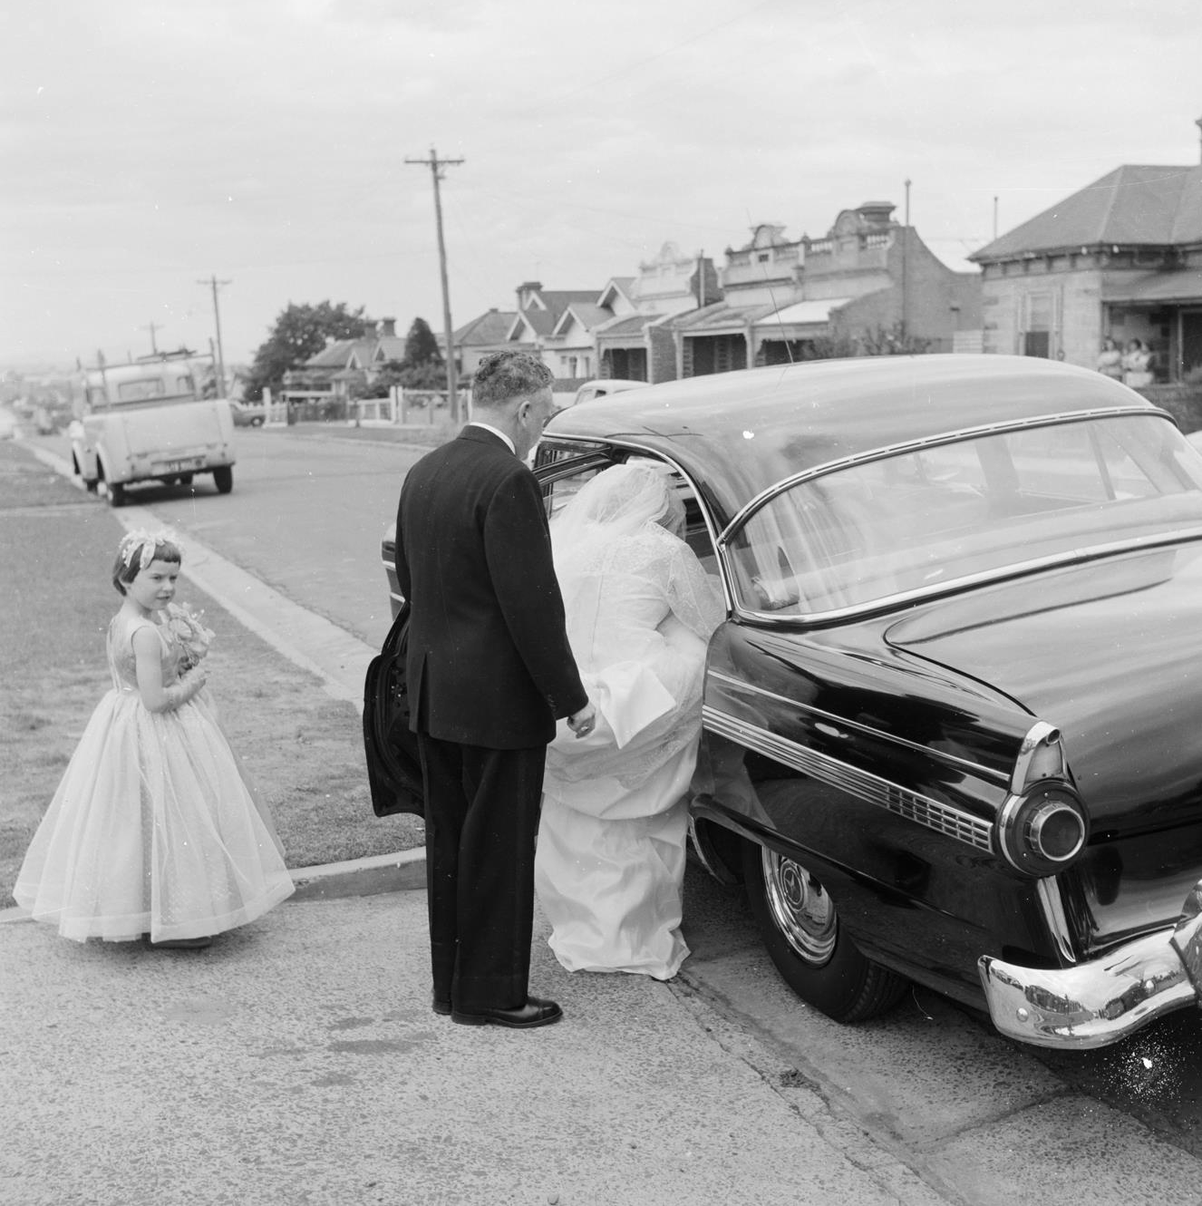
Bride entering a car as flower girl watches.
Photographer: Richard Seeger

Slide 24
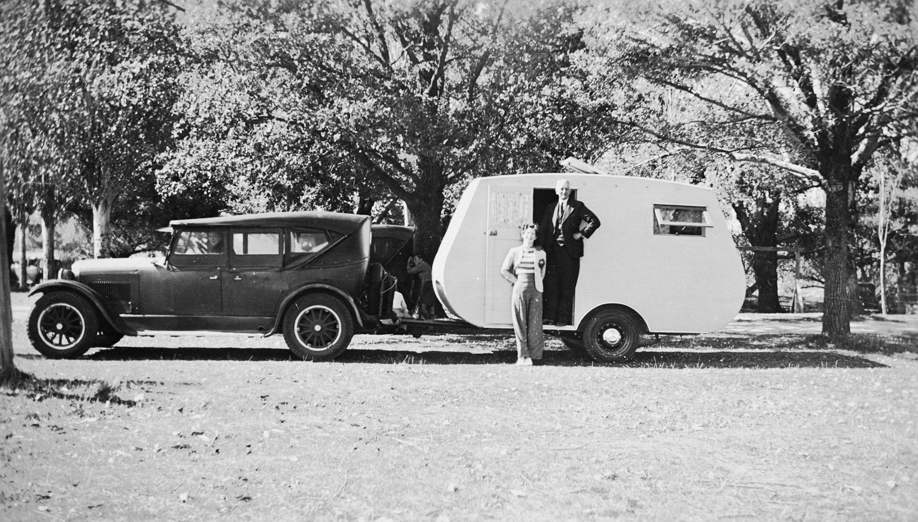
A man and woman with their car and caravan at Kyneton mineral springs.
Photographer: Unknown

Slide 25
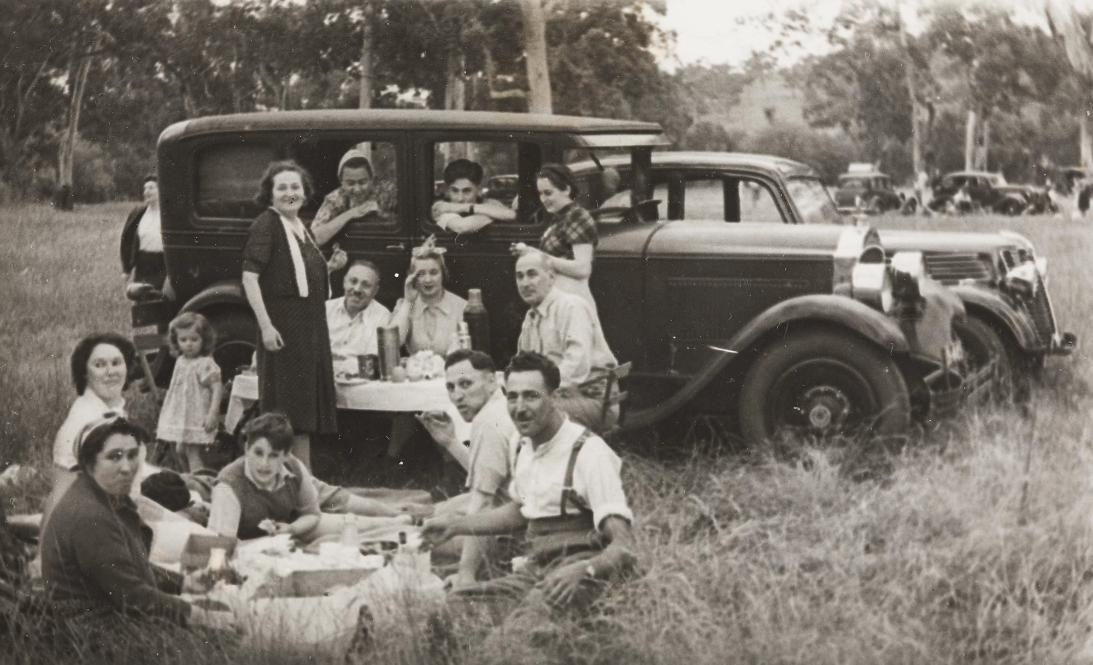
A group of people on a Picnic with two cars in background.
Photographer: Unknown

Slide 26
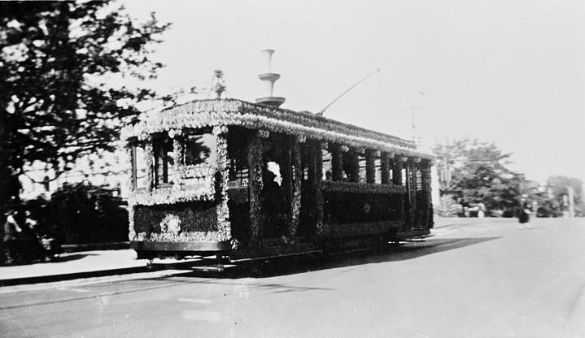
Tram Decorated for Centenary Celebrations, Ballarat, Victoria, 1938
Photographer: Jane Holmes

Slide 27
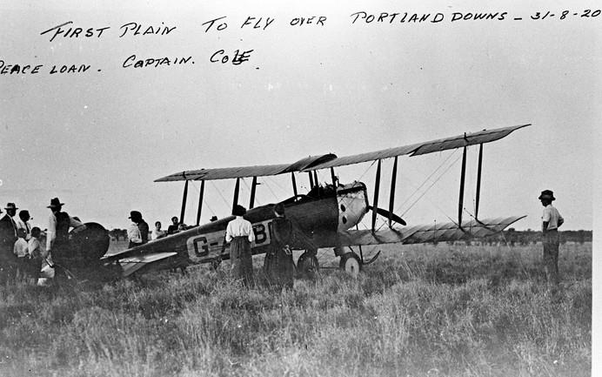
First plane to fly to 'Portland Downs' station. The pilot was Captain Cole. The aircraft is an Avro 504, QLD
Photographer: Hamilton

Slide 28
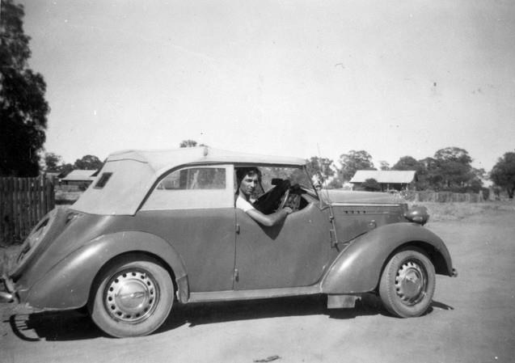
Alf Turner in his 1947 Vauxhall, Victoria, c.1950
Photographer: Unknown

Slide 29
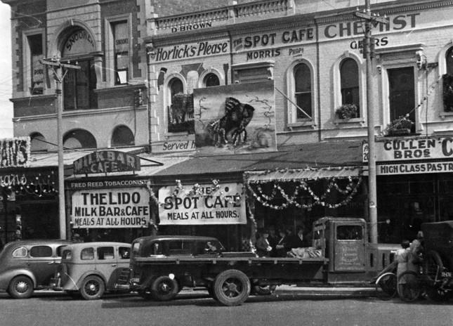
Decorated shop fronts. Part of the celebrations for Ballarat Gala Day
Photographer: Unknown

Slide 30
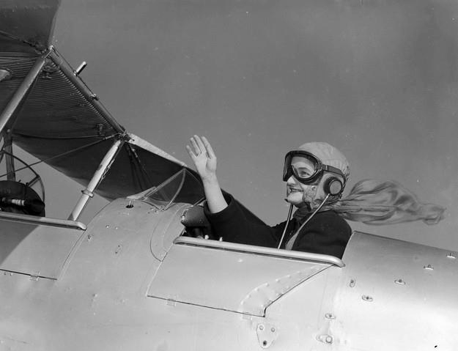
A woman in an aeroplane wearing a scarf, goggles and cap
Photographer: Laurie Richards

Slide 31
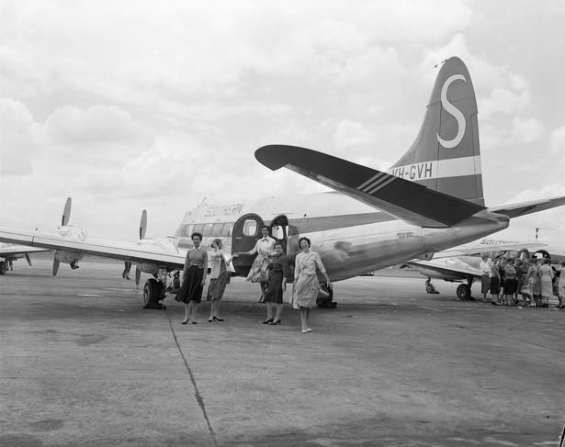
Southern Airlines Ltd, Passengers Disembarking, Essendon
Photographer: Laurie Richards

Slide 32
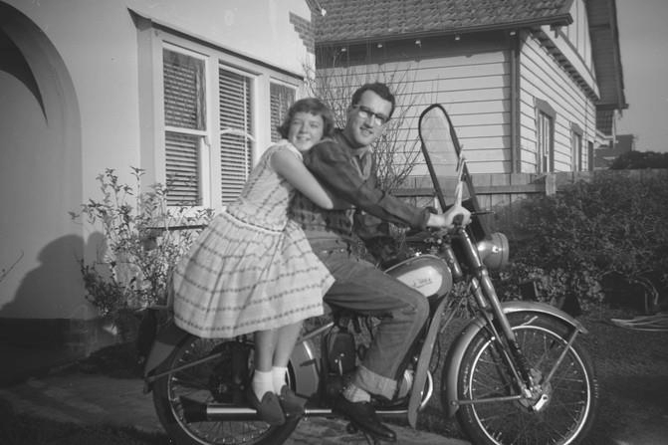
A man sitting on a bike with a girl holding on to him from behind, in front garden of house.
Yarraville, VIC
Photographer: Laurie Richards

Slide 33
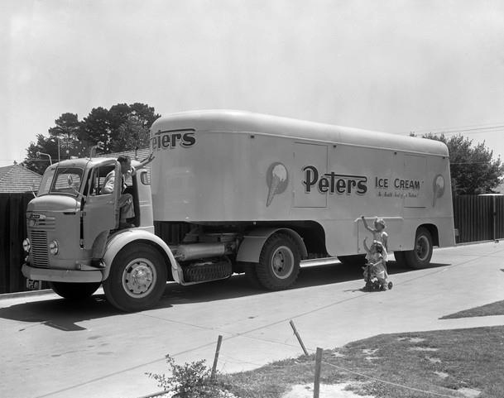
Peters Ice Cream (Vic) Ltd, Delivery Truck, Melbourne, Victoria, 1957
Photographer: Laurie Richards

Slide 34
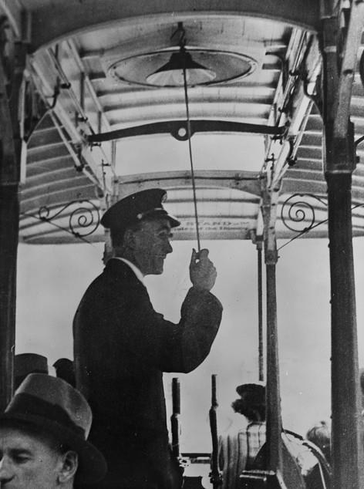
Tram Conductor in a Grip Cable Tram
Photographer: Unknown

Slide 35
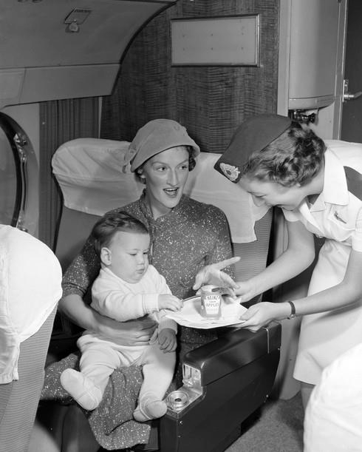
Woman sitting in an aeroplane seat while she holds a small child on her lap.
Photographer: Laurie Richards

Slide 36
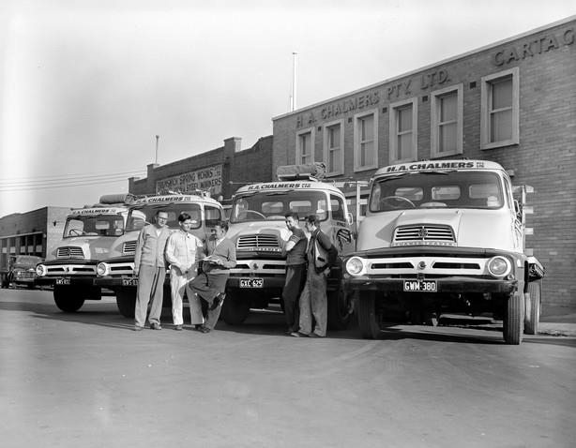
Men and four Ford trucks outside Ford Motor Company of Australia, Cartage Contractors in West Melbourne.
Photographer: Laurie Richards

Slide 37
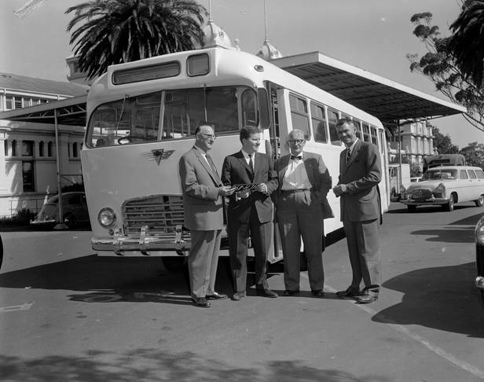
Associated Equipment Company, four men standing in front of a Bus
Photographer: Laurie Richards

Slide 38
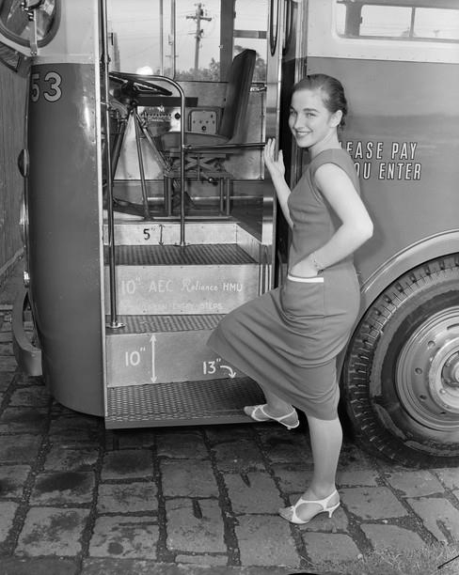
Woman boarding a bus at Dorcas Street, North Melbourne.
Photographer: Laurie Richards

Slide 39
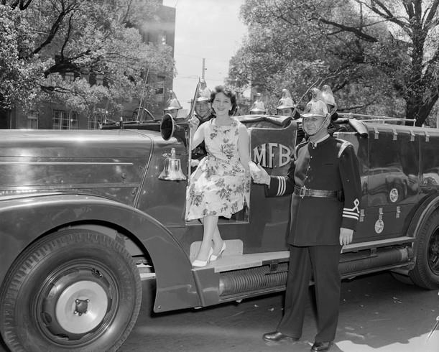
Woman with firemen seated in a Metropolitan Fire Brigade truck at the Royal Women's Hospital
Photographer: Laurie Richards

Slide 40
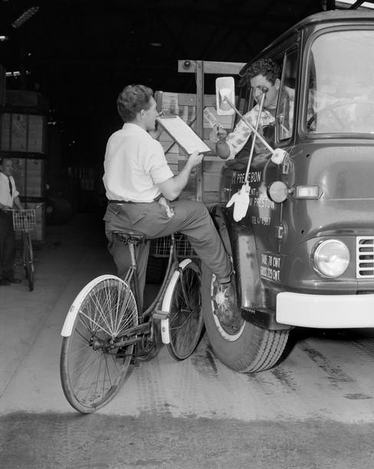
A truck driver, sitting in a truck cabin, signing a clipboard held by a male storeman on a bicycle, in the dispatch area of an A.P.M. paper mill.
Photographer: Laurie Richards

Slide 41
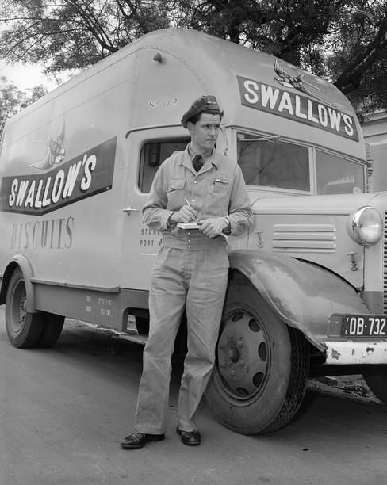
A delivery driver, wearing a uniform, leaning against a Swallows biscuit truck with large logo painted on side.
Photographer: Laurie Richards

Slide 42
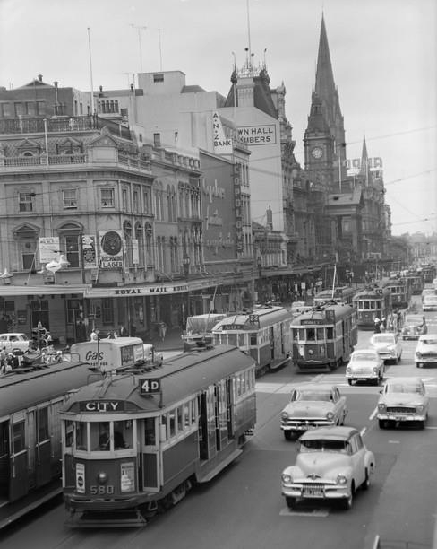
"Traffic Scene" view of Swanston Street looking south from Collins Street, towards St. Paul’s Cathedral. A large number of trams are travelling along the street.
Photographer: Laurie Richards

